Slide 1
Inventory Features Ahead

Slide 2
Inventory Features
Bill of Materials
Manufacturing Journal
Re-Order level
Batch number, Manufacturing Date and Expiry Date

Slide 3
Bill of Material
A Bill of Materials is a list of constituent items along with quantity details that can be allotted for the manufacture of a certain product, by-product or likewise
Bill of Material (BoM) is created only for those items that are being assembled in-house
For trading items, you do not need a BoM.
Bill of Material feature is useful for manufacturing organisations
Notes:
https://help.tallysolutions.com/article/Tally.ERP9/Creating_Masters/Inventory_Info/Bill_of_Materials_Stock_Item.htm

Slide 4
Bill of Material - Configuration
Go to Gateway of Tally > F12: Configure > select Accts/Inventory Info.
Set Enable component list details (Bill of Materials)? to Yes
OR
Go to Gateway of Tally > Inventory Info > Stock Items > Create.
Press F12: Configure (Stock Item Configuration) and set Enable component list details (Bill of Materials)? to Yes.

Slide 5
Bill of Material - Setup
BOM may be created for a stock item where you use standard set of inputs to manufacture finished goods.
In Create/Alter Stock Item, enter Units and Alter components(BOM) to Yes -> BOM List screen pops up
Enter the BOM name, now Component Screen pops up. Enter the details of BOM Items used

Slide 6
Bill of Material - Usage
All the manufacturing transactions can be accounted through a Stock Journal
Create a Manufacturing Journal under Stock Journal by setting the option Use as a Manufacturing Journal to Yes

Slide 7
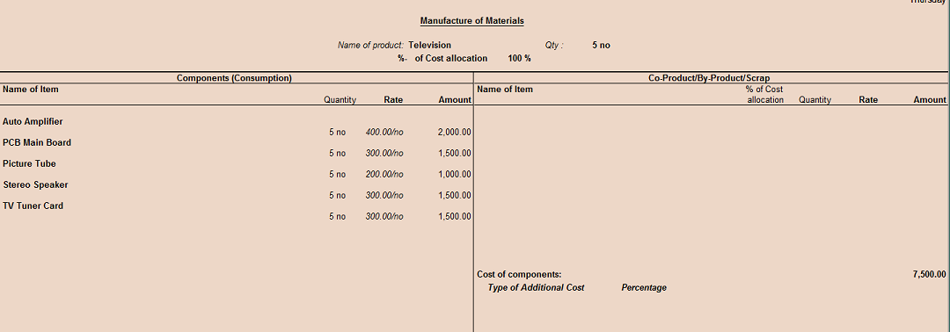
Manufacturing Journal

Slide 8
Re-Order Level
Reorder level is the quantity of stock beyond which the stocks have to be replenished
By defining the Reorder levels and Reorder Quantities in Tally.ERP 9, you can ensure that you never run out of stocks
To decide on reorder levels for stock items consider the following:
The lead-time for suppliers to deliver the stock.
The delivery time specified by the customer.
The stock-in-hand to satisfy existing orders.
In simple mode, Tally.ERP 9 accepts the quantities that you want to specify. In advanced mode, it considers the previous consumption patterns to suggest reorder levels.
The purpose of specifying reorder levels is to obtain a report that indicates the quantity of a stock item that you must order.

Slide 9
Re-Order Level – Enable and Use
Enable reorder level feature
1. Go to Gateway of Tally > F11 > F2 .
2. Set the option Enable purchase order processing to Yes.
Now the option Reorder Levels will appear in the Inventory Info. Menu
On Selection of Reorder Level, you get option to select Stock group, Item or category
In Simple form, two information is entered Reorder Quantity and Minimum Order Quantity
View the report Display-> Statement Of Inventory -> Reorder Status
Click R : Adv Reorder to view the Advanced Parameters for Reorder Level
Click M : Adv Min Qty to view the A dvance Minimum Order Quantities .

