Slide 1
TDS
Domain & Tally.ERP 9

Slide 2
Direct Taxes
Taxes that are levied on the income of Individuals or Organizations.
E.g. Income Tax, Corporate Tax, Inheritance Tax etc.
Salaries
Interest
Income Tax
Investments
Companies/
Firms
Profit Revenue
Corporate Tax
Notes:
Before we start with TDS, first we need to understand what is meant by Direct taxes as TDS is a direct tax.
What do you mean by Direct Tax?
Direct tax is directly paid by an individual or an organization.
A tax such as income tax, which is levied on the income or profits of the person/organization who pays it, rather than on goods or services.

Slide 3
Tax Deducted at Source (TDS)
Collection of revenue at the very source of Income.
Firms/Companies
Proprietary Firms liable for Audits U/s 44 AB
Government
TDS
Payment
Preponed Tax collection
Deduction
Regular Source of Revenue
Greater reach/wider base of Tax
Notes:
Tax deducted at source (TDS), as the very name implies aims at collection of revenue at the very source of income. It is essentially a direct method of collecting tax which combines the concepts of “pay as you earn” and “collect as it is being earned.” Its significance to the government lies in the fact that it prepones the collection of tax, ensures a regular source of revenue, provides for a greater reach and wider base for tax. At the same time, to the tax payer, it distributes the incidence of tax and provides for a simple and convenient mode of payment.
The concept of TDS requires that the person on whom responsibility has been cast, is to deduct tax at the appropriate rates, from payments of specific nature which are being made to a specified recipient. The deducted sum is required to be deposited to the credit of the Central Government. The recipient from whose income tax has been deducted at source, gets the credit of the amount deducted in assessment on the basis of the certificate issued by the deductor.

Slide 4







Deductor / Deductee
(Deductor)
Government of India
Deducts TDS during Booking expenses/ making Payment
Deposit the same to the Government’s treasury within the stipulated time
(Deductee)
Notes:
Understanding who’s the Deductor / Deductee.
The person making the payment is called the payor or deductor. The person who receives the money is called the payee or deductee
For e.g. You have taken office premises on rent and while making payment to the owner (Deductee), you (Deductor) will deduct 10% TDS on Rent amount and then pay the balance amount.
<CASH OR ACCRUAL BASIS>
In the case of VAT, the seller must pay VAT charged even if the buyer never pays the money. In the case of Service Tax in Accrual mode, which is what we discussed in the Service Tax session, the same thing happens. The tax must be paid by the supplier of services even if he never gets paid.
For TDS, it is due to be paid when any advance is made, or when the expense is booked.
Further, once the TDS amount is paid to the department, you need to issue Form 16A to the Deductee.

Slide 5
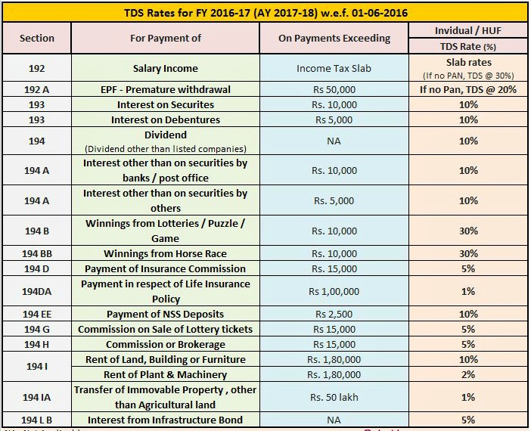
TDS Applicability
Notes:
Every tax type has its own treatment, and TDS too has it’s own special rules. Let us go through each, and also differentiate this with the other taxes we have covered so far, which have been VAT and Service Tax
<DIFFERENT RATES>
We have already discussed about Service Tax which has a uniform rate of tax on the value of services. VAT has different rates for different commodities. TDS is a presumptive tax – an assumption is being made on the income, and so different taxes get charged based on this.
For example, salaries paid are assumed to be full income after subtracting tax investments and other allowed deductions. So the TDS each if us pays is based on the income tax rules. For other payments, different rates are specified.
<ABOVE CERTAIN LIMITS>
The TDS rules say that TDS is applicable only after a specified limit for each service for each deductee. Take the case of rent. The deductor must deduct TDS only if the rent paid exceeds 1,80,000 per owner.
<PAYABLE FROM RUPEE 1..>
Take the case of the rent limit of 1,80,000. Say you paid rent of 20,000 each month and took the property for 9 months rent from April 1st. Since the total rent that you will pay for the whole year will not be more that 1,80,000 (that is 9 months @ 20,000 per month), you need not deduct TDS. Let us say that at the end of 9 months, the end of December, you extend the rental for one more month. Now the amount for the year has crossed 1,80,000 so TDS is payable at 10% on the whole amount from rupee 1, and not just for the amount that exceeds 1,80,000. This is why companies estimate the annual income for us and deduct one twelveth each month, otherwise we may not any salary in the last one or two months of the year when they deduct TDS for the whole years income.
<PAN NUMBER IMPACT>
If the receiver, who is the deductee, and we will henceforth use the words deductor and deductee - so if the deductee does not have a PAN number, the rate of TDS is a flat 20% for all types of deductions. The different type of deductions, say salary and rent, are called Nature of Payment.
<LOWER / NIL RATE OF TDS>
Well, let us say that someone deducted TDS and when you filed your income tax return, you find that more TDS was deducted that was actually due. What do you do? You will then seek a refund from the income tax department, and this refund can take months. If you are sure in advance that there will be more TDS than you need to pay income tax, you can approach the Income Tax department and get an individual approval that a lower or even zero rate apply for you. Submit this approval and the deductor will follow the lower or zero TDS for you specifically. This way you may not have to apply for a refund of excess income tax. Note that the sections are 197A for zero TDS deduction and 197 for lower rate of TDS

Slide 6
Filing TDS Returns
Form 26Q
TDS Returns
On or before 15th of succeeding month after Quarter Completion
TDS Statement | Due Date | Date from which penalty will be imposed
30th September | 15th October 2015 | 15th October 2016
Notes:
Form 26Q is the Quarterly return of TDS in respect of all payments other than salaries.
As per the Income Tax Act, 1961, every corporate and government entity responsible for deduction of tax at source should furnish TDS returns containing details of deductee(s) and challan details relating to deposit of tax with the Income Tax Department.
This is applicable for Resident and the due date for Government entities is July 31st, October 31st, January 31st, and May 15th;
For non-government entities the due dates for filing returns are July 15th, October 15th, January 15th, and May 15th.

Slide 7
Agenda
TDS Setup
Dues and Advance Payments
Single Bill Value Limit and Cash Transactions
Form 26Q
TDS Reversal
Triangulation Report
Questions
Notes:
Now we move on to discuss the aspects of TDS and the ways to handle the same in Tally.ERP 9
Note that the earlier sessions are mandatory to get fully understand TDS, as we do not repeat basic elements. This will make this a shorter and clearer session.

Slide 8
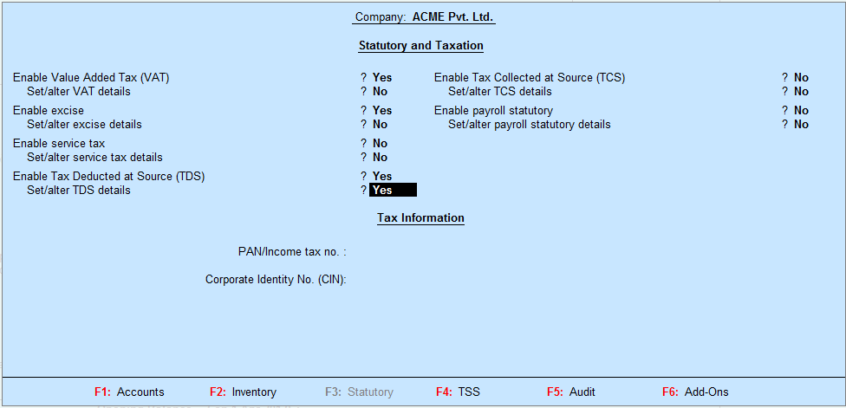
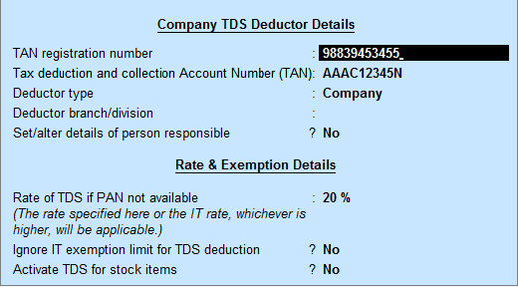
TDS – Setup
F11: Features → F3: Statutory
Notes:
We will first look at the very basics, and you will setup Acme Pvt. Ltd. (1) from the list of demo companies available.
Enable TDS from F11: Features, Statutory
Set/ Alter TDS Details → “Yes”
Set the TDS as per the user. For now set some random information for TAN registration number, TAN Deduction and Collection Account Number, Deductor Type and other fields as shown on-screen.
For your information, only those who have a Tax Deduction and Collection Account Number, called TAN can deduct TDS. A TAN number is a number allotted by the Income Tax department, just like a VAT number is by the state sales tax department, and a Service Tax number is issued by the Central Excise Department.

Slide 9
TDS - Ledgers
Notes:
Just like in the case of VAT and Service Tax also we will have ledgers for the TDS accounts
Taking the case of Consultancy Services, we will have the Party account, which is the Deductee, and the TDS collected account.
Party account will be grouped under Sundry Creditors while TDS account under Duties and Taxes.
Let us set them up now. Use ACME Pvt. Ltd. (1)

Slide 10
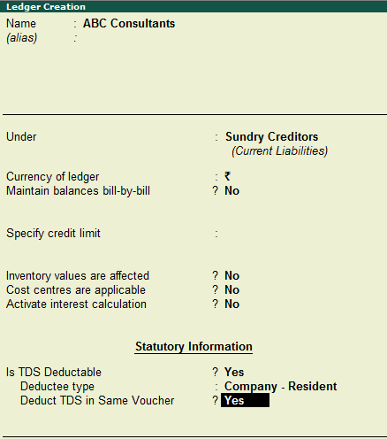
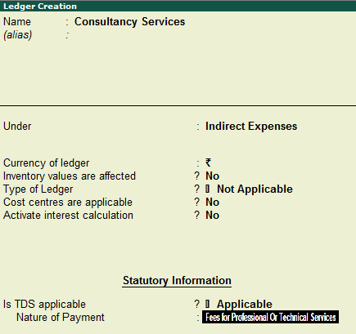
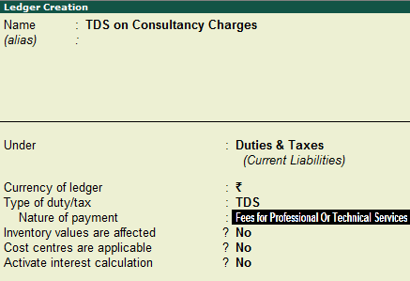
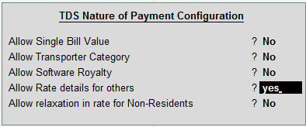
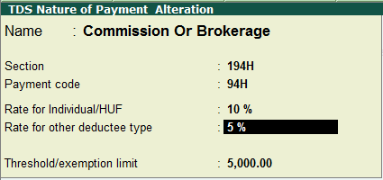
The Ledgers
Party Ledger Expense Ledger TDS Ledger
“Allow Rate Details for Others”
Notes:
We will use Consultancy Services as the example for TDS.
Create these ledgers
1> ABC Consultants as a Sundry Creditor, is the provider of the services and is the deductee. Note that we must enter the TDS options as shown on-screen. For now DO NOT enter the PAN number for ABC Consultants. We’ll take this up at the time of discussing the triangulation report.
2> Consultancy A/c as an Expense Account. This is the account we debit when we receive the consultancy bill from ABC Consultants. Here too, you will setup TDS details as shown. Say “Yes” to “Is TDS Applicable” and with your cursor on Nature of Payment, press ALT+C to create a new nature of payment – Fees for Professional and Technical Services. This is the hotkey for creating a nature of payment on the fly.
Note:
Tally.ERP 9 Release 5 gives you the flexibility to create and define the nature of payment as per your requirement. From Gateway of Tally → Accounts Info → Statutory Info, select TDS Nature of Payment and create ONLY those nature of payments that are suitable for your business and transactions (facilitator to guide participants with the navigation). In the TDS Nature of Payment Creation screen, press CTRL+C: Helper to get all necessary details pertaining to a particular nature of payment. Be it the name or section or payment code, you get everything at the click of a button.
Again, for different nature of payments, the rate is different for Individual/ HUF and other deductee types. So all you need to do is press F12: Configure, enable the option “Allow Rate Details for Others” and set the rate as per the TDS law.
3> Finally, create a TDS ledger under Duties and Taxes as shown on-screen. This is the account which is credited with the TDS that has been deducted.

Slide 11
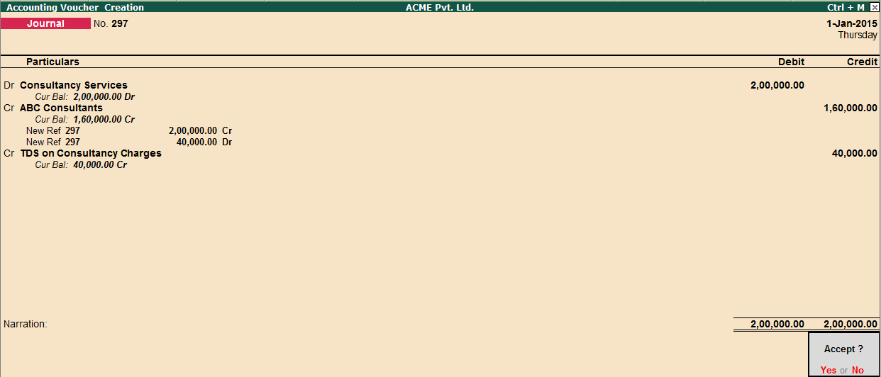
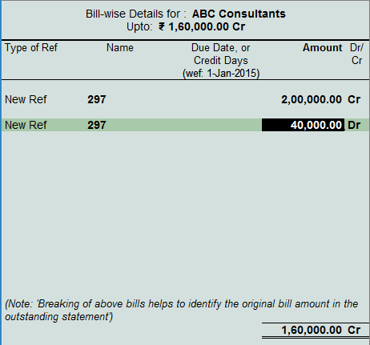
Booking the Due
Journal (Booking Expenses)
Bill-wise details
Notes:
Assume that ABC Consultancy sends us a Service bill for two lakhs for consultancy. Let us assume for simplicity that no Service Tax was charged. In real life Service Tax will also be charged, we will ignore this for simplicity.
Make a Journal Voucher with these steps
Select the ledger Consultancy Services and enter assessable value as two lakhs
Select the Party ledger i.e. ABC Consultants (Ensure bill-wise details is enabled for this ledger)
Bill-wise details screen will be shown and it will back bifurcate the amount to be paid to the party and the TDS amount.
Select TDS on Consultancy Services Ledger and save.

Slide 12
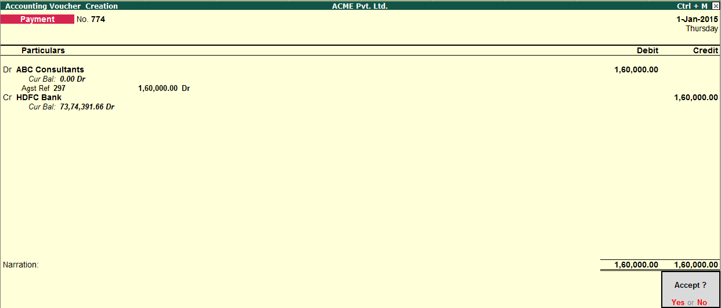
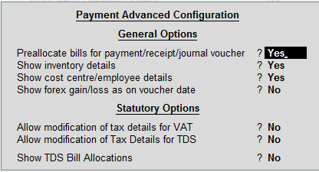
Payment to Deductee
Payment to Party
F12: Advanced
Notes:
We will now make the payment to the deductee. This is the regular payment voucher.
Press F12: Configure → F12: Advanced and enable the option “Preallocate bills for payment/receipt/journal voucher”
Select the party ledger i.e. ABC Consultants
Select Agst Ref and select the bill to adjust and press

Slide 13
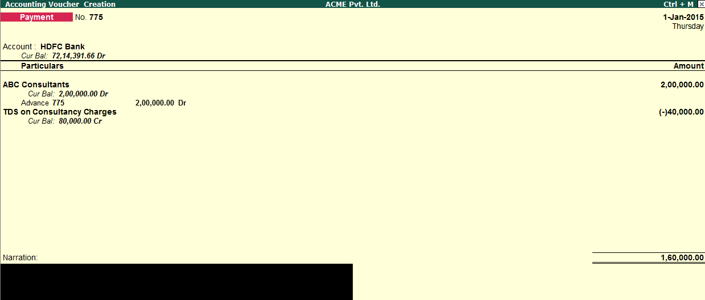
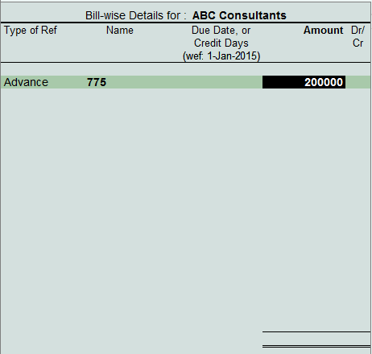
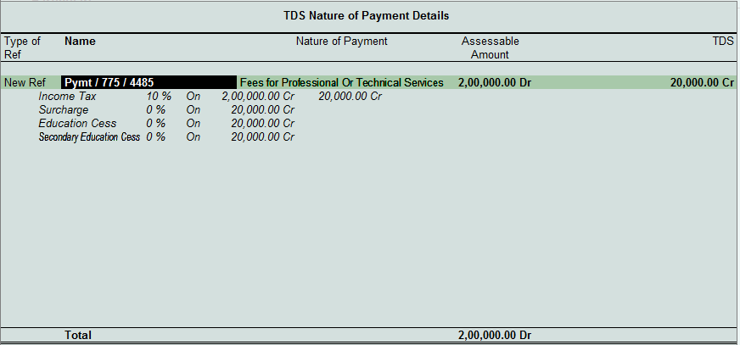

Advance payment subject to TDS
Advance Payment Voucher
Bill-wise details screen
TDS Nature of Payment details
F12: Advanced
Notes:
<INTRODUCTION>
Let us look at three more regular business practices.
One is an advance payment, the second is a single bill value limit and the third one is TDS on cash transactions.
We start with a new advance payment of another two lakhs to ABC Consultants.
Make a payment voucher, as usual to ABC Consultants.
In bill-wise allocation screen, take the type of reference as ‘Advance’.
Just after entering 2,00,000 select the TDS Deducted Ledger.
As you can see, we have not provided PAN details for ABC Consultants hence 20% got charged. (Such transactions will appear in Form 26Q > “Uncertain Transaction” bucket under the head “PAN not available”, which we will discuss later in this session.)
Now, go back to the Party ledger alteration screen by pressing Ctrl_Enter and provide PAN number and then try to pass the voucher.
You can now see that TDS of 10% got charged.
Accept the values shown and come back to the voucher by pressing Pg Up button.
Press F12: Configure → F12: Advanced → Enable “Show TDS Bill Allocations” and accept by pressing Ctrl_A (twice)
Now after selecting “TDS on Consultancy Services” ledger, you will get TDS Nature of Payment details screen, where you can view the TDS deducted details.

Slide 14
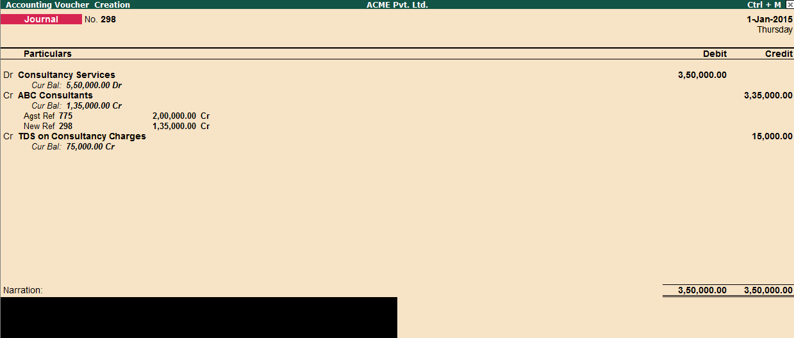

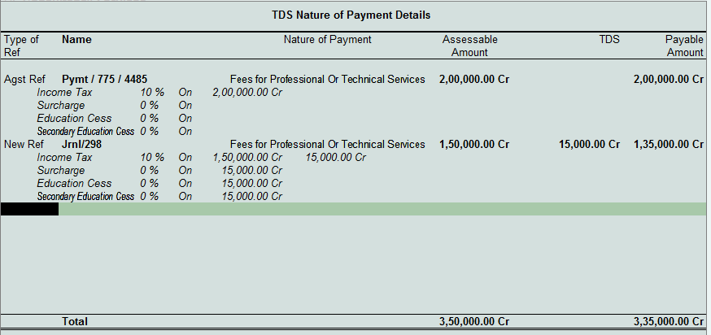
Booking the expense after Advances
Journal (Booking Expenses)
TDS Nature of Payment Details
Notes:
So we paid two lakhs as advance, and we now receive the bill. Let us say the bill is for three lakhs fifty thousand. We need book the expense but also account for the TDS deducted as part of the advance.
Create a new Journal to record the invoice received from the service provider.
When we select the ledger for ABC consultants, Tally prompts to adjust the advance TDS payment. Say “Yes” to it.
When the TDS Details come up, we select Against Reference and adjust two lakhs to the earlier payment made – for example see the reference Pymt/775/4485.
For the balance 1,35,000 we book new TDS deduction by selecting the type of reference as ‘New Ref’
You will observe that 10% of one lakh fifty thousand which is 150,000 has now been deducted.
Adjust the bill-wise details by selecting first the advance amount of 2,00,000 which is already paid and allocate balance 1,35,000 by selecting new reference.
Select TDS on Consultancy Services ledger and accept.

Slide 15
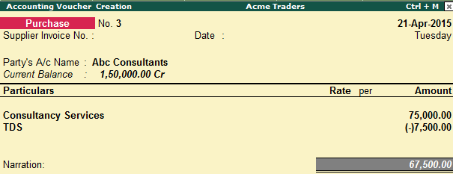
TDS on Single Bill Value Limit
Enter a Purchase Invoice
“Account Invoice” Mode
Notes:
<INTRODUCTION>
Now take up the scenario of deducting TDS on Single Bill Value Limit.
As per the TDS rule, every nature of payment has a threshold limit and TDS will be calculated ONLY if that limit is crossed. But there are instances when businesses dealing with regular parties want to have the flexibility of recording their TDS deductions if the billing amount exceeds a given limit, without the threshold limit being crossed.
So let us see how this is handled by Tally….
Alter the ledger Consultancy Services, press CTRL+ENTER on “Nature of Payment”. Enable “Allow Single Bill Value” from F12: Configurations and mention the single bill value limit say, Rs. 50,000. Set the applicability date as 20.4.15. From F11 → enable the option “Ignore IT exemption limit for TDS deduction
Now enter a purchase invoice.
Select the TDS ledger. Observe that although the amount is within the threshold limit, still TDS is getting calculated on the entered amount as it has crossed the Single Bill limit.

Slide 16
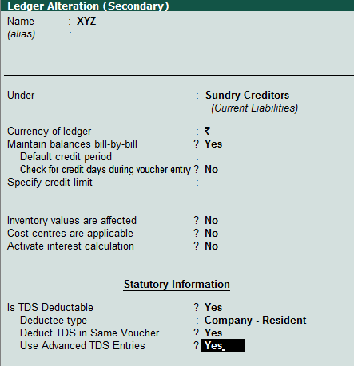
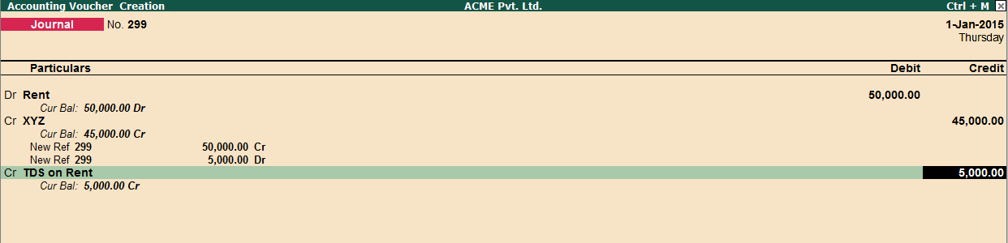
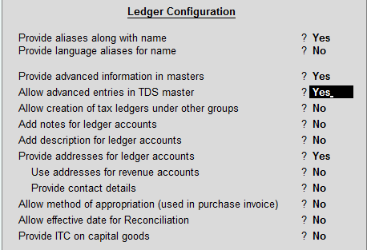
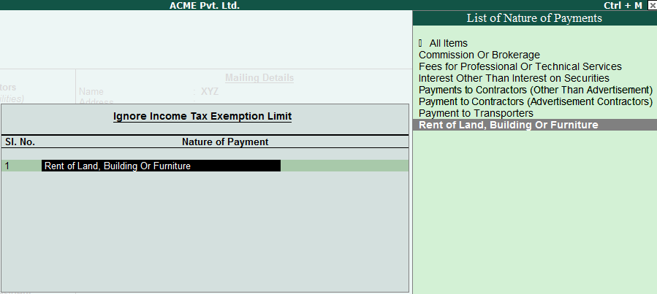
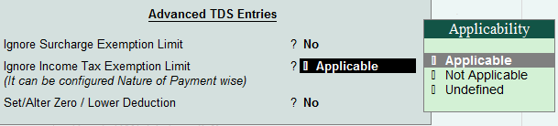
TDS on Single Bill Value Limit
Party Ledger
Journal (Booking Expenses)
F12: Configure
Notes:
So far we have seen, how TDS amount gets deducted once it crosses the threshold limit. Now, let’s take an example where in the TDS needs to be deducted for a Party while raising the first bill itself (Do not wait till the bills crosses the threshold limit).
Let’s say we are paying Rent of 50,000/- to XYZ and the limit for Rent is 1,80,000.
Create a ledger called Rent under Indirect Expenses and enable TDS and allocate the Nature of Payment as “Rent of Land, Building or Furniture
Create a new Party ledger called XYZ, press F12: Configure and enable “Allow advanced entries in TDS master
Use Advanced TDS entries → Yes → Ignore Income tax exemption limit → Applicable → Rent of Land, Building or Furniture (List of Nature of Payments).
Also specify the PAN number for the Party XYZ and save it.
You can now see, after giving value as 50,000 while passing the Journal voucher, Tally deducts TDS as 5,000/-

Slide 17

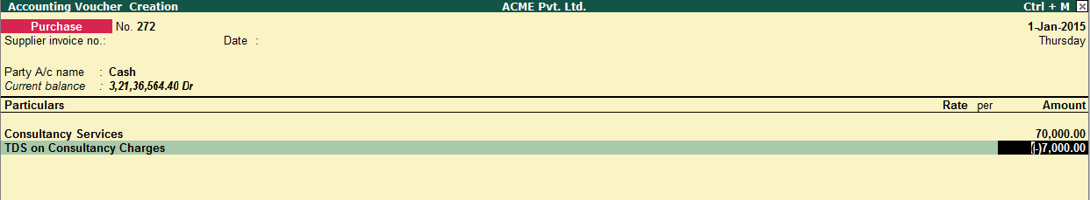
TDS on Cash Transactions
Enter a Purchase Invoice
“Item Invoice” Mode
Use Common Ledger account for item allocation – “No”
Notes:
<INTRODUCTION>
Finally, we take up a scenario of deducting TDS on direct cash transactions made. This is particularly applicable for those who does more cash transactions and want to record TDS deduction for party without creating a ledger.
Enter a Purchase invoice (Ensure “use common ledger account for item allocation” is set to “No”).
Select “Cash” as the party account
In the party details screen enter a supplier name say, ABC Enterprise
Select the expense ledger – consultancy services and enter an amount of say, 70,000/-
Select the TDS ledger. As soon as the TDS ledger is selected, Tally prompts for party PAN number and deductee type. Select deductee type as “Company Resident”.
As soon as the party PAN number and deductee type information is provided, the TDS gets calculated!
So even though no separate ledger account has been created for the supplier, but the expense can still be booked against the supplier.
Note: You can also pass the above transaction in Payment voucher.

Slide 18
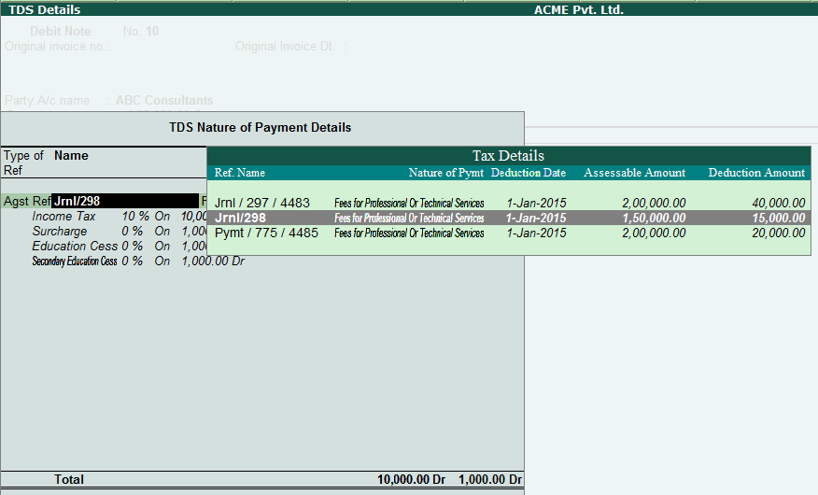
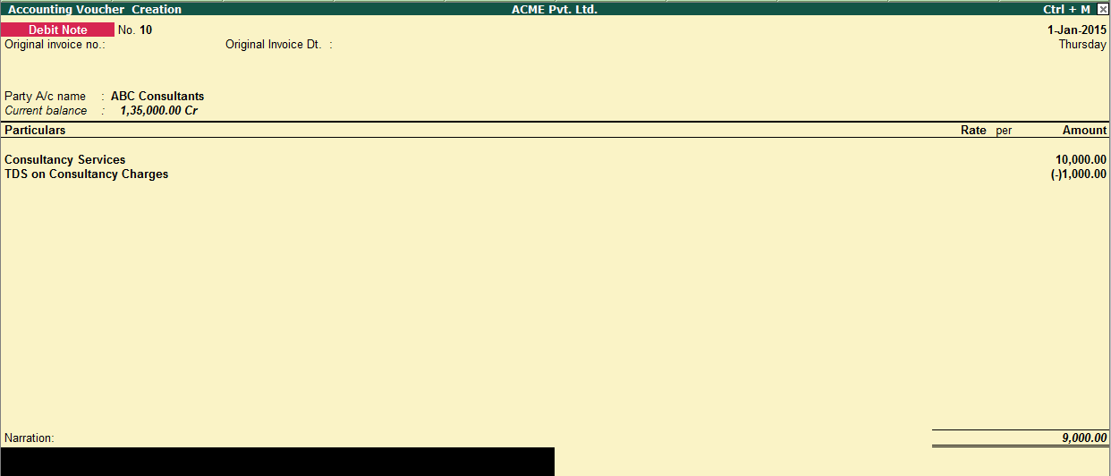
TDS Reversal
Tax Details
Debit Note
Notes:
We heard that TDS becomes payable as soon as we book the expense. In the case of ABC Consultants we booked an expense. We now decide that we will reverse 10,000. What happens to the TDS already deducted, maybe even paid?
Follow the instructions on the screen and you will have recorded the reversal of the dues as well as for the TDS
Enable Debit & Credit Notes in Invoice mode → From F11: Feature > Accounts
Record Debit Note in Accounts Invoice mode
Adjust TDS against the list of bills shown under “Tax Details”

Slide 19
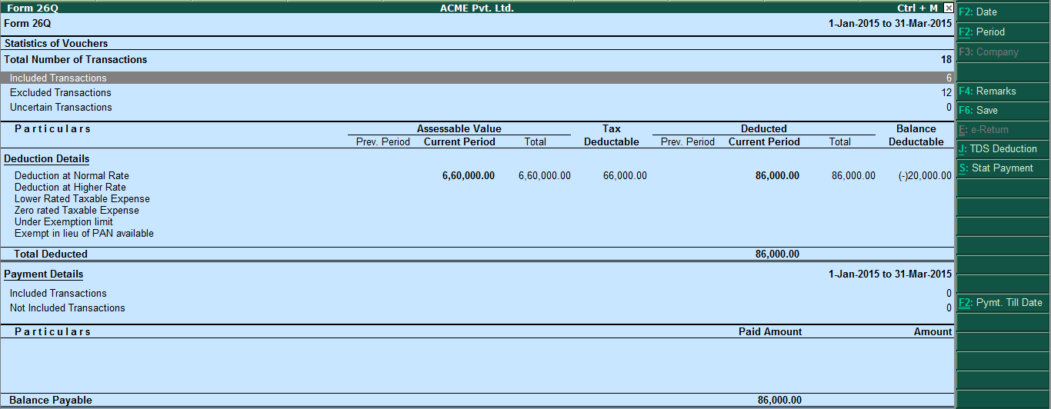
TDS Triangulation Report
Notes:
From Display → Statutory Reports → TDS reports, look at Form 26Q.
You will see that the total deducted value has been accurately captured. Also, if you observe the report closely, you’ll see that the TDS Report – Form 26Q – has been designed in such a way that the user can identify the following:
The total number of transactions recorded
Out of the total number, number of transactions INCLUDED for generating the TDS Returns
Transactions EXCLUDED because they are not relevant, and
Transactions about which Tally is UNCERTAIN as to what to do – because there is missing information or possible errors.
This concept is called “Triangulation”.
The user can drill down into each type – INCLUDED, EXCLUDED, AND UNCERTAIN – and satisfy himself of the correctness of information
In the UNCERTAIN bucket, Tally gives the different reasons for errors OR missing information and all of then are self-explanatory. The user can go DIRECTLY into the Masters or Transactions, and correct the errors OR provide the missing information → This results in 100% CORRECT Return – giving CONFIDENCE of a hand-prepared return!
Let us see this powerful capability in action!

Slide 20
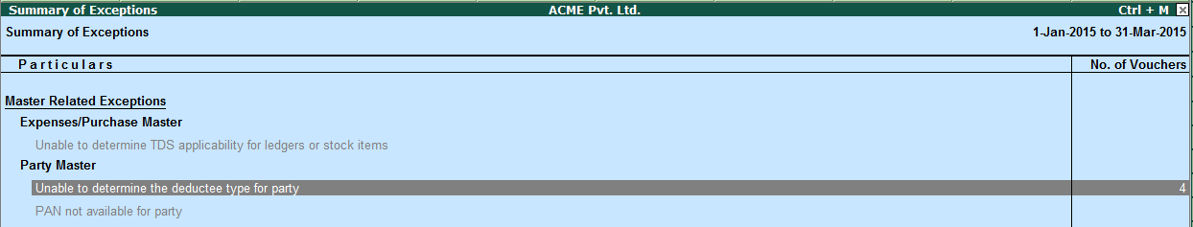
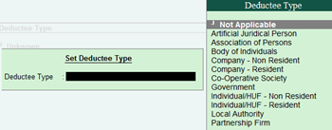
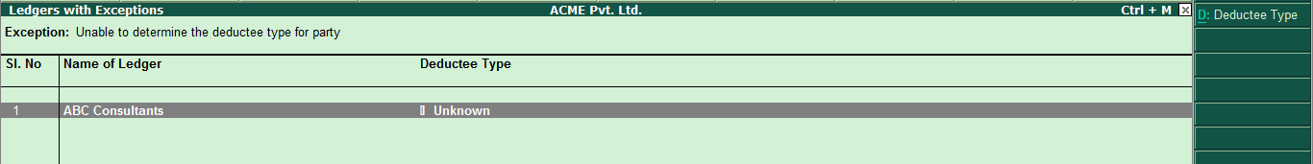
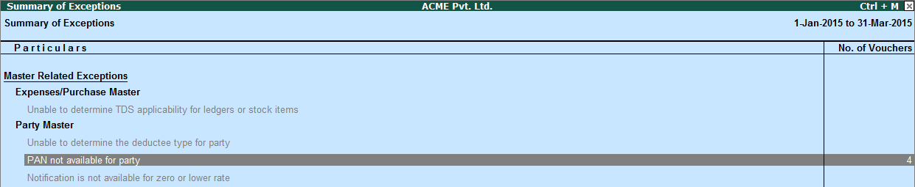
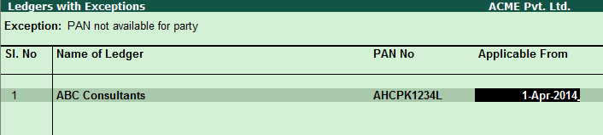
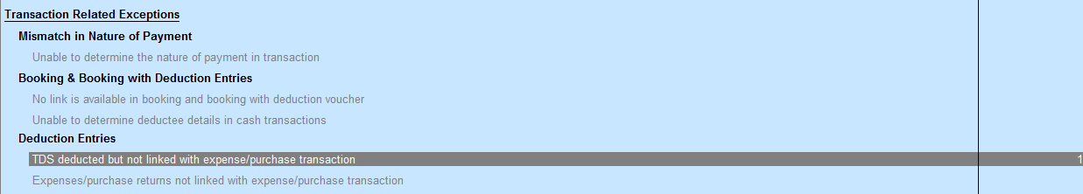
Clearing Exceptions
Notes:
Now, go an alter the ledger “ABC Consultants” and make the “Deductee Type” as “Unknown” and remove PAN too.
Go to Gateway of Tally → Display → Statutory Reports → TDS reports, look at Form 26Q. Observe a new thing – it’s showing that there are 4 transaction in the “Uncertain transactions” bucket!
Drill down and see the exception – Unable to determine Deductee Type for party.
Press Enter.
The party ledger for which you’ve altered the deductee type is displayed. All you need to do is, select the ledger by pressing the SPACE bar and then press ALT+D: Deductee Type to set the same. Select the deductee type as “Company – Resident” As soon as the same is selected, the exception gets cleared (facilitator to help the participants in doing the same. Any questions till now?).
Press the ESC key to go back to the summary of exception screen. Observe that the screen is showing yet another exception “PAN not available for party” (facilitator to discuss why Tally is showing this particular exception?.
In order to clear this exception, once again press ENTER → key in the PAN number and the applicable date, and save the same.
With all necessary details entered, the exceptions get cleared. Now if you come back to the Triangulation report screen, you’ll see that there are 0 transactions in the uncertain bucket.
Note:
If you book expenses and TDS separately i.e. expense is booked in Journal first and then TDS is deducted against the first entry in separate Journal voucher. Later, if the first transaction is deleted then the second transaction will be shown under Included bucket → Deduction Voucher.
Later, if this 2nd transaction is re-accepted then it will move from Included bucket and go to Uncertain Transactions → TDS deducted but not linked with expense / purchase transaction.
Any questions till now? (take questions)

Slide 21
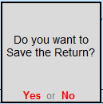
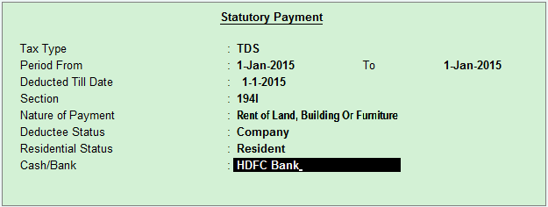
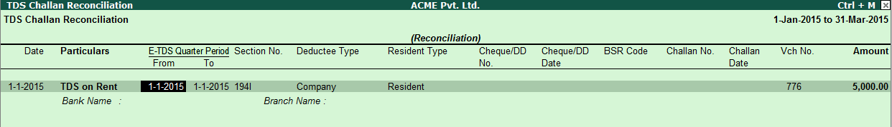
Saving your returns
Return Finalized →Press F6: Save Return
View saved returns from Display > TDS > Return Transaction Book
With saved returns one can easily track changes made to the returns
Press F7 to recompute and save the revised return
Press CTRL+E to export TDS form
ALT+S: Stat Payment
Notes:
Now we shift our attention to yet another powerful capability of Tally. Tally.ERP 9 Release 5.x gives a powerful capability of SAVING Returns.
Once you’ve cleared out the exceptions and finalised your returns, press F6 to save the same. Saved returns can be viewed from Display > Statutory Reports > TDS > Return Transaction Book.
After you SAVE the Return, whatever changes are done, they will be reflected in the Report – thereby helping in immediate action! Press F7 to re-compute and save the revised return (facilitator to demo the steps to the students).
The option to export your TDS form directly from Tally is now available. While you’re in the triangulation report screen, simply press CTRL+E: e-Return, and your form will get exported in SDF format.
Press ALT+S: Stat Payment, to make your TDS payments directly from the Triangulation Report. In this context it is important to note that for every Nature of Payment and Deductee Type (Company / Non Company) separate payment entry needs to be made. Once the payment entry is recorded, make sure that you specify the payment details like BSR code, Date of Challan, payment date etc from Display → Statutory Reports → TDS → Challan Reconciliation. Press F5: Reconcile Challan and enter the necessary details as shown on-screen. Without these details, the payment transaction WILL NOT be included in your returns.
Alternatively, these details can also be entered from the Triangulation Report Screen. Go down to the “Payment Details” section and select “Not Included Transactions”. List of transactions for which the necessary bank details are not available will appear under the exception “Bank Details are not available in Payment Voucher”. Enter the necessary details and save.
(facilitator to help the participants with the entire flow)
Note:
In order to file e-TDS Returns from Tally.ERP 9, following information needs to be provided –
PAN no. of Party
PAN Effective Date
Name on PAN

Slide 22
Conclusion
TDS Setup
Dues and Advance Payments
Single Bill Value Limit and Cash Transactions
Form 26Q
TDS Reversal
Triangulation Report
Questions
Notes:
Now we move on to discuss the aspects of TDS and the ways to handle the same in Tally.ERP 9
Note that the earlier sessions are mandatory to get fully understand TDS, as we do not repeat basic elements. This will make this a shorter and clearer session.

Slide 23
Thank You

