Slide 1
Accounting Features More…

Slide 2
Accounting Features More…
Special Vouchers
Scenario Management
Outstanding Management
Maintain Budget and Controls
Cost Centers
Activate Interest Calculation
Banking Features
Voucher Type and POS Invoice
Voucher Class

Slide 3
Special Vouchers in tally
Memo Voucher (Ctrl+F10)
Optional Voucher (Ctrl+L)
Reversing Journal (F10)
Post-Dated Voucher (Ctrl+T)

Slide 4
Memorandum Vouchers
A memorandum voucher is a voucher in which you record entries for which you are NOT sure whether they are going to occur.
And if they are going to occur then by HOW much amount.
A main distinguishing feature of memorandum voucher is that it does not affect your ACCOUNTS unless you convert it to a general voucher.

Slide 5
Example : Memorandum Vouchers
In your office, you gave ₹10,000 for office expenses for a month.
Now, you are NOT sure how much amount will be spent and what will remain at the end of the month.
In this case you will create a Memorandum Voucher for payment of ₹10,000.
At the end of the month let us assume that the actual expenses were ₹9,000.
What you will do is convert the memorandum voucher to payment voucher and change the amount from ₹10,000 to ₹9,000.
By doing this, along with the modified entry, the books of accounts will also get updated.

Slide 6
Enabling : Memorandum Voucher
To use Memorandum voucher, Enable the following option from F11: Accounting Features
Use Reversing Journals & Optional Vouchers

Slide 7
View : Memorandum V
To view all the memorandum vouchers:
Go to Gateway of Tally > Display > Exception Reports > Memorandum Vouchers.
Note: You can also view memorandum vouchers from the Day Book.
You can alter and convert a Memo voucher into a regular voucher when you decide to consider the entry into your books. Use Scenarios to see the effect of Memo entries on reports and statements.

Slide 8
Process : Memorandum Voucher
How to convert a memorandum voucher to a regular voucher.
Select the memo voucher from memorandum register or day book.
Press enter to view the voucher.
Select the voucher type from right button panel or using shortcut key. For example F5 Payment, F6 Receipt, F8: Sales and save the screen.

Slide 9
Optional Vouchers

Slide 10
Optional Vouchers
This is also a non-accounting voucher. Unlike a Memo voucher, this is not a separate voucher type.
You can mark an existing voucher (for example, a payment voucher or a receipt voucher) as Optional.
Press CTRL + L or click on Optional from the Button Bar. This button toggles between Regular and Optional.
By marking a voucher Optional, the voucher does not get posted anywhere but remains in the Optional Voucher Register.
You can make a voucher type Optional to regular, if you need to create a new voucher type or alter an existing voucher type.
Go to Gateway of Tally > Accounts Info > Voucher Types> select a Voucher Type> Set Make Optional as default to Yes.

Slide 11
Uses of Optional Vouchers
If you do not want a transaction that is incomplete to affect the accounts, you can mark this as an Optional Voucher. Once the transaction is complete, modify the voucher and post it as a Regular Voucher. For example, Proforma sales invoice. In fact, an optional sales invoice is printed as a Proforma Invoice.
Optional Vouchers allow you to see the impact of transactions without actually posting them.
Optional Vouchers can be used to forecast future sales. For example, create a New Voucher Type – Sales Forecast. Record future sales projections using this voucher type.

Slide 12
Post Dated Vouchers
Post dated vouchers can be used for any entry which is going to take place at some future date.
Although, post dated vouchers are generally used for creating entries related to post dated cheques, that does NOT mean that they are specifically used for post dated cheques.

Slide 13
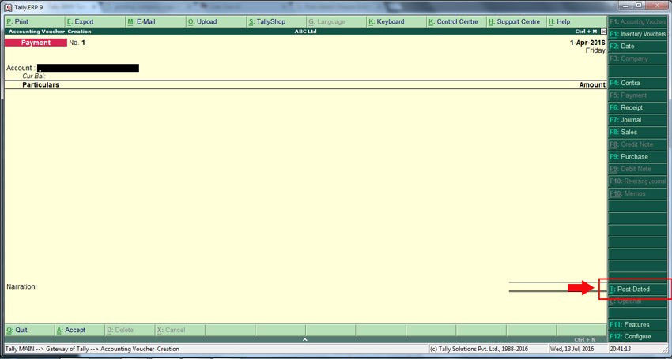
Create: Post Dated Voucher

Slide 14
View: PDV
To see the report,
from Gateway of Tally, press DXS consecutively and you will see all the post dated vouchers in debit as well as credit amounts.

Slide 15
Reversing Journal

Slide 16
Reversing Journal
Reversing Journals are special journals that are automatically reversed after a specified date.
They exist only till that date and are effective only when they are included in reports. These are used in interim reporting in the course of the financial year where accruals are to be reported.
These accruals are usually short term and are cleared in the subsequent period. However, to get a proper perspective, decision makers require the reports with full impact of all aspects and transactions.

Slide 17
Reversing Journal
On 30th June you want to view the Balance Sheet but June month’s rent is not been paid. You may create a Scenario and pass a Reversing Journal entry to view the reports which will be effective up to the applicable date.
When you view the Balance Sheet with particular scenario, Tally.ERP 9 displays the report with the reversing journals included. The voucher affects the report only for that day, 30th June.

Slide 18
Reversing Journal: View
Reversing Journal are not displayed in regular report and can be viewed by Scenario
Gateway of Tally>Account Info>Scenario>Create
Include the desired vouchers: Provisional Vouchers and Regular vouchers that are marked Optional are permitted for selection.

Slide 19
Scenario Management
When we want to see the effect of our non - accounting voucher on profit and loss and balance sheet then we use after creating scenario we get a duplicate copy of our profit and loss and balance sheet.
To Create Scenario
GOT>Account Info>Scenario>Create
To add scenario in report: use New Column option

Slide 20
Outstanding Management
Option Maintain bill-wise details is used to maintain Outstanding reports of customers and suppliers. Trading accounts are Sundry Debtors and Creditors
There is option of maintaining Bill-wise details of Non trading accounts also eg Loan Account,
Activate the Accounting Feature:
Maintain Bill Wise Details
Create ledgers with activated Maintain balance bill-by-bill

Slide 21
Outstanding Management - Example
Make sales transaction
Accept receipt of money
In Receipt Voucher, A popup appears forbill wise details of the customer.
Type of Reference:
Advance: This option is selected when you receive an advance from customer.
Agst Ref: This is used when you are adjusting receipt amount against a pending bill.
New Ref: This option is used when you are creating a new bill, used when entering sales voucher.
On Account: This option is used when you are not sure,against which bill the payment received. You can use On Account for keeping adjustment as pending ,and later you can adjust against correct bill.

Slide 22
Outstanding Management - Report
Gateway of Tally >Display>Statement of Accounts>Outstanding>
Receivable
Payable
Ledger
Group

Slide 23
Budgets and Controls - Credit
Controls will be on credit limit, credit period and putting a check on this.
Activate the Accounting Feature:
Maintain Budgets and Controls
Set Credit Limit for Single Ledger(Ledger-> Create/Aleter)
Set Credit Limit for Multiple Ledgers
Go to Gateway of Tally > Accounts Info > Ledgers > Credit Limits
Select the group of ledgers, for which the credit limits have to be set, from List of Groups
Set credit limits for both, amounts and periods here

Slide 24
Budgets and Controls - Budgets
Budget management is an effective tool for organisations to better manage their expenses and costs.
Activate the Accounting Feature:
Maintain Budgets and Controls
To Create Budget , Gateway of Tally > Accounts Info. > Budgets
Once a budget is created, it can then be displayed in the new columns in financial statements such as Balance Sheet, Profit & Loss Account etc.

Slide 25
Cost Center
A cost centre is nothing but a separate department within a business to which costs can be allocated
The cost category is used to accumulate costs or profits for parallel sets of cost centres.
Activate the Accounting Feature:
Maintain Cost Center
More than one Payroll/Cost Category
Creating cost centres and cost categories
Gateway of Tally.ERP 9 > Accounts Info. > Cost Centres >
Enable Cost Center Are Applicable in Ledger
Allocating expenses to cost centre
Reports: Gateway of Tally > Display > Statements of Accounts > Cost Centres

Slide 26
Activate Interest Calculation
Interest is a legitimate return on money invested and chargeable in the business world on loans and also on delayed payments
Interest can be calculated on the basis of Simple or Compound Interest
Enable the Accounting Feature:
Activate Interest Calculation
Enable in Ledger Account (Sundry Creditors/Sundry Debtors)
Activate Interest Calculation
Enter sales voucher or any desired entry
Check interest calculation
Gateway of Tally > Display > Statements of Accounts > Interest Calculations

Slide 27
BANKING FEATURES

Slide 28
Banking – Cheque Book
Alter bank ledger
Set Cheque Book
Banking – Cheque Register

Slide 29
Banking – Bank Reconciliation
The process of checking the differences between a bank column of the cash book and the bank statement or passbook is called Bank reconciliation process in accounting terms
Manual Reconciliation:
Banking -> Bank Reconciliation -> Select Account ->
Notes:
https://tallysolutions.com/tally/bank-reconciliation-in-tally-erp-9/

Slide 30
POS Invoice
POS is an acronym for Point of Sale . Point of Sale could mean a retail shop, a check-out counter in a shop or any other location, where a sales transaction takes place
To create a POS invoice voucher type, create a new POS invoice Voucher Type or alter an existing Sales voucher type
Set Use for POS Invoicing? to Yes
Note: The Use for POS Invoicing? option will appear only when the Default Tax Unit is set to Not Applicable .

Slide 31
Voucher Class
Voucher Classes are used to automate accounting allocations in transactions
It is a table for predefining the entries to make invoice entry a simple task
Voucher Classes are available for all major voucher types like Contra, Payment, Receipt, Journal, Sales, Credit Note, Purchases, Debit Note, Sales Order, Purchase Order, Delivery Note, Stock Journal and Payroll.

Slide 32
Tally : Reports
http://www.tallyerp9help.com/Pages/Reports/Contents-Reports-TallyERP9.html

