Slide 1
Indian Taxation System

Slide 2
Taxation
Taxation refers to practice of government collecting money from its citizens or legal entities to pay for public services. This money is collected by imposing taxes on a Person.
According to Section 2(31) of Income Tax Act,1961, Person means who can EARN.
Individual (Natural Human Being),
Hindu Undivided Family (HUF),
Company (Only when registered under Companies Act, 2013) ,
Firm,
Local Authority
Association of Persons (AOP) or Body of Individuals (BOI),
Artificial Judicial Person ( Statutory Corporations and etc.)

Slide 3
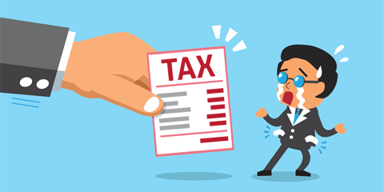
What is a Tax?
A tax is a compulsory financial charge or some other type of levy imposed upon a taxpayer by a governmental organization in order to fund government spending and various public expenditures. In India, Article 246 of Indian Constitution, provides the government the power to levy and collect taxes. Taxes are of two types-
Direct Tax
Indirect Tax

Slide 4
Direct Tax
Direct taxes are those which are paid directly are paid by the person to the imposing authority. They are levied on income and profits. Some examples of Direct Tax are:-
Corporation Tax
Taxes on Income
Estate Tax
Interest Tax
Wealth Tax
Expenditure Tax

Slide 5
Direct Tax
Tax deposition has to be done by the assesse directly. There are two types of direct taxes levied in India:-
TDS (Tax Deducted at Source), these are tax deducted on payments made by companies and individual, if payment exceeds the threshold. For example, Salary, rent, brokerage, professional fees, commission, interest etc.
TCS (Tax Collected at Source), these are the tax collected by the seller when selling certain goods to the buyer or grants a lease/license/enters into contract/transfer of rights or interests. This is generally done by governmental bodies. For example, Alcohol for human consumption, Tendu Leaves, Timber obtained under forest lease, Scrap, Minerals being coal or lignite or iron ore, Lease of parking lots, mines and quarries and even toll plazas. There is also a, 1%, TCS on high value items (i.e. above Rs 10 Lacs) like Cars, Jewellery and etc.

Slide 6
Indirect Tax
Indirect Tax is levied on goods and services rather than on income or profits. It is a collected by an intermediary from the person who bears the ultimate economic burden of the tax. The intermediary later files a tax return and forwards the tax proceeds to government with the return.
In this type, the final burden is on the Consumer and it cannot be averted as many sellers and manufactures and it to the cost. Hence, it tends to increase Inflation. Some examples are:-
Custom Duty and Import Duty
GST (Goods and Services Tax)
Excise Duty (Union and State)
Entertainment Tax

Slide 7
Need for Indirect Tax Reform - GST

Slide 8
Past Problems: Need for Reform
Both Centre and State has power to levy taxes on the items divided in Article 246 of Indian Constitution
The center can levy taxes listed in Central list and state can levy on State list;
There is one more list called concurrent list on which Centre and State both have power to levy tax;
The present tax system is origin based tax (the taxes, central taxes, are charged at the place of origin ie where goods are manufactured or services are originated where as state taxes are destination based taxes);
Taxes are levied and collected by respective tax departments of central and state govt.
No sharing of taxes so collected;

Slide 9
Taxes Subsumed
Central Taxes
State Taxes
Central excise duty
Duties of Excise
Additional duties of excise
Additional duties of Customs (CVD)
Special additional duties of customs (SAD)
Service taxes
Central surcharges and cesses
State VAT
Central sales tax
Luxury tax
Entry tax (on goods including octroy)
Entertainment and Amusement Tax
Taxes on advertisement
Purchase tax
Taxes on lotteries, betting and gambling
State surcharges and cesses
CGST
SGST

Slide 10
Exemptions: The Left Out
Out of GST Purview
Alcoholic Liquor for human consumption
Crude petroleum
Motor sprit (petrol)
High speed diesel
Natural gas
Aviation turbine fuel
Taxes levied by local bodies

Slide 11
Removal of Cascading Effect of Taxes
Development of Common National Market
Free movement of Goods & Services
Benefits of GST
Rationalize structure of Indirect Taxation
Abolition of Multiple Tax Layers
Seamless Flow of Credit
Wider Coverage of input tax and service tax set off

Slide 12
TAXES UNDER THE PREVIOUS INDIRECT TAX REGIME
Manufacturer
Output Manufacturer
VAT Dealer
“A” sells goods worth Rs. 100
“B” sells after value addition
“C” sells with Further Value Addition
Consumer
Particulars | Amount
Value for A | 100
Excise Duty | 12.5
Base Value | 112.5
VAT @12.5 | 14.06
Total Value | 126.56
Particulars | Amount
Cost for B | 100
Value add. @ 15% | 15
Base Value for ED | 115
Excise Duty | 14.38
Base Value for VAT | 129.38
VAT @12.5 | 16.17
Total Value | 145.55
Particulars | Amount
Cost for C | 129.38
Value Add. @15% | 19.41
Base Value for VAT | 148.79
VAT @ 12.5% | 18.60
Total Value | 167.39
Tax to be paid
CG = 12.5
SG = 14.06
Tax to be paid :
CG = 14.38 – 12.50 = 1.88
SG = 16.17 – 14.06 = 2.11
Tax to be paid :
CG = Nil
SG = 18.60- 16.17 = 2.43
Total tax received by CG is 14.38 & SG is 18.60

Slide 13
TAXES UNDER THE GST REGIME
9
Manufacturer
Output Manufacturer
VAT Dealer
“A” sells goods worth Rs. 100
“B” sells after value addition
“C” sells with Further Value Addition
Consumer
Particulars | Amount
Value for A | 100
CGST @ 9% | 9
SGST @ 9% | 9
Total Value | 118
Particulars | Amount
Cost for B | 100
Value Add. @15% | 15
Base Value for GST | 115
CGST @ 9% | 10.35
SGST @ 9% | 10.35
Total value | 138
Particulars | Amount
Cost for C | 115
Value Add.@15% | 17.25
Base Value for GST | 132.25
CGST @ 9% | 11.90
SGST @ 9% | 11.90
Total Value | 158.71
Total GST to be paid:
CG = 9
SG = 9
Total GST to be paid
CG = 10.35 - 9 = 1.35
SG = 10.35 – 9 = 1.35
Total GST to be paid
CG = 11.90 – 10.35 = 1.55
SG = 11.90 – 10.35 = 1.55
Total tax received by CG is 11.90 & SG is11.90

Slide 14
GST Process

Slide 15
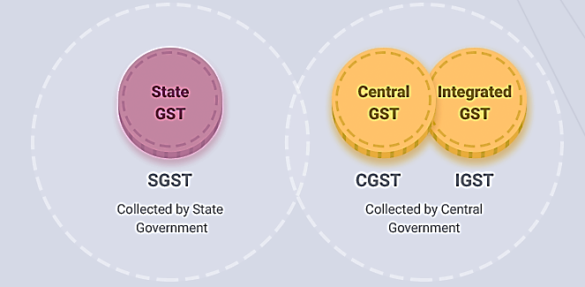
Goods and Services Tax (GST)
GST came into effect in India from 1st July 2017, through the implementation of 101th i.e. One Hundred and First Amendment of Constitution of India. The GST replaced then existing multiple taxes levied by the State and Central Government. It is a comprehensive, multistage, destination-based tax.
Notes:
comprehensive because it has subsumed almost all the indirect taxes except a few state taxes. Multi-staged as it is, the GST is imposed at every step in the production process, but is meant to be refunded to all parties in the various stages of production other than the final consumer and as a destination-based tax, it is collected from point of consumption and not point of origin like previous taxes.

Slide 16
GST (Continued)
GST is Destination based consumption tax (and not origin based tax);
No state and center and concurrent list, common list for both;
It would be a dual GST where center and states will levy it ,,,,,,
Taxes levied by center will be known as CGST;
Taxes levied by State will be known as SGST;
Taxes Levied by Union Territory will be known by UTGST;
Taxes levied on interstate sales and services will be known IGST;
In case of Intra state sales and services (supply) the tax will be charged at one common rate which will be shared equally by center and state (CGST and SGST or CGST and UTGST);
In case of Intra-state sales and services (supply), single rate tax will be charged, known as IGST, which will be collected by center and later on will be passed on to concerned states;

Slide 17
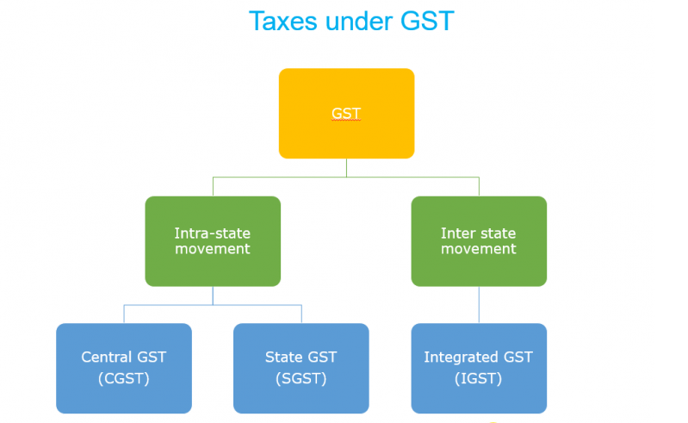

Slide 18
TDS under GST
Tax Deducted at Source (TDS), as per section 51 of CGST Act, 2017 prescribes the authority and procedure for TDS. The tax would be deducted at 1% of the payment made to the supplier (the dedutee) of taxable goods or services or both, where total value exceeds Rs 2,50,000/- excluding CGST, SGST and IGST. The government may order few specified persons (the deductor) to deduct tax at source:
Local authority, Governmental agencies; or
A department or establishment of the central government or the state government
Legal Aspects:- The deductor has to compulsorily register and can register using the TAN. The deductor will have to issue TDS certificate in GSTR - 7A.

Slide 19
TCS under GST
Tax Collected at Source (TCS), refers to tax which is collected by the electronic commerce operator, when a supplier supplies some goods or services or both through its portal and payment for that for that supply is collected by the E-Commerce operator like Amazon, Flipkart, Swiggy, Foodpanda and etc. The e-commerce operator has to collect tax at a rate of 1% from the supplier.
Power to collect tax: Section 52 of CGST act, 2017 provides for TCS, by e-Commerce operator.
Legal Aspects:- The e-Commerce operator and supplier are compulsorily required to register. The e-Commerce operator has to file GSTR-8 (a.k.a. Statement of Tax Collection) by 10th of the following month and a Annual Statement

Slide 20
GST Process
GST Portal : https://gst.gov.in
Registration
Invoicing
Return filing
Invoice Matching
Input Tax Credit(ITC)

Slide 21
GST - Registration
In the GST Regime, businesses whose turnover exceeds Rs. 40 lakhs* (Rs 10 lakhs for North East and hill states) is required to register as a normal taxable person. This process of registration is called GST registration.
GST registration usually takes between 2-6 working days.
GST is registered for each state
GSTIN is a 15 characters alphanumeric.
1-2 ( State Code)
3-12 ( PAN Number)
13-15 ( Unique ID number)

Slide 22
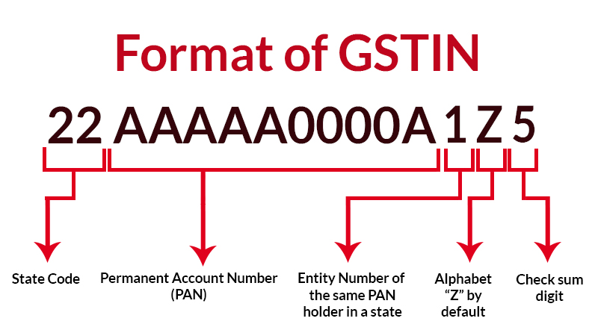

Slide 23
GST – Registration Types
Normal Taxpayer (Regular)
Composition
Casual Taxable Person
Input Service Distributor (ISD)
Non-Resident Taxable Person
Non-Resident Online Service Distributor
Embassy/UN Body/ Other Notified Persons
Special Economic Zone (SEZ) Developer/ Unit
Tax Deductor at Source (TDS) /Tax Collector at Source (TCS)

Slide 24
GST – Registration Types
Normal Taxpayer (Regular) :
Can issue tax invoice
Can avail input tax credit of GST Paid on purchase of goods or services or both.
Has to file returns monthly (GSTR1, GSTR3B)
Composition: This scheme can be opted by any taxpayer whose turnover is less than Rs. 1.5 crore. The following are the advantages of registering under composition scheme:
Lesser compliance (returns, maintaining books of record, issuance of invoices)
Limited tax liability
High liquidity as taxes are at a lower rate
https://gstportalindia.in/types-of-gst-registration-for-indian-taxpayer/

Slide 25
HSN Code/ SAC Code
Goods are classified under HSN Code. HSN full form is Harmonized System of Nomenclature
Services are classified under SAC Code. SAC full form is Services Accounting Code
Based on the HSN or SAC code, GST rates have been fixed in five slabs, namely NIL, 5%, 12%, 18% and 28%.

Slide 26
Tax Invoices
To be issued by the supplier containing, inter-alia, the following details:-
(a) name, address and GSTIN of the supplier/recipient;
(b) a consecutive serial number, unique for a financial year, date of its issue;
(c) Description, Quantity, HSN code of goods or Accounting Code of services;
(d) total value of goods or services;
(e) taxable value of goods or services after discount or abatement, if any;
(f) rate of tax (CGST, SGST or IGST);
(g) amount of tax charged (CGST, SGST or IGST);
(h) place of supply along with the name of State, in case of a supply in the course of inter-State trade or commerce;
(i) place of delivery where the same is different from the place of supply

Slide 27
GST RETURNS

Slide 28
Need for Returns
Mode for transfer of information to tax administration
To declare tax liability for a given period
Furnish details about the taxes paid in accordance with that return
Compliance verification program of tax administration
Providing necessary inputs for taking policy decision
Management of audit and anti-evasion programs of tax administration

Slide 29
Types Of Returns
Format | Description | Due date
GSTR-1 | Statement of Outward Supplies | 10th of next month
GSTR-1A | Details of outward supplies as added, corrected or deleted by the recipient | Auto-Generated by System
GSTR-2 | Statement of Inward Supplies claiming ITC | 10th to 15th of next month
GSTR-2A | Details of inward supplies made available to the recipient on the basis of GSTR-1 furnished by the supplier | Auto-Generated by System
GSTR-3 | Monthly Return | 20th of next month

Slide 30
Format | Description | Due date
GSTR-4 | Quarterly Returns for Compounding suppliers | 18th of month in next quarter
GSTR-5 | Return for Non-resident suppliers | 20th of next month
GSTR-6 | Return for ISD | 13th of next month
GSTR-7 | Return for TDS Deductors | 10th of next month
GSTR-8 | Details of supplies effected through e-commerce operator and the amount of tax collected | 10th of next month
GSTR-9 | Annual Return | 31st December
GSTR-10 | Final return | Within 3 months of cancellation of Registration
GSTR-11 | Details of inward supplies to be furnished by a person having UIN | 28th of next month

Slide 31
GSTR-1 (Information)
Basic details – GSTIN, Name, period, Turnover in last financial year–mostly auto-populated
Invoice level details
B2B supplies, interstate and intrastate, interstate B2C supplies more than Rs. 2.5 lakh
GSTIN of recipient
Invoice details – Number, date, Value, HSN, Taxable value,
Tax – IGST, CGST, SGST – Rate and Tax amount
Place of Supply
Reverse Charge
Details of supplies where no invoices raised
Advances received; Free Supply
Credit and Debit Notes – linkage to original invoice
Document number
Original Invoice Number
Differential amount and differential tax
(relevant for interstate supplies)

Slide 32
GSTR-1A
Details of exports – with and without payment of tax
Invoice details, Shipping Bill/Bill of Export, tax details
Details of exempt, Nil rated and Non-GST supplies
Interstate and Intrastate B2B and B2C supplies
Amendment of any of the above details filed in previous months
Details of outward supplies as added, corrected or deleted by the recipient
Auto Generated/populated

Slide 33
GSTR-2
Statement of Inwards Supplies
Auto-populated from Statements of outward supplies
Claimed – non auto-populated
Supplies attracting reverse charge
Invoice level details
As in statement of outward supplies
Input Tax Credit available, eligibility and availed
Import of Services
Invoice details, IGST rate and amount, ITC
Details of credit and debit notes
Auto-populated from statement of outward supplies
Claimed – non auto-populated
ISD Credit received
TDS Credit received
Other details of inward supplies
From exempt/composition suppliers
Exempt, nil rated and non-GST supplies

Slide 34
GSTR 2A
Details of inward supplies made available to the recipient on the basis of FORM GSTR-1 furnished by the supplier

Slide 35
Returns Monthly/ Quarterly
Auto-populated based on GSTR-1 and GSTR-2
Outward Supplies
B2B and B2C inter and intra state supplies
Exports
Revision of tax of previous periods
Inward Supplies
Inter and intra state supplies received
Imports
Amendment to tax of previous periods
Credit to ITC Ledger
Tax Liability
Tax on outward supplies
Changes in output liability of previous periods
Amount payable due to reversal of ITC
Payment details
Utilization of credit of each tax (debit to ITC ledger)
Cash (debit to cash ledger)
Claim of Refund of ITC or cash ledger

Slide 36
Annual Returns
Annual summary of all transactions
Accounts to be certified by Chartered Accountant etc. if turnover more than Rs. 2 Crore
Personal Details
Details of Expenditure
Purchases – goods/services – intra/inter state
Imports
Details of Income
Supplies – goods/services – intra/inter state
Exports
Account of taxes payable and paid
Arrears of taxes
Refunds
Profit and Loss
Reconciliation Statement
Not to be filed by ISD, TDS Deductor, Casual Taxpayer, and Non resident taxpayer

Slide 37
Return for Composition Suppliers
No ITC Available
Details of inward supplies
Invoice level – auto-populated and uploaded
Details attracting reverse charge – purchases from unregistered suppliers
Details of import of goods and services
Details of outward supplies – gross basis
Tax liability and payment details

Slide 38
Return for Non-resident Tax Payers
Backed by advance tax
They can take credit of IGST on import and pass on credit on all supplies
Credit of tax paid on imports
Details of outward supplies
Similar to GSTR-1
Details of tax paid
– ITC ledger and cash ledger
Closing stock of goods

Slide 39
Return for ISD
Details of inward supplies
Similar to GSTR-2
Details of credit distributed
GSTIN of recipient
Invoice details
Credit distributed – IGST, CGST, SGST
ITC account
ITC received
ITC distributed

Slide 40
Return for TDS Deductors
Pertains to cash ledger and not credit ledger
TDS details
GSTIN of deductee
Invoice details – number, date value
TDS details – rate and amount – IGST, CGST, SGST
Details of payment – only by cash ledger
TDS amount cannot be paid by debiting ITC ledger`

Slide 41
ITC Matching and Reversal
All returns filed with payment of taxes are treated as valid return
Self assessment – ITC to be allowed on filing of return
Provisionally allowed for payment of taxes in that return as per his claim
After filing of return
ITC claims checked for duplication
ITC claims matched with tax paid in valid returns
Claims that come as a result of auto-population taken as matched if tax paid by supplier
Uploaded invoices matched with supply invoices
Duplicate claims communicated to recipient and unmatched claims communicated to both
ITC claimed on duplicate invoice added in next return
Unmatched invoices
Either supplier owns up in next return and uploads it as part of his next month’s GSTR-1 – match in that return cycle
Otherwise, ITC claim remains unmatched in next month return and gets added in next return

Slide 42
Correction in Returns
No Revision of returns
As per the return taxes have already been paid and fund transfers already settled
No significance as the basis now is individual transaction
All changes through amendments in subsequent returns
If an invoice has been left out in GSTR-1 or GSTR-2 – can be uploaded in subsequent returns
If and invoice has been wrongly entered but remains unmatched – can be amended in subsequent returns;
Post transaction changes to be done through debit or credit notes
Other details like B2C supplies can be amended in subsequent returns
Delayed uploading coupled with payment of interest
All changes, credit or debit notes to be carried out before September of the next financial year
To enable any auto-reversal before Annual Return

Slide 43
ITC Matching and Reversal
All returns filed with payment of taxes are treated as valid return
Self assessment – ITC to be allowed on filing of return
Provisionally allowed for payment of taxes in that return as per his claim
After filing of return
ITC claims checked for duplication
ITC claims matched with tax paid in valid returns
Claims that come as a result of auto-population taken as matched if tax paid by supplier
Uploaded invoices matched with supply invoices
Duplicate claims communicated to recipient and unmatched claims communicated to both
ITC claimed on duplicate invoice added in next return
Unmatched invoices
Either supplier owns up in next return and uploads it as part of his next month’s GSTR-1 – match in that return cycle
Otherwise, ITC claim remains unmatched in next month return and gets added in next return

Slide 44
Accounts and Registers
Electronic Tax Liability Register FORM GST PMT-1 on the Common Portal
It shall be debited by:
(a) the amount payable towards tax, interest, late fee or any other amount payable as per the return;
(b) the amount of tax, interest, penalty or any other amount payable as determined by a proper officer.
It shall be Credited by:
Payment of every liability as per return shall be made by debiting the electronic credit ledger or the electronic cash ledger and the Tax Liability register shall be credited accordingly.
The amount of penalty imposed shall stand reduced partly or fully, as the case may be, if the taxable person makes the payment of tax, interest and penalty specified in the show cause notice or demand order, and the Tax Liability register shall be credited accordingly.

Slide 45
Credit Ledger
Electronic Credit Ledger shall be maintained in FORM GST PMT-2 on the Common Portal
It shall be credited by
Every claim of input tax credit under the Act shall be credited to the said Ledger.
It shall be debited by
The extent of discharge of any liability,
Claim of refund of any unutilized amount from the electronic credit ledger.
If the refund so filed is rejected, either fully or partly, the amount debited, to the extent of rejection, shall be re-credited to the electronic credit ledger by the proper officer by an order made in FORM GST PMT-2A.

Slide 46
Cash Ledger
The electronic cash ledger in FORM GST PMT-3 on the Common Portal
Credited for the amount deposited
And debited for the payment there from towards tax, interest, penalty, fee or any other amount.

Slide 47
Invoice Matching
Invoice matching is a concept wherein all the taxable supplies procured by a buyer and supplied by a seller are matched. The Government, through this concept, seeks to ensure the accurate transfer of Input Tax Credit (ITC) between the states and the parties in a transaction.
The procurer of goods is eligible to claim Input Tax Credit (ITC) for specified transactions. This benefit can only be claimed when the details of inward supply filled by the purchaser in GSTR-2 matches with the details of outward supply filled by the supplier in GSTR-1. Hence the need for this mechanism.
Invoice matching is a mechanism wherein all taxable GST supplies are matched with the ones received by the purchaser.
Components to be Matched
The following details must be matched in the GSTN portal while filing Form GST-2:
GSTN of the supplier
GSTN of the recipient
Invoice/Debit Note number
Invoice/Debit Note date
Taxable value
Tax amount

Slide 48
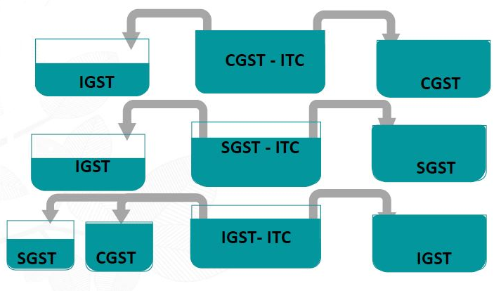
ITC OFFSET

Slide 49
SISOFT TECHNOLOGIES Pvt. Ltd.

Slide 50
The Genesis
The idea of moving towards GST was first mooted in Budget for 2006-07;
Earlier it was proposed to implement by 1st April, 2010;
The power to levy GST comes from 101th Constitutional amendment in Article 246A passed on 20th Sep. 2016;
This empowers Centre, State and UTs to make laws related to GST;

