Slide 1
Masters -Accounting Info Groups, Ledgers, Voucher
Sisoft Technologies Pvt Ltd
SRC E7, Shipra Riviera Bazar, Gyan Khand-3, Indirapuram, Ghaziabad
Website: www.sisoft.in Email:info@sisoft.in
Phone: +91-9999-283-283

Slide 2
Chart of Accounts
Capital
Revenue
Liability
Assets
Income
Expense
Equity
Balance Sheet
Profit-Loss Account

Slide 3
Accounting Groups
Account Groups are maintained to determine the hierarchy of Ledger Accounts which is helpful in determining and presenting meaningful and compliant reports.
The Group behaviour is classified into Capital or Revenue and more specifically into Assets, Liabilities, Income and Expenditure.
The Groups ascertain whether the same will affect Profit and Loss Account which is revenue in nature or Balance Sheet which is capital in nature.

Slide 4
Accounting Groups
Tally provides 28 pre-defined groups. Out of these 28 groups, 15 are primary and 13 sub groups.
Out of 15 groups, 9 groups appear in balance sheet and 6 primary groups appear under profit and loss account.

Slide 5
Predefined Group

Slide 6
Sub Groups

Slide 7
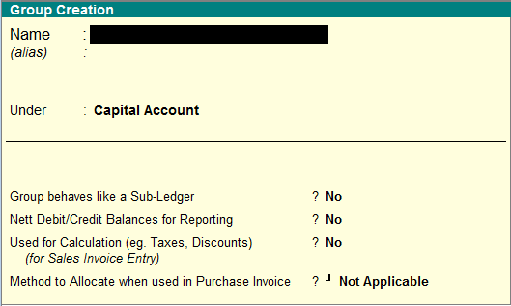
Group Creation

Slide 8
Group Creation – Advance Options
Group behaves like a Sub-Ledger
When activating Group behaves like sub ledger you will not see the ledger wise break-up of that particular group. You can view only the summary of that group as sub ledger.
Net Debit/Credit Balance for Reporting
The net balance of group, which means that no Debit balance total or credit balance total will not displayed instead Net debit or credit balance
Used for Calculation (eg Taxes/Discounts) For sales Invoice Entry
set automatic calculation for discounts taxes etc.
Method to allocate when used in purchase invoice
This is used to allocate expense in the reation of value or quantity or value.

Slide 9
Ledger(बही- खाता)

Slide 10
Configuring

Slide 11
Multiple ledger

Slide 12
Voucher Types
Accounting Vouchers
(Receipt, Payment, Contra and Journal )
Billing/Invoice Vouchers
(Sale, Credit Note, Purchase, Debit Note
Inventory Vouchers
( Stock Journal and Physical Stock Voucher
Order Vouchers
( Sales Order, Delivery Note, Rejection Ins)
(Purchase order, Receipt Note, Rejection Outs)

Slide 13
Voucher Types - Configuration
Have the different Voucher numbering methods.
Give own prefix and suffix details for the voucher numbering.
Use the Effective Dates for the vouchers.
By default, make some vouchers optional if required.
Decide to have the Common Narration or Narration for each entry.
Automate the printing immediately after saving the vouchers.
Get separate reports for each type of voucher.

