Slide 1
Getting Started With Tally
Sisoft Technologies Pvt Ltd
SRC E7, Shipra Riviera Bazar, Gyan Khand-3, Indirapuram, Ghaziabad
Website: www.sisoft.in Email:info@sisoft.in
Phone: +91-9999-283-283

Slide 2
Tally Software Versions
Tally ERP9 Silver
Tally ERP9 Gold
Tally Server9

Slide 3
Features of Tally
Accounting Management
Billing or Invoicing
Banking Transaction Support
GST Compliance
Budget and Credit Limits
Inventory Management
Order Management
Payroll
Security Controls

Slide 4
Installation of Tally
http://www.tallysolutions.com/download
Install Now or Install for later Use

Slide 5
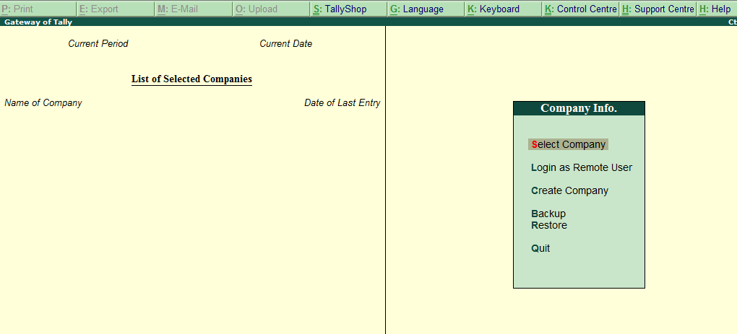
Gateway of Tally (GOT)

Slide 6
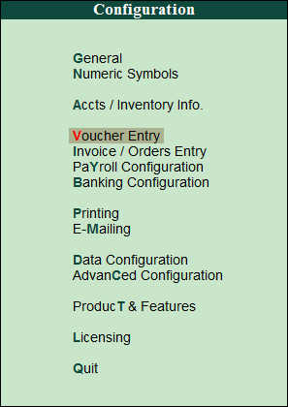
Tally Configuration (F12)

Slide 7
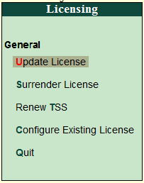
Tally Configuration -> Licensing

Slide 8
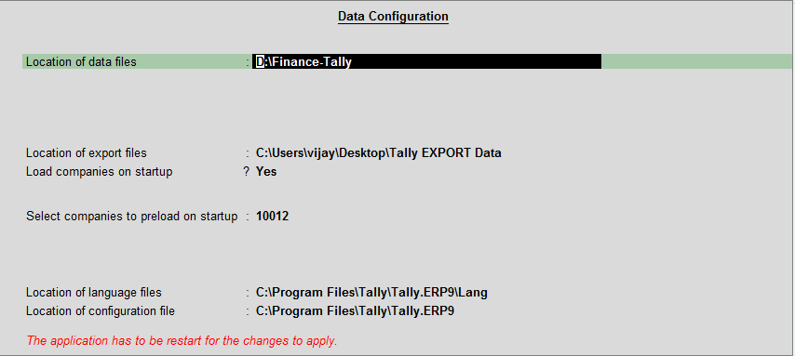
Tally Configuration -> Data Configuration

Slide 9
Gateway of Tally (GOT)

Slide 10
Creating a company in Tally
Gateway of Tally -> Company Info -> Create Company
Gateway of Tally -> Company Info (Alt+F3) -> Create Company

Slide 11
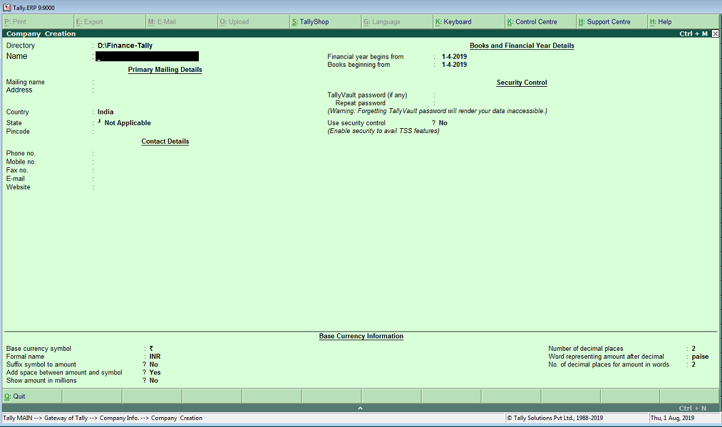
Company Creation Screen

Slide 12
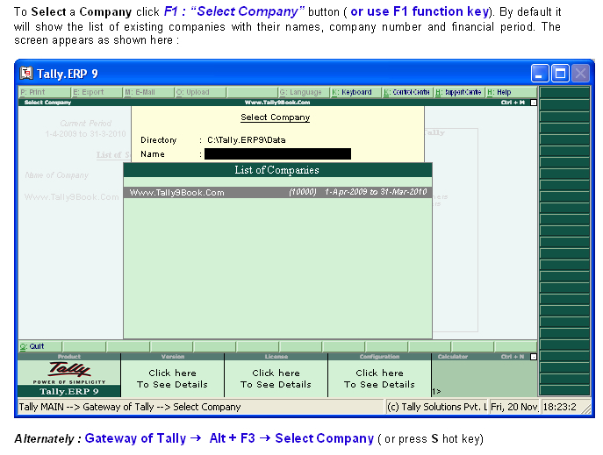
Selecting a company

Slide 13
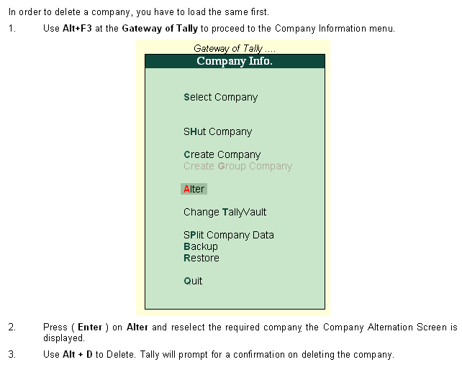
Deleting a Company

Slide 14
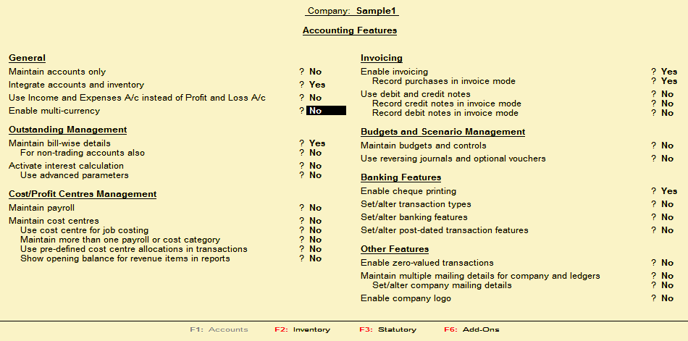
Accounting Features – F11

Slide 15
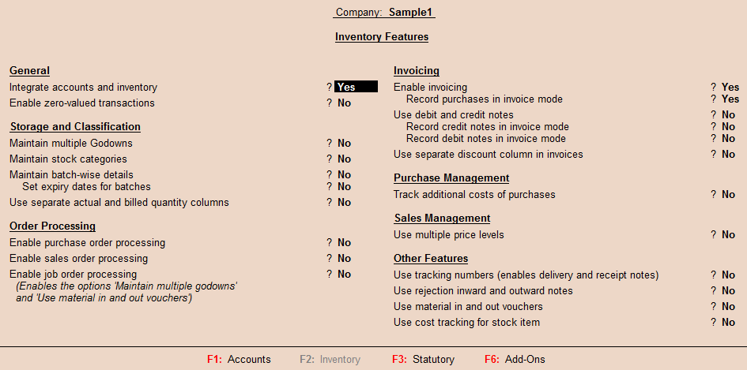
Inventory Features – F11

Slide 16
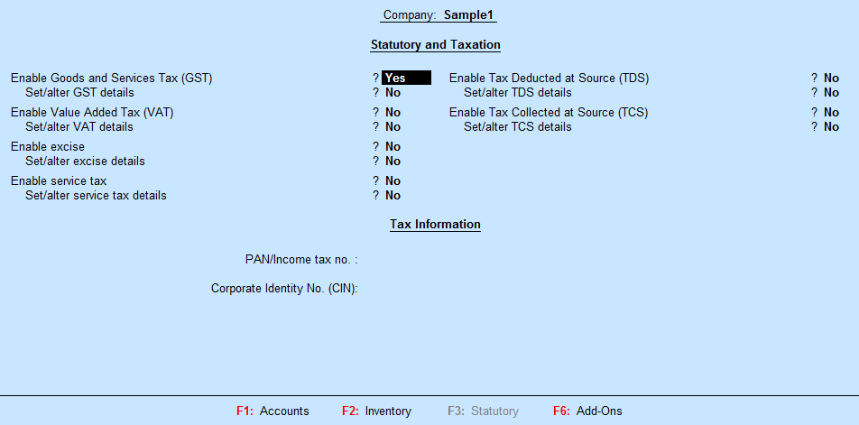
Statutory and Taxation Features – F11

Slide 17
Tally Short-cut Keys
Enter => To move down, To move to next field
Escape => To return up
Tab => To move to next field
Shift+Tab/Backspace => To move to previous field
Alt+C => on fly create master on the field you are
Ctrl+Enter => On fly alter master
F2 => Change Date
Alt+F2 => Change Period
Single Underline mean Alt Key
Double underline mean Control Key
F11 => Features
F12 => Configure

