Slide 1
Sale and Purchase Management
Sisoft Technologies Pvt Ltd
SRC E7, Shipra Riviera Bazar, Gyan Khand-3, Indirapuram, Ghaziabad
Website: www.sisoft.in Email:info@sisoft.in
Phone: +91-9999-283-283

Slide 2
Sale and Purchase Management
GST Composite and Mixed Supply
GST for packing, insurance, freight etc
Standard Rate
Use Multiple Price Levels
Discount
Invoice Round Off
Additional Cost of Purchase

Slide 3
GST Composite & Mixed Supply

Slide 4
Learning Outcomes
At the end of this session, you should be able to:
1. Understand the meaning of GST Composite Supply and Mixed Supply
2. Understand how to implement GST Composite Supply and Mixed for Excellent Enterprises
Notes:
At the end of this session, you should be able to :
Understand the meaning of GST Export Supply
Implement GST Export transactions for Excellent Enterprises
Understand the meaning of Exempt and Nil Rated supply
Implement Exempt and Nil rated supply for Excellent Enterprises
View and understand the implications on GST Reports

Slide 5
What is Composite Supply ?
Notes:
Question to audience – What do you think Sales means?

Slide 6
What is Composite Supply ?
Composite supply means a supply comprising of two or more goods/services, which are naturally bundled and supplied with each other in the ordinary course of business, one of which is a principal supply.
It means that the items are generally sold as a combination.

Slide 7
How to determine a ‘Composite Supply’ ?
A supply of goods and/or services will be treated as composite supply if it fulfills the following criteria:
Supply of two or more goods or services together
It is a natural bundle, i.e., goods or services are usually provided together in the normal course of business.
There should be one principle supply.

Slide 8
What tax rate will apply for Composite Supply ?
The tax rate of the principal supply will apply on the entire supply.
Example:
Goods are packed and transported with insurance. The supply of goods, packing materials, transport and insurance is a composite supply. Insurance and Packaging charges cannot be done separately if there are no goods to supply. Thus, the supply of goods is the principal supply.
Tax liability will be the tax on the principal supply i.e., GST rate on the goods

Slide 9
Tax Rate for Excellent Enterprises
Excellent Enterprises is now adding packing charges and insurance charges along with the Samsung TV 42”. Tax rate on TV is 18% as already known.
What is the tax rate that will apply on the sale with Samsung TV 42”, packing and insurance charges ?
Tax Rate on Samsung TV 42” will apply for the entire sale, i.e. 18%

Slide 10
Composite Supply Transaction
Composite Supply under GST - Transaction
Stock Item Name | Quantity | Rate | GST % | Amount
Samsung TV 42” | 1 nos | 68,775 | 18% | 68,775
Packaging Charges |  |  |  | 1000
Insurance Charges |  |  |  | 500
Sub Total |  |  |  | 70,275
State GST |  |  | 9% | 6,324.75
Central GST |  |  | 9% | 6,324.75
Invoice Total |  |  |  | 82,924.50

Slide 11
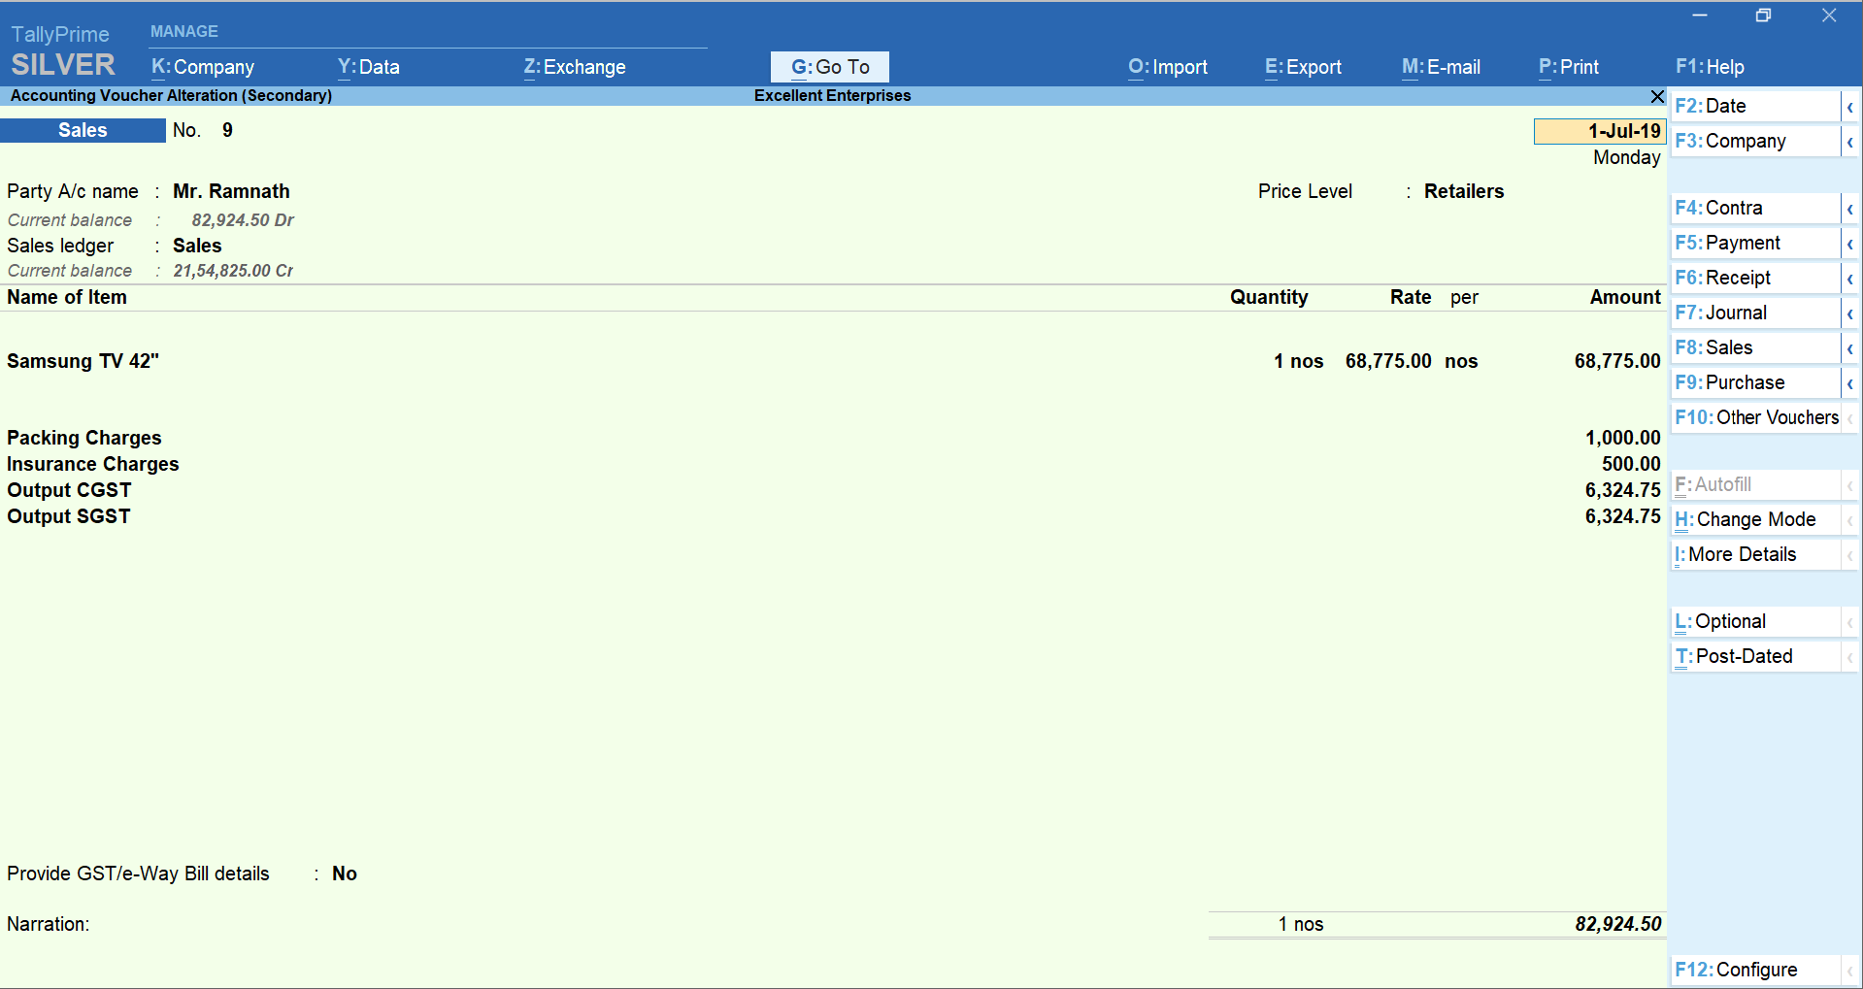
Sale Invoice

Slide 12
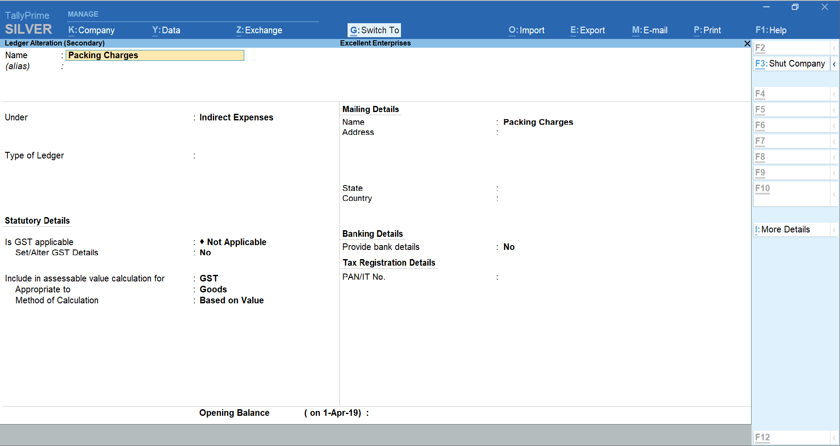
Expense Master Configuration

Slide 13
Include Freight for GST calculation in Sale Invoice
Create Ledger “Freight” under “Indirect Expense”
Is GST Applicable? will be set to Not Applicable .
Include in assessable value calculation for - GST
For the option Appropriate to , select
o Goods , if the expense or income value has to be included in the stock item cost.
o Services , if the expense or income value has to be included in the service value.
o Both , if the expense or income value has to be included in stock item cost or service value.

Slide 14
Include Freight for GST calculation in Sale Invoice
Select the Method of Calculation based on the selection made for the option Appropriate to . If you set it to Goods , select the Method of Calculation as:
Based on Quantity , if the expense or income amount has to be distributed based on the quantity entered for each stock item in the invoice.
Based on Value , if the expense or income amount has to be distributed based on the value of each stock item or service selected in the invoice.
You can use the expense ledger in a sales invoice for recording additional expenses along with the sale of goods or services

Slide 15
What is Mixed Supply ?
Notes:
Question to audience – What do you think Sales means?

Slide 16
What is Mixed Supply ?
Mixed supply means a combination of two or more goods or services made together for a single price.
Each of these items can be supplied separately and is not dependent on any other.

Slide 17
How to determine Mixed Supply ?
You must rule out that the supply is a composite supply.
A supply can be a mixed supply only if it is not a composite supply.
If the items can be sold separately, i.e., the supplies not naturally bundled in the ordinary course of business, then it would be a mixed supply.
For example:
If a person buys canned foods, sweets, chocolates, cakes, dry fruits, aerated drink and fruit juices separately and not as a Diwali gift box, then it is not considered a mixed supply. All items will be billed and taxed separately as a separate line item

Slide 18
What tax rate applies for Mixed Supply ?
Under GST, a ‘Mixed supply’ will have the tax rate of the item which has the HIGHTEST RATE OF TAX.
Example:
A Diwali gift box consisting of canned foods, sweets, chocolates, cakes, dry fruits, aerated drink and fruit juices supplied for a single price is a mixed supply.
All are also sold separately.
Since aerated drinks have the highest GST rate of 28%, so 28% will apply on the entire gift box.

Slide 19
Tax Rate for Excellent Enterprises
In their food and beverages line of business, they are selling Diwali Gift packs:
Bill of Materials - Sunlit Diwali Gift Pack
Components | Unit of Measure | Quantity per 1 Pack | GST %age
Sunlit Marie Biscuit - 100 Gms Pkt | Nos | 10 | 5%
Namkeen mixture pkt | Nos | 1 | 12%
Sunlit Brownie cake | Kgs | 1 | 18%
Sunlit Cola | Nos | 1 | 28%
What is the tax rate that will apply on this mixed supply ?
28% , HIGHEST RATE OF TAX

Slide 20
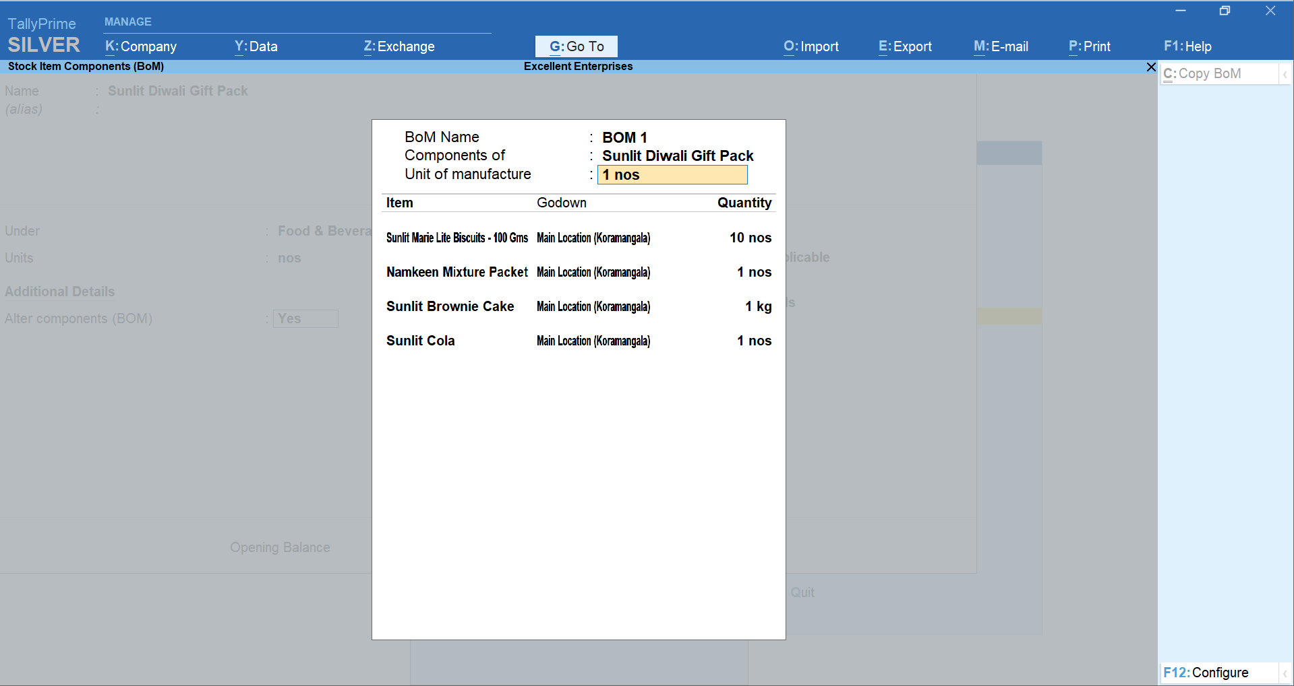
BOM for Sunlit Diwali Pack

Slide 21
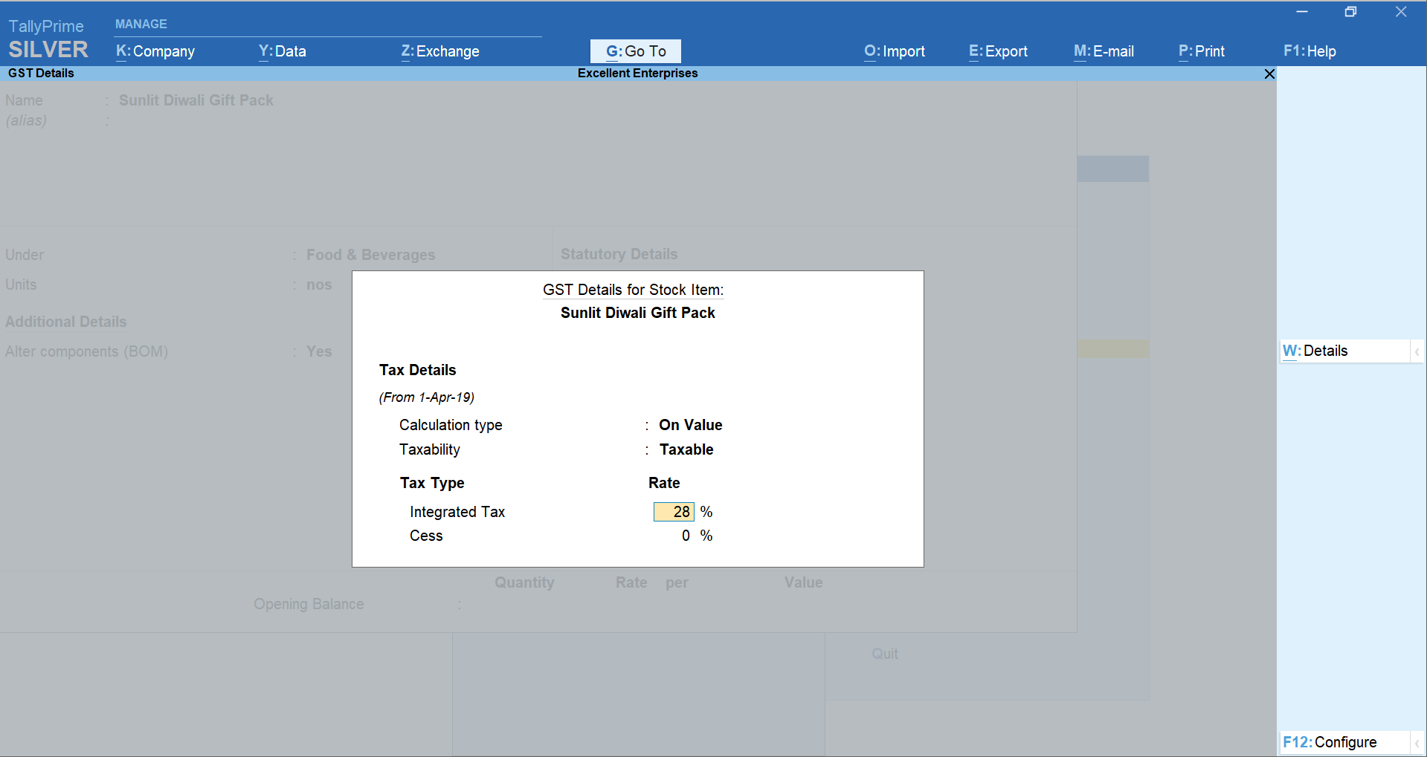
Tax on the Mixed Supply

Slide 22
Quiz
GST Composite and Mixed Supply
Notes:
Allow the participants to check Tally if they wish to and write the answers in their workbook. This will be a silent quiz. Answers will be discussed only at the end of the quiz.

Slide 23
What is the GST Rate that will apply for ‘Composite Supply’ _____________
A) Tax rate of the item which has the HIGHTEST RATE OF TAX.
B) The tax rate of the principal supply will apply on the entire supply
C) Tax rate of the item which has the LOWEST RATE OF TAX.
D) The tax rate of the supplementary supply will apply on the entire supply

Slide 24
What is the GST Rate that will apply for ‘Mixed Supply’ _____________
A) Tax rate of the item which has the HIGHTEST RATE OF TAX.
B) The tax rate of the principal supply will apply on the entire supply
C) Tax rate of the item which has the LOWEST RATE OF TAX.
D) The tax rate of the supplementary supply will apply on the entire supply

Slide 25
Setup Price

Slide 26
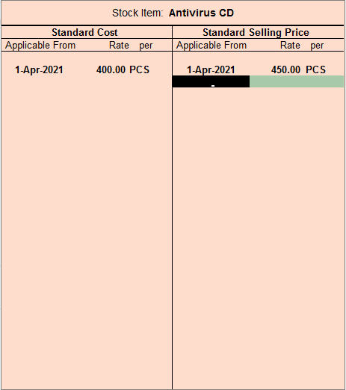
Standard Rates
In Configure, Enable Standard Rate
In the stock item master screen, set Set Standard Rates to Yes.
Notes:
http://tallyerp9book.com/Pages/Web-Page/Home-TallyERP9Book/Stock/6-Additional-Cost-Details-TallyERP9.html

Slide 27
Price Levels
Enable in Company Features
-> Features(F11)
-> Inventory Features
-> Sale Management
-> Use Multiple Price Levels
-> Enter name of price levels
Inventory Info
Price List
Notes:
http://tallyerp9book.com/Pages/Web-Page/Home-TallyERP9Book/Stock/6-Additional-Cost-Details-TallyERP9.html

Slide 28
Discount Promotion Techniques
Trade Discount:
Trade discount is a discount given by the seller to the buyer at the time of purchase of goods, as a reduction in the list price of the quantity sold. This is usually due to bulk buying
Cash Discount:
Cash Discount is a discount allowed to customers by the seller at the time of making the payment of purchases, as a reduction in the invoice price of the commodity.
Notes:
Trade discount – means discount on specific items
Cash Discount – Means discount on final invoice value

Slide 29
Trade Discounts
Enable in Company Features
-> Features(F11)
-> Inventory Features
-> Invoicing
-> Use separate discount columns in invoices
-> Features(F11)
-> Inventory Features
-> Storage and Classification
-> Use separate actual and billed quantity columns
Notes:
http://tallyerp9book.com/Pages/Web-Page/Home-TallyERP9Book/Stock/6-Additional-Cost-Details-TallyERP9.html

Slide 30
Trade Discount (using discount ledger)
Create discount ledger
Record the given transactions in Tally
Print Invoice

Slide 31
Invoice Round Off
Create Ledger “Round Off” under “Indirect Expense”
Set Type of Ledger? as Invoice Rounding .
Select the Rounding method to “Normal Rounding”
Enter the Rounding limit to 1
The option Is GST Applicable? will be set to Not Applicable .
Select this ledger in the invoice to round-off the invoice value.

Slide 32
Item Invoice
Sale/Purchase Voucher entry can be done in Item Invoice Mode
In this mode, item name is entered instead of any ledgers
Ledger also can be entered by leaving one line blank from item names entry
Notes:
http://tallyerp9book.com/Pages/Web-Page/Home-TallyERP9Book/Stock/6-Additional-Cost-Details-TallyERP9.html

Slide 33
Additional Cost Of Purchase
The cost of an item is the rate at which the item is purchased. However there are other expenses like packing charges, freight charges, cartage etc also should be added to the cost of purchasing item
Thus, these additional cost details needs to be added to the actual cost of purchase.
These expenses posted using Additional cost on Purchase features, do not affect the relevant nominal ledger accounts but update the cost of the Stock Item, i.e., the additional costs incurred are updated without actually affecting accounting, only the stock value goes up.
Notes:
http://tallyerp9book.com/Pages/Web-Page/Home-TallyERP9Book/Stock/6-Additional-Cost-Details-TallyERP9.html

Slide 34
Additional Cost Of Purchase
Enable in Company Features
-> Features(F11)
-> Inventory Features
-> Purchase Management
-> Track Additional Cost Of Purchase
Change in Direct Expense Group Method of Allocation in Purchase Invoice
-> Alter Direct Expense Group
-> Change Method to allocate when used in Purchase Invoice to (Appropriate by Vale)
Notes:
Note: To get the option Method to Allocate when used in Purchase Invoice , enable the option Record purchases in invoice mode in F11: Features (F1: Accounting Features)

Slide 35
Additional Cost Of Purchase
Create Ledger “Freight in Purchase” under “Direct Expense”
Create Purchase Invoice
Add expenses in Freight in Purchase
Check in Stock Summary
Check in Ledger Account “Freight in Purchase”

