Slide 1
Sale and Purchase Vouchers
Sisoft Technologies Pvt Ltd
SRC E7, Shipra Riviera Bazar, Gyan Khand-3, Indirapuram, Ghaziabad
Website: www.sisoft.in Email:info@sisoft.in
Phone: +91-9999-283-283

Slide 2
Regular Vouchers in tally
Contra Voucher (F4)
Payment Voucher (F5)
Receipt Voucher (F6)
Journal Voucher (F7)
Sales Voucher (F8)
Credit Note Voucher (Ctrl+F8)
Purchase Voucher (F9)
Debit Note Voucher (Ctrl + F9)

Slide 3
Sales/Purchase Entry Modes
Sales/Purchase may be entered either as Voucher or Invoice
Voucher Mode:
Invoice Mode: Two Invoice Modes
Accounting Invoice: Only ledger may be selected and no stock item during voucher entry
Item Invoice: Stock item may be selected and its movement may be recorded

Slide 4
Sales Entry - Ledgers
These ledgers required:
Sales Ledger – A Ledger for recording sales. It can even be used for differentiating sales like domestic or international. This is created under Sales Accounts
Customer - The person to whom you are selling. This is created under Sundry Debtor
Sales Return Ledger : A Ledger for recording sales return. This is created under Sales Accounts

Slide 5
What is Sales ?
In simple terms, selling means giving goods/services in exchange for money
Types of Sale
Cash Sale
Credit Sale

Slide 6
Sales Voucher Overview
For Sales of any services or item, a entry is made that in Sales Voucher.
Cash Sales : Payment is received during the sales.
Dr Cash Account (Cash/Bank Account)
Cr Sales Ledger
Credit Sale: Payment is received later.
Step 1: Dr The Party & Cr the Sales
Step 2: Receipt Voucher : Dr The Cash/Bank & Cr the Party to whom the sales were made.

Slide 7
Cash Sales Entry – Voucher Mode
Cash Sales : Payment is received during the sales.
Dr Cash Acccount (Cash/Bank Account)
Cr Sales Ledger
Supplementary Details : Buyer information
 |  | Debit | Credit
Dr | Cash/Bank Account | XXXXX
Cr | Sales Ledger |  | XXXXX

Slide 8
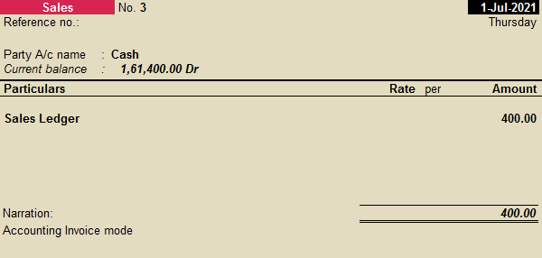
Cash Sales Entry – Accounting Invoice
Cash Sales : Payment is received during the sales.
Party Name: Cash Acccount (Cash/Bank Account)
Particulars : Sales Ledger
Supplementary Details : Dispatch Details, Order Details, Buyer information
In case of Bank Account, Bank Allocation screen is prompted.

Slide 9
Cash Sales Entry – Examples
Voucher Mode
Oct 7, Sold Cash of INR 5000 to Ramamurthy of Gyan Khand
Oct 8, Sold to Ram Narayan of INR 7000, who paid by cheque
Accounting Invoice Mode
Oct 9, Sold Cash of INR 6000 to RamNathan of Gyan Khand
Oct 10, Sold to Ram Nathan of INR 8000, who paid by cheque

Slide 10
Credit Sales Entry – Voucher Mode
Credit Sales : Payment is received after the sales.
Dr Party Account
Cr Sales Ledger
Supplementary Details : Dispatch Details, Order Details, Buyer information

Slide 11
Credit Sales Entry – Accounting Invoice
Credit Sales : Payment is received after the sales.
Party A/c Name: Customer Name
Particulars : Sales Ledger
Supplementary Details : Dispatch Details, Order Details, Buyer information

Slide 12
Credit Sales Entry – Examples
Voucher Mode
Oct: 11 Sold goods to Kishore Rs. 40,000 ( Bill No: X)
Oct: 12 Cash received from Kishore Rs. 25,000 (Bill No: X)
Accounting Invoice Mode
Oct: 14 Sold goods to Kishore Rs. 30,000 ( Bill No: X)
Oct: 15 Cheque received from Kishore Rs. 30,000 (Bill No: X)

Slide 13
View Sales Vouchers
Voucher Mode
Gate of Tally -> Display -> Day Book
Period:
Change Voucher to Sales
Gate of Tally -> Display -> Account Books -> Sales Register

Slide 14
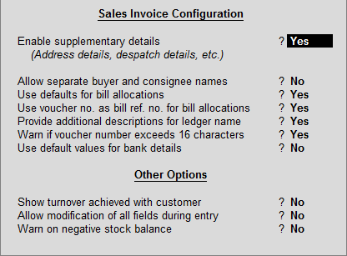
Sales Vouchers Configuration
F12 – Configuration

Slide 15
Sales Vouchers Sharing
Printing
Exporting
Emailing

Slide 16
Invoice Print Configuration
Voucher Details
Statutory Details
Header Information
Company Details
Party Details
Order and Dispatch Details
Footer Information
Printer Settings

Slide 17
Entry of other details
Sale Voucher Entry
Dispatch Details, Order Details, Export Details
Party Details (Buyer, Consigner)
eWay Bill Details
Purchase Voucher Entry
Receipt Details, Order Details, Import Details
Party Details (Buyer, Consigner)

Slide 18
Credit Notes -
Credit note voucher is used specially for sales return entries. It means we are crediting the account of customer and money either can be refunded or adjusted
Credit note can be entered in Voucher mode or Invoice mode(Accounting or
For Credit Note – Voucher Mode
Original Invoice Number and Date
Cr to Customer Account
Dr to Sales Ledger
For Credit Note – Invoice Mode
Original Invoice Number and Date
Party A/c Name: Customer Name
Particular :

Slide 19
View Credit Note Vouchers
Voucher Mode
Gate of Tally -> Display -> Day Book
Period:
Change Voucher to Sales
Credit Note register displays all the credit notes recorded for each month.
Gateway of Tally > Display > Account Books > Journal Register > Credit Note Register

Slide 20
Purchase Entry
For Purchase of any services or item, a entry is made that results in
Dr to Purchase Ledger
Cr to Supplier Ledger

Slide 21
Purchase Entry - Ledgers
These ledgers required:
Purchase Ledger – A ledger for recording purchases. Again, it can be used for differentiating purchases such as domestic or international. This is created under Purchase Accounts
Supplier : The person from whom you are purchasing. This is created under Sundry Creditor

Slide 22
Entry of other details
Purchase Voucher Entry
Supplier Invoice Details
Receipt Details, Order Details, Import Details
Party Details (Buyer, Consigner)

Slide 23
Purchase Entry – Examples
Oct 16: Purchased goods from Aroma Traders Rs. 85,000 (bill No: 108)
Oct 17: Purchased goods for cash Rs. 10,000
Voucher Mode
Accounting Invoice Mode

Slide 24
Debit Notes
Debit Note voucher is used specially for purchases return entry
For Debit Note (Purchase Return)
Cr to Purchase Ledger
Dr to Supplier Ledger

Slide 25
Assignment – Sales/Purchase Entry

