Slide 1
Accounting Vouchers
Sisoft Technologies Pvt Ltd
SRC E7, Shipra Riviera Bazar, Gyan Khand-3, Indirapuram, Ghaziabad
Website: www.sisoft.in Email:info@sisoft.in
Phone: +91-9999-283-283

Slide 2
Regular Vouchers in tally
Contra Voucher (F4)
Payment Voucher (F5)
Receipt Voucher (F6)
Journal Voucher (F7)
Sales Voucher (F8)
Credit Note Voucher (Ctrl+F8)
Purchase Voucher (F9)
Debit Note Voucher (Ctrl + F9)

Slide 3
Contra Vouchers
To record transfer of fund between Cash and Bank Accounts.
Different contra voucher entry will indicate transfer of fund between:
Cash Account to Bank Account
Bank Account to Cash Account
Bank Account to Bank Account
Dr/Cr both will be cash account (cash or bank)
For example:
Deposit of cash in your bank
Withdrawal of amount from bank

Slide 4
Contra Vouchers
Notes:
Money transfer from one pocket to another pocket.

Slide 5
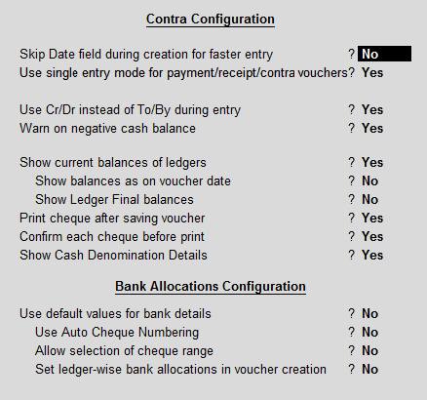
Contra Vouchers - Configuration
Notes:
Money transfer from one pocket to another pocket.

Slide 6
Contra Vouchers Examples
2 Apr, Manoj invested 80,000 as cash in his business
3 Apr, Deposited 20000 cash in ICICI Bank
20 Apr, transferred 5000 from ICICI Bank using cheque no 123461 to SBI
21 Apr, Withdrawn 6000 from ICICI Bank using cheque no 123462

Slide 7
Payment Vouchers
Payment voucher is used to account all the payments made by the company by way of Cash/Bank.
Payment voucher can be passed using Single Entry or Double Entry mode by configuring the setting Use Single Entry mode for Pymt/Rcpt/Contra in F12 configuration .

Slide 8
Payment Vouchers
To record payments of money
Payment will be through bank account or cash as per you needs.
Cr will be cash accounts (Cash or Bank Accounts)
Dr will be some other account
For example,
Payment of salary to someone working for you
Payment for an expense such as maintenance expenses, you have to pass a payment entry.

Slide 9
Payment Vouchers (Double Entry Mode)

Slide 10
Payment Vouchers Examples
1 May, Paid INR 2000 Cash to Mr Ram Sharma as credit
2 May, Paid INR 5000 to Sohan Verma as salary by ICICI cheque 123462
31 May, Paid INR 7000 Cash as Rent

Slide 11
Receipt Vouchers
It is the exact opposite of a payment entry.
It is passed when you receive cash or an amount in your bank account.
Dr will be cash accounts (cash/bank account)
Cr will be some other account
For example:
Receipt of cash for selling things
Receipt of service charges in your bank account for working for someone

Slide 12
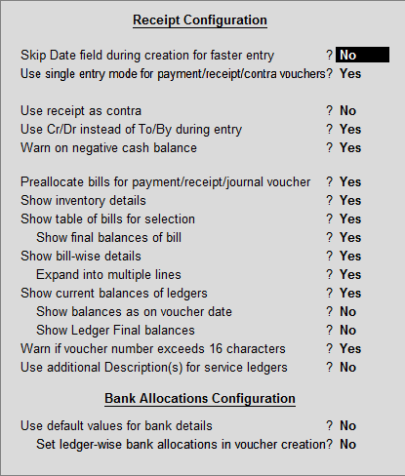
Receipt Vouchers - Configuration
Notes:
Money transfer from one pocket to another pocket.

Slide 13
Receipt Vouchers

Slide 14
Receipt Vouchers Examples
1 Jun, Manoj invested 80,000 as cash in his business
2 Jun, Received INR 2000 Cash from Mr Ram Sharma as return
30 Jun, Received INR 17000 Cash as customer for credit sale

Slide 15
Journal Entry
It is an accounting entry which is required to be created when there is no cash or bank account involved.
So, basically it is an entry for transactions such as outstanding payments or receipts, accounting adjustments or it can be closing entries at the end of the accounting year.
In simple words, whenever there is no cash account or bank account involved it is a journal entry.

Slide 16
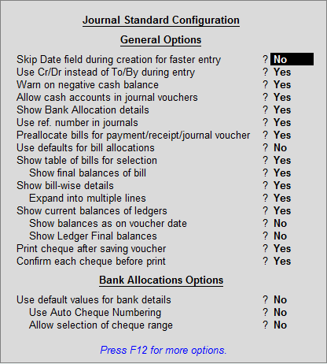
Journal Vouchers - Configuration
Notes:
https://tallygame.com/vouchers/journal-entry-tally-examples/

Slide 17
Journal Vouchers Examples
Outstanding Expense: – Outstanding expenses are
expenses which are due but not paid. Usually telephone bill of January 2014 will be paid on February 2014. but the expense should be recorded in January so as to get an accurate financial report or profit of April month. To do this we use a journal entry at the end of the January by debiting “telephone expense” and crediting “expense payable ledger”. Some other examples of outstanding expenses are Interest payable, Electricity bill payable etc.
Adjustment entries
Depreciation entries

