Slide 1
Masters -Accounting Info Groups, Ledgers, Voucher Types
Sisoft Technologies Pvt Ltd
SRC E7, Shipra Riviera Bazar, Gyan Khand-3, Indirapuram, Ghaziabad
Website: www.sisoft.in Email:info@sisoft.in
Phone: +91-9999-283-283

Slide 2
Chart of Accounts
Capital
Revenue
Liability
Assets
Income
Expense
Equity
Balance Sheet
Profit-Loss Account

Slide 3
Accounting Groups
Account Groups are maintained to determine the hierarchy of Ledger Accounts which is helpful in determining and presenting meaningful and compliant reports.
The Group behaviour is classified into Capital or Revenue and more specifically into Assets, Liabilities, Income and Expenditure.
The Groups ascertain whether the same will affect Profit and Loss Account which is revenue in nature or Balance Sheet which is capital in nature.

Slide 4
Ledgers
A ledger is the actual account head to identify your transactions and are used in all accounting vouchers.
For example, purchase, payments, sales, receipts, and others accounts heads are ledger accounts.
Without a ledger, you cannot record any transaction.
All ledgers have to be classified into groups. These groups and ledgers are classified into profit and loss or balance sheet.
There are two pre-defined ledgers in Tally.ERP 9:
Cash ledger
Profit and loss account

Slide 5
Accounting Groups
Tally provides 28 pre-defined groups. Out of these 28 groups, 15 are primary and 13 sub groups.
Out of 15 groups, 9 groups appear in balance sheet and 6 primary groups appear under profit and loss account.

Slide 6
Predefined Group

Slide 7
Party Accounts/Ledgers

Slide 8
Branch/Divisions
This maintains ledger accounts of all your company's branches, divisions, affiliates, sister concerns, subsidiaries and so on.
Tally.ERP 9 permits Sales and Purchase transactions to take place with accounts opened here.
Remember, these are their accounts in your books and not their books of accounts.
Just treat them as any other party account.
If you wish to maintain the books of a branch/division on your computer, you must open a separate company

Slide 9
Sundry Debtors
Under: Current Assets
One who own money
All customers ledgers are created under this group

Slide 10
Sundry Creditors
Under: Current Liability
From whom we own money
All suppliers ledgers are created under this group

Slide 11
Parties Ledger (Which Group ??)
Parties ledger with whom your company is trading should be opened under any of the following groups (or sub-groups under them):
Sundry Debtors
Sundry Creditors
Branch/Divisions
Tally.ERP 9 classifies debtors, creditors and branch/divisions for convenience.
This helps you in the process of keeping the accounts of a particular group together during display and analysis.
Though you can pass both sales and purchase entries for a party account placed under Sundry Debtors.
Use the classification depending on the most natural group for the party.
Bill-wise allocation and tracking will be available only to the accounts belong to one of these groups.

Slide 12
Owner’s Account Groups
Capital Account ( Under Liability)
This records the Capital and Reserves of the company. The ledgers that belong to Capital Accounts are Share Capital, Partners' Capital A/c, Proprietor's Capital Account and so on.
Reserves and Surplus [Retained Earnings] (Under Capital Accounts)
This contains ledgers like Capital Reserve, General Reserve, Reserve for Depreciation and so on.

Slide 13
Income Ledgers Groups
Sales Account (Under Income)
All trade income accounts fall under Sales Accounts.
You can classify your sales accounts based on Tax slabs or type of sales. This also becomes a simple mechanism for preparation of Tax returns. For example,
Domestic Sales
Export Sales
Now under Domestic Sales open the following ledgers:
Sales (10%)
Sales (5%)
Sales (exempt)
You can even open an account as Sales Returns under the group Domestic Sales to view your net sales after returns (or the returns may be directly passed through Journal against the specific Sales account).

Slide 14
Income Ledgers Groups
Direct Income [Income Direct]
These are Non-trade income accounts that affect Gross Profit. You may also use this group for accounts like Servicing, Contract Charges that follow sales of equipment.
For a professional services company, you may not use Sales Account group at all. Instead, open accounts like Professional Fees under this group.
Indirect Income [Income Indirect]
These are miscellaneous non-sale income accounts. Example: Rent Received and Interest Received.

Slide 15
Expense Ledgers Groups
Purchase Account (Under Expense)
All trade expense accounts fall under Purchase Accounts.
You can classify your purchase accounts based on Tax slabs or type of purchase. This also becomes a simple mechanism for preparation of Tax returns. For example,
Domestic Purchase
Export Purchase
Now under Domestic Purchase open the following ledgers:
Purchases (10%)
Purchases (5%)
Purchases (exempt)
You can even open an account as Purchases Returns under the group Domestic Purchases to view your net purchases after returns (or the returns may be directly passed through Journal against the specific Purchases account).

Slide 16
Expense Ledgers Groups
Direct Expenses [Expenses Direct]
These are Manufacturing or direct trading expenses. These accounts determine the Gross Profit of the company.
Indirect Expenses [Expenses Indirect]
All administrative, selling or non-direct expenses.

Slide 17
Cash/Bank Books
Bank Accounts :
Current account, savings account, short term deposit accounts and so on.
Cash-in hand :
Tally.ERP 9 automatically creates Cash A/c in this group. You can open more than one cash account, if necessary.

Slide 18
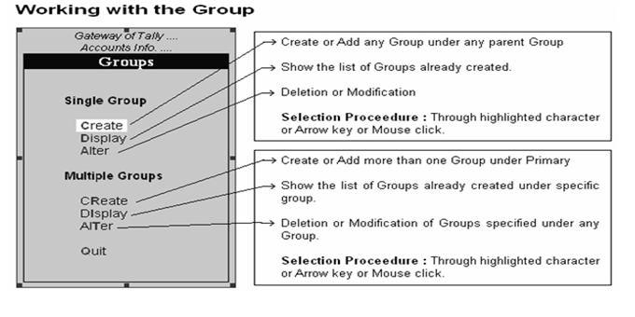
Working with Groups

Slide 19
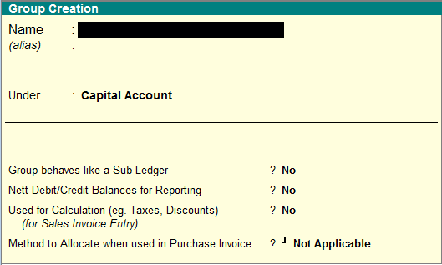
Working with Groups: Creation
Notes:
Cover Alter and Delete here.

Slide 20
Group Configuration

Slide 21
Group Creation – Advance Options
Group behaves like a Sub-Ledger
When activating Group behaves like sub ledger you will not see the ledger wise break-up of that particular group. You can view only the summary of that group as sub ledger.
Net Debit/Credit Balance for Reporting
The net balance of group, which means that no Debit balance total or credit balance total will not displayed instead Net debit or credit balance
Used for Calculation (eg Taxes/Discounts) For sales Invoice Entry
set automatic calculation for discounts taxes etc.
Method to allocate when used in purchase invoice
This is used to allocate expense in the reation of value or quantity or value.

Slide 22
Predefined Group

Slide 23
Assignments
Review Groups and Classify them in Assets, Liability, Income and Expense

Slide 24
Ledgers

Slide 25
Predefined Ledgers
Cash
The cash ledger is grouped under cash-in-hand.
You can enter the opening balance as on the day the books begin.
This ledger can be altered and deleted.
Profit and Loss Accounts
The profit and loss account ledger is grouped under primary.
The previous year's profit or loss is entered as opening balance of the ledger. The balance entered is the opening profit/loss. It is shown in the balance sheet as opening of the profit and loss account in the liabilities.
This ledger can not be deleted but it can be modified.

Slide 26
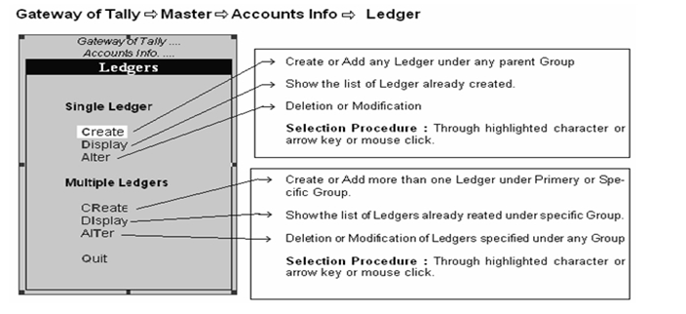
Working with Ledger(बही- खाता)

Slide 27
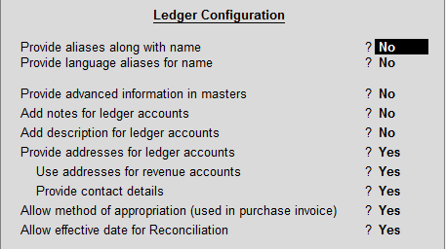
Ledger Configuration

Slide 28
Multiple ledger

Slide 29
Assignments
Create Ledgers With Opening Balance

Slide 30
Voucher Types
Accounting Vouchers
(Receipt, Payment, Contra and Journal )
Billing/Invoice Vouchers
(Sale, Credit Note, Purchase, Debit Note
Inventory Vouchers
( Stock Journal and Physical Stock Voucher
Order Vouchers
( Sales Order, Delivery Note, Rejection Ins)
(Purchase order, Receipt Note, Rejection Outs)

Slide 31
Voucher Types - Configuration
Have the different Voucher numbering methods.
Give own prefix and suffix details for the voucher numbering.
Use the Effective Dates for the vouchers.
By default, make some vouchers optional if required.
Decide to have the Common Narration or Narration for each entry.
Automate the printing immediately after saving the vouchers.
Get separate reports for each type of voucher.

