Slide 1
Sisoft Technologies Pvt Ltd
SRC E7, Shipra Riviera Bazar, Gyan Khand-3, Indirapuram, Ghaziabad
Website: www.sisoft.in Email:info@sisoft.in
Phone: +91-9999-283-283

Slide 2
LEARNING TOPICS
What is Wordpress?
History of Worpress
Demand of Worpress
Wordpress Installation
Wordpress Login
Wordpress Themes
Creating posts
Creating blogs
Creating Links
WordPress Plugins

Slide 3
Wordpress is powerful CMS for making dynamic and interactive Websites quickly.
Wordpress allows users to build dynamic websites and blogs that may be updated customized and managed from its back-end.
⦿
⦿
⦿
⦿

Slide 4
Wordpress started in 2003 with a single bit of code
Since then it has grown to be the largest self- hosted blogging tool in the world, used on millions of sites and seen by ten millions of people every day
Matt Mullenweg and mike little co-founded wordpress

Slide 8
Open source web Application
Superb plugins are available
Create web application in short period
Safe and secure websites
Easy to use
Create Multi-Author Sites
SEO(Search engine optimization) friendly
Create Responsive website
Best blogging platform

Slide 10
WWW.Wordpress.org
Use your own domain name
This is used to create Website
Upload and install themes and
plugins
Edit the code behind your site
Install a plugin, like Jetpack, to enable sharing functionality on your site. Visit the WordPress.org support forums for assistance.
No registration
with WordPress.org is required.
WWW.Wordpress.com
No hosting costs
This is used to createblog
No managing a web server Easy to set up
No Customization option
No uploading custom theme
No uploading plugins
No access to your site’s code

Slide 11
Wamp Server/Xampp Server
Wordpress Package
Any smart editor(Dreamweaver and notepad++)

Slide 13
Step 1:Already Install wamp server Step 2: Start Server
Step 3:copy WordPress package in directory(www) Step 4:Goto PHPmyadmin and Create Database

Slide 15
Open wordpress package in browser(localhost/yourfoldername).

Slide 20
Goto browser localhost/yourwpname/wp-admin

Slide 22
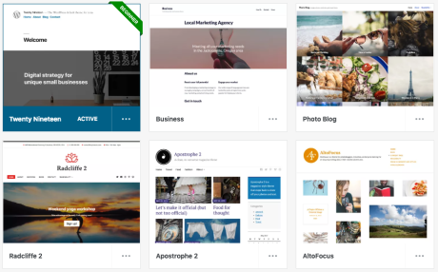
WordPress Themes
What is a Theme?
A theme is the overall look and feel of your site. A theme defines where menus and widgets appear on your site, as well as the color scheme and the default layout of pages and posts.
Examples of Themes in our Theme Showcase

Slide 23
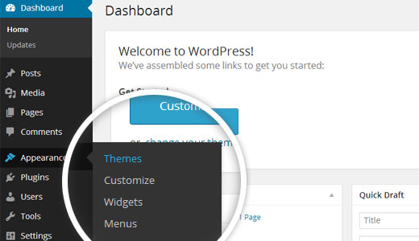
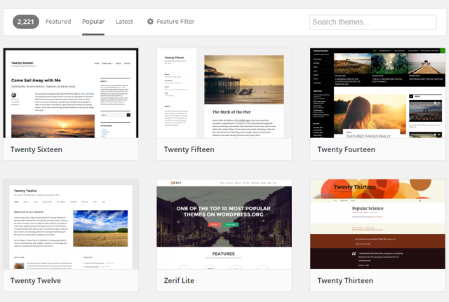
View Themes
We have a Theme Showcase full of 300 different designs, layouts, and color schemes to suit your site’s needs.

Slide 24
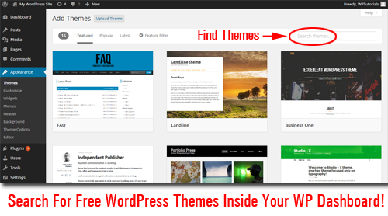
Search for a Theme
Looking for a particular theme or a feature? Enter your keyword in the search box, and you’ll only be shown themes that match.
Click on Feature Filter to filter to the themes available to all sites, or click on Popular to filter to themes included in the Premium or higher plan. Premium themes can also be purchased for use on a site that doesn’t have a Premium or higher plan.

Slide 25
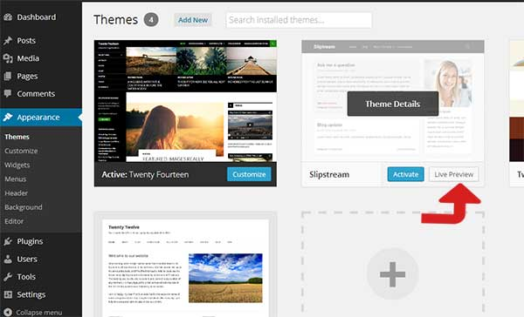
Theme Menu
Live Preview – A specially designed site showcasing all of the features of a particular theme
Activate – immediately apply the theme to your live site
Customize – view what your site with your content will look like with the new theme

Slide 26
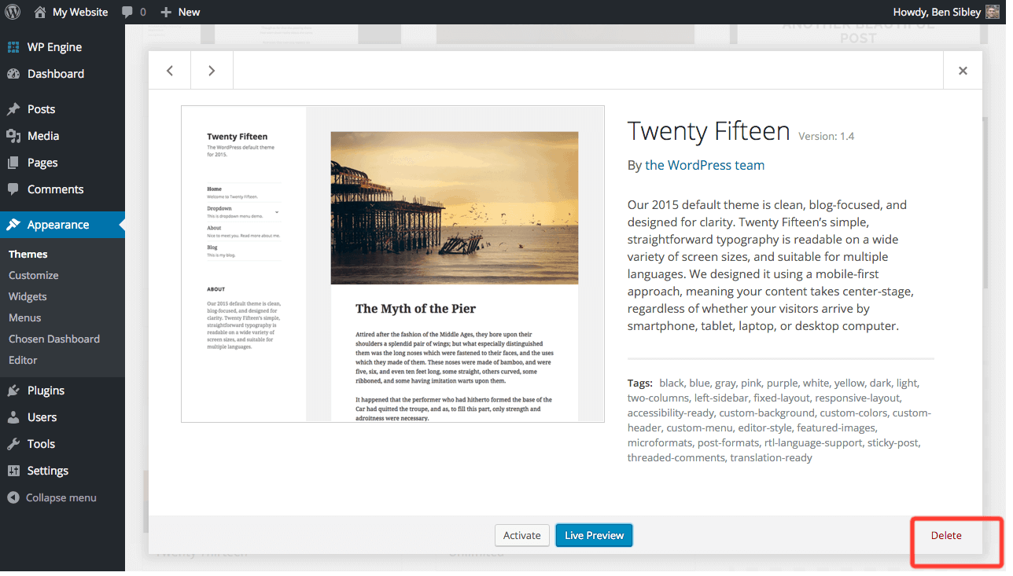
Preview Menu

Slide 27
THE DO’S AND DON’TS OF CHOOSING A WORDPRESS THEME
Make a list of all the features you’re looking for in a theme. The WordPress feature filter makes it easy for you to customize your theme search based on the features you want.
2. Choose a theme with s responsive design. It should be compatible with various devices and also, mobile-friendly.
3. Go for a paid theme. While you may be looking to create a website on a budget, free themes are not regularly updated and they lack support. Premium these are updated, offer more features, are customizable, and are supported.
4. Ensure the theme works on various browsers such as Mozilla and Google Chrome.
5. Read online reviews before choosing a certain theme. This way, you’ll get firsthand information on how the theme is.
6. Test a potential them thoroughly before putting it to actual use.
7. Do choose a theme which is SEO friendly.
THE DOS OF CHOOSING A WORDPRESS THEME:

Slide 28
THE DO’S AND DON’TS OF CHOOSING A WORDPRESS THEME (Contd..)
Don’t go for a bloated theme. While these themes may have lots of features, they tend to run slow and distract users.
2. Don’t choose a theme with hard-to-read fonts. The fonts should be easily readable and simple.
3. Don’t forget to consider its color. Visual appearance plays a big role when it comes to website design. Don’t choose extremely bright or extremely dark colors; they should appeal to every user.
4. Don’t forget to choose a theme that supports various plugins such as Yoast and others.
5. Don’t choose a theme without examining your competitors. If you’re looking to stand out from the rest, conduct research on your competitors. This way, you will know what to improve and what to add to your theme so that you can beat them.
These are some of the dos and don’ts you need to consider before choosing a WordPress theme. There are lots of them available and it’s up to you to choose the right one.

Slide 29
A
Fig. 4
The Dashboard
The Dashboard is the entry page to the Administration portion of Wordpress (Fig. 4). You can ignore most of the information here for now. As you become more comfortable with basic writing and editing of your posts, pages and links, you may wish to use the additional information for managing your site.
For now, notice the second navigation box on the left-hand side of the screen (A)

Slide 30
A
B
Fig. 4
The Dashboard
Let’s clarify the terms “Posts” (A) and “Pages” (B) in Wordpress. Normally, you will want to write a new Post. “Posts” are organized around categories (e.g., Blog, News, Products, Articles, Services, Resources, Healthy Snacks) while “Pages” have no category and stand alone (e.g., Contact Us, Legal Disclaimer, Terms of Service, Thank You for Shopping With Us).

Slide 31
Why Write Posts instead of Pages?
If you use “posts” and “categories”, Wordpress can organize your site navigation and information architecture for you. This is one of the biggest advantages to using a Content Management System (CMS) program instead of coding individual web pages by hand.
Organizing around posts can also improve your SEO rankings, especially if you create categories based on your keyword phrases.
Don’t be surprised if you never write a “page” after your site is set up. So plan on writing a new post. Let’s write one now!
*Note: Posts are entries organized by categories automatically making the site more user-friendly for you, your visitors and search engines.

Slide 32
A
Fig. 5
Writing a New Post
To start writing a new post for your web site, click the Add New link in the Posts menu (Fig. 5 (A)).
If you don’t see, the Posts menu, click on the Expand/Contract triangle which is located where the red arrow is pointing.

Slide 33
{
A. This is the Title input box
Navigation Menus
B. This is the Entry or Content
input box.
Fig. 6
Writing a New Post
You are now at the “Add New Post” screen. Before you start typing, notice that the left-hand navigation menus remain the same. Also, notice the names of your input boxes: Title and Entry. The Title will be the title of your posts while the Entry will be the content or body of your post.
Before you type your entry, let’s talk about the importance of Titles.

Slide 34
Tips On Titles
Ideally, your post title should contain at least one of your keywords or phrases. This improves your SEO (search engine optimization).
Don’t make the title too long or keyword stuffed. Assuming “aging” is one of your keywords, “Top 10 Tips for Healthy Aging” is better than “Top 10 Aging Tips for Optimal Aging No Matter What Your Age”.
Choose your title before you start to write. Otherwise, Wordpress’s auto-save feature may assign the title before you’ve perfected it.
Always spell-check your title before saving. Why? Because you should...
NEVER change the title of a post once you have saved and published it (i.e., made it public). Changing a post title can cause all kinds of problems both for your site navigation, and for your SEO. Get your title right before you write.

Slide 35
A
This is the Title of your new post
And here is the content (or body) of your post entry.
B
Fig. 7
Writing a New Post
Type your post’s title in the Title Input Box (A).
Next, put your text into the Entry/Content input box (B). You can type the text or copy-and-paste it into the box.
Next, you’ll add some tags.

Slide 36
Tips On Tags
Tags are key words or phrases that help your target audience find the right content. They are used extensively by various search engines. You should have no more than 2-5 tags per entry.
Your tags must be relevant to your content or you will be penalized by the search engines. Your tags should appear in the body of your entry in exactly the same way. For example, the tag “energy therapy” is not the same as “energy therapies” or “energy techniques”.
You should be using the tags/keyword phrases that are the most relevant to your target audience and your content should be built around your tags/keyword phrases.
You should use a few tags often. You don’t want a bunch of tags that are used only once or twice on your site. The more often you use a tag, the more significant it becomes to the search engines.
You should use tags/keyword phrases that people actually search for. It doesn’t do any good to use the tag “cooking porcupine” if no one is searching on that phrase.

Slide 37
A
B
Fig. 8
Writing a New Post — Adding Tags
The tag entry box is on the right-hand side of the screen.
Type your tags/keyword phrases separated by comas in the Tags input box (A).
Then click on the Add button (B).

Slide 38
A
Fig. 9
Writing a New Post — Adding Tags
After clicking on the Add button, you should see a list of your tags below “Tags used on this post” (A).
You’re almost done, but before you publish, let’s choose a category and decide whether to allow comments or not.

Slide 39
A
{
Current Categories with check boxes to select
Fig. 10
Writing a New Post — Selecting a Category
Scroll down until you see Categories box (A).
To select a category for your post, click the check box beside the category name.
Your list of categories will be different than the one in Fig. 10. If you have not created any categories, the default category “Uncategorized” will be listed. You’ll learn about adding categories later.

Slide 40
A
Fig. 11
Writing a New Post — Comments
At the bottom of your Post entry screen, you’ll see a box labeled “Discussion” with 2 check boxes (A). This allows you to control whether site visitors can submit a comment about this post. The default setting allows comments. There can be SEO advantages to allowing comments, however, if you do not want to allow comments on this post, click the check box so that the checkbox is cleared.

Slide 41
A
Fig. 12
Writing a New Post — Publishing
You have a Title, Body Content, Tags, assigned a Category and decided whether or not to allow comments. You’re now ready to publish (i.e. make the post visible on the web) your first post. Scroll back to the top of the page.
To publish, click the publish button (A).

Slide 42
A
Fig. 13
Writing a New Post — Publishing
A few moments after clicking the Publish button, the screen should refresh and you will see a yellow band across the top with the notice “Post published” and a link to “View post” (A).
To view your new post, click the View post link.

Slide 43
Fig. 14
Writing a New Post — Publishing
And you should see your brand new post on your web site. Congratulations! You’ve created your first post.
But wait there’s more, (like removing this bogus post from your site). Next we’ll look at basic editing.

Slide 44
A
Fig. 15
Editing a Post
To begin editing a Post, return to your Wordpress Administration:
Click the “Site Admin” link of your web site navigation (under Admin or Meta) (for example, (A) ), OR
Click the Back button of your web browser, OR
Type in the URL to you WP Admin in your browser (for example, http://northeastwebdesign.com/wp-admin)

Slide 45
A
Fig. 16
Editing a Post
However, you get to your WP Administration, the important thing is the Posts link in the left-hand Posts navigation box (A).
Click on the Posts link.

Slide 46
A
Fig. 17
Editing a Post
You should see a list of all of your posts similar to Fig. 17. The top-most post should be the one you just published.
To edit a post, click on the post’s title (A).

Slide 47
B
A
Fig. 17
Editing a Post
You should see your example post with the title, content, tags and category filled in. You’ll notice one little difference — the Publish box now has an Update Post button instead of Publish (A).
Now notice the row of icons just above your body content. These are your basic editing buttons. [Do the icon buttons look different?] Make certain you are in Visual edit mode by clicking on the Visual tab (B). ]

Slide 48
A
Fig. 18
Editing a Post
Let’s format some text.
Highlight some text and the click the Bold button (A).

Slide 49
A
Fig. 18
Editing a Post
Your highlighted text should now appear bold.
So let’s talk about all the icon buttons and what they do.
Click on the last icon (A)..

Slide 50
Fig. 19
Editing a Post — The Editing Icons In Detail
1 Bold
2 Italic
3 Strikethrough: Used most often to denote a correction or change from the original text.
4 Bulleted List
5 Numbered List
6 Blockquote: Indents a paragraph both right and left. This will look different depending upon your theme’s stylesheet.
7 Paragraph Alignment: Left, Center, Right
8 Link/Unlink: For adding or removing a web hyperlink. The icons are grayed out until text is highlighted.
9 More Tag: Inserts the word “More” and a link to the complete post allowing you to set the excerpt for a post ends in archive and other aggregate pages.
10 Spellcheck Toggle: Turns the spellchecker on and off. When on, misspelled words are underlined in red.
11 Expanded Menu Bar — Click on this icon to show (or hide) the second row of icons. There are very few of the additional editing features that you’ll need right now, but there are a few useful ones. These include:
12 Formatting List — This provides a drop-down list of additional HTML codes, such as Headings, that can be used to format text.
13 Copy-and-Paste Plain Text — Click on this icon when you are pasting plain text, such as text from a web page, into your post.
14 Copy-and-Paste MS Word Text — Click this icon when you are pasting text that was original written in Microsoft Word to avoid the custom editing code and characters that MS Word uses are not pasted into your post. It also makes for safer posts, ensuring your aren’t copying some hidden code that can be carried from MS Word.
15 Special character palette — If you want to use a special character, such as a foreign character or a financial or math symbol, clicking on this button where give you a pop-up window of HTML entities that you can click on to insert a character.

Slide 51
A
Fig. 20
Editing a Post — Add a Hyperlink
Let’s add a hyperlink to our sample post.
Highlighted some text and then click the Link icon button (A).
A pop-up form should appear. Type in the URL of the link (e.g., http://google.com).
You can also choose the “target window” for your link from the Target drop-down menu if you want the link to open in a new window.
You don’t need to worry about “Title” and “Class” at this point. Just ignore for the moment.

Slide 52
A
Fig. 21
Editing a Post — Add a Hyperlink
You can always cut-and-paste a URL from your browser which is very helpful for long web addresses (or if you concerned about typos.)
Once you have your URL in place, click the Insert button (A).

Slide 53
B
A
Fig. 22
Editing a Post — Add a Hyperlink
You should see you hyperlink in color and underlined (A).
Before we jump into adding photos or other media, let’s take a look at what the actual HTML code is looking like.
Click on the HTML tab at the top of the input box (B).

Slide 54
A
Everything between
the anchor or “a” tags
is a link.
Everything between the strong tags
will be bold. “strong” is HTML for bold.
Fig. 23
Editing a Post — HTML View
Aren’t you glad you don’t have to hand-code the HTML? It can be useful to look at the HTML. Note that each of the HTML code tags come in pairs. If you seem to have a formatting error that you can’t correct, be sure you have both tags and that only the text you want is between the tags. Now let’s return to Visual view.
Click on the Visual tab at the top of the input box (A).

Slide 55
Upload Menu
{
A
Add Other File Types, e.g. PDF
Add Music
Add Video
Add Photo/Image
Fig. 24
Editing a Post — Adding Photos and Other Media
The Upload/Insert Menu sits just above the editing icons row (A). The first icon looks like a film slide or framed picture, depending upon your view. This is the add photo or image icon button.
Place your cursor where you want to place your photo in the content body input box.
Now click on the Add Photo icon button.

Slide 56
Fig. 25
Editing a Post — Adding Photos and Other Media
The Add an Image pop-up form should appear.
To add a photo/image from your computer, click the Browse button or select files button.
A window of your computer directory should appear. Navigate to the photo/image that you want to use and double-click on it. (You also may click on the Open button). The photo/image file will be uploaded to the web server.

Slide 57
**If you get a permission error or can’t see your photo/image, you may need to set the permission on your /uploads and/or your /wp-content directories to 777. And if you do not know what this means, ask your server administrator or support team.
Click the X in the left-hand corner of the input box and go on to the next section for now.
A
B
Fig. 26
Editing a Post — Adding Photos and Other Media
Once the photo/image is uploaded, you should see a thumbnail of your photo/image and the information input form.
The Title field should be filled in with the file name of your photo, but you should change it to something more descriptive and, if possible, using a relevant keyword phrase (A). Search engines check your image title and alt tags.
The Caption field is very important (B). Let’s take a moment to look at why.

Slide 58
Editing a Post — Adding Photos and Other Media
While the photo/image Title field is important because it’s also used in determining Page Ranking by search engines, the Caption field is very important for a number of reasons:
First, the caption text becomes the alternative (alt) attribute text in the image tag. The alt attribute is used by browsers for the visually impaired or when the image link is broken.
Second, Google and other search engines are giving more weight to the text in the alt attribute when determining search rankings. Your captions can make a big impact on your SEO.
Third, since the 196o’s it’s been known in marketing that over 90% will read the caption of a photo even if they don’t read anything else.
So the ideal caption should be relevant to your topic, contain your main point or call to action and include one of your keyword phrases. It’s a lot of work for a short sentence! It’s worthwhile to put a little time and thought into your photo/image captions.
No matter how tempting, NEVER keyword stuff your captions. Google will penalize your Page Rank for attempting to scam them.

Slide 59
A
B
Fig. 27
Editing a Post — Adding Photos and Other Media
Now you should have your Title field and your Caption field typed in. The Description field isn’t important. It’s only used to described the photo in the WP Administration Media list.
When the image is placed in your post, a link to another page or to the full-size image can be attached. You can link your image to any web address by typing or copying-and-pasting the URL in the Link URL field (A). By default, Wordpress automatically fills in the URL of the full-size image file. If you don’t want any link attached to your image, click the None button (B).

Slide 60
A
Fig. 28
Editing a Post — Adding Photos and Other Media
Alignment (A) determines how your text wraps around the image in your post: None means the body text won’t wrap around but sit above or below the image. Left puts the body text to the right side of the image. Center means that image will be centered in the body text. Right puts the body text to the left side of the picture.
Click the radio button next to your choice of image alignment.

Slide 61
A
Fig. 29
B
Editing a Post — Adding Photos and Other Media
You have several choices in display Size (A). Thumbnail places small version of the image in the post. Medium places a larger version. If the Large setting has been specified in your set up, the pixel size will be listed. Or you can place the Full size image in the post. WP 2.9 puts the pixel size below each of your options (B). If you don’t know the maximum width of your content column, your safest choice is Medium with a link to the full-size image (File URL) in the Link URL field.
Click the radio button next to your choice of image size.

Slide 62
A
Fig. 29
Editing a Post — Adding Photos and Other Media
Once you have the Title, Caption, Link URL, Alignment and Size fields completed, you are ready to place your photo/image into your post — finally!
Click the Insert into Post button (A).

Slide 63
A
Fig. 29
Editing a Post — Adding Photos and Other Media
And here we are! A medium-sized photo is now placed in the post.
There’s just one more thing to do to save the changes —
Click the Update Post button in the Publish box (A).

Slide 64
Fig. 30
Editing a Post — Adding Photos and Other Media
Go to your web site and you should see your sample post with your bold text, hyperlink and photo.
Of course, you don’t want to leave this sample post on your site, so let’s delete it.
Return to the Wordpress Administration.

Slide 65
C
A
Edit | Quick Edit | Delete | View
Fig. 31
Editing a Post — Deleting Posts
Click on the Posts link to get your lists of posts (A).
There are 3 ways to delete a post.
Method 1:
Place your cursor by the title of the post you want to delete. You should see a list of links: Edit | Quick Edit | Trash| View.
To delete the post, click on Trash (B).
Method 2:
Click the check box beside the Title of the post you want to delete and select Delete from the Bulk Actions drop-down menu (C). This is a good way to delete several posts at once, however, you probably don’t want to delete posts often. We’ll discuss that in a moment.
B

Slide 66
A
Fig. 31
Editing a Post — Deleting Posts
Method 3:
The 3rd way to delete a post is:
Open the post as if you were going to edit it by clicking on the Title.
Click on the Move to Trash link (A) in the Publish form.
But you may want to think twice before Deleting.

Slide 67
A
Fig. 32
Editing a Post — Deleting Posts
There are several reasons why you should limit the number of posts you delete.
SEO & SEM: When you delete a post, all of the information about the post is removed from the Wordpress database. It is irretrievably gone forever. Removing posts from your site can harm your search engine ranking. Older, sometimes out of date, pages often get ranked higher than new pages because they have been indexed longer and because there are more links to them. If you delete a page, someone (and search engines) following an older link will get a 404-Page Not Found Error. It’s better to simply make a note on the page that the information has been surpassed by new information and provide a link to the new content (or 301 Redirects). In addition, sites with more content rank higher, so you want to keep adding content instead of exchanging it.
Efficiency: If you have content that is relevant for specific periods of time on a regular basis, for example seasonal content such as event information, holiday information or annual sales, rather than re-write the post from scratch, simply put it in storage and then edit or copy-and-paste bits the next time you need it. How?
To change the status of a post, Click on the “Edit” link beside the Status info in the Publish input box (A) and select “Draft” from the options menu.

Slide 68
A
Fig. 33
Adding & Editing Categories
The ability to organize posts by categories (or subjects) is one of the greatest strengths of a Content Management System (CMS) like Wordpress. Even if you have already published the content, you can change posts categories and re-organize your web site instantly.
To get to the Categories administration view, Click on the “Categories” link in the Posts navigation menu (A).

Slide 69
Fig. 34
Adding & Editing Categories
It’s best to start with a small group of broad categories. If you find that 10% or more of a category is on the same sub-topic, then it might be good candidate for its own category or child category.
You can also assign a post to more than one category, but beware — to visitors, including search engines, it looks like 2 web pages with the exact same content. Google and other search engines will penalize your ranking for duplicate content on a site.

Slide 70
You can see at a glance how many posts are in each category.
A
Your default category won’t have a check box.
B
Fig. 35
Adding & Editing Categories
To add a new category:
Type the category name as it will appear in the navigation menu on your web site into the Category Name input box (A).
Type the slug — the Internet-friendly version (which means no spaces) — into the Category Slug input box (B).

Slide 71
A
Fig. 36
Adding & Editing Categories
To add a new category:
Wordpress allows sub- or child- categories under a parent category. For example, you may have a parent-category named “Products” with 2 child-categories of “T-shirts” and “Sneakers.”
If you wish to make the new category a child (or sub-category, select the Parent category from the Category Parent drop-down menu (A). Usually, the Category Parent remains None.

Slide 72
A
Fig. 37
Adding & Editing Categories
To add a new category:
The Description is optional. It’s useful in giving more detail about a category if multiple people will be contributing to the site.
If you wish to add a category description, type it into the Description text input box (A).

Slide 73
A
Fig. 38
Adding & Editing Categories
To add a new category:
Once you have entered your Category Name and Category Slug and any of the other category settings your wish,
Click the Add Category button (A). 20

Slide 74
Edit | Quick Edit | Delete
Fig. 38
Adding & Editing Categories
And the new category is added to your category list!
You can edit or delete categories from the list, the same ways that you edited or deleted posts:
Click on the Name OR
Hover your cursor by the Name and click on the function you want ( Edit | Quit Edit | Delete ) OR
Bulk Delete by clicking the check boxes by the category names & selecting from the drop-down box.
The default category will be applied to all posts associated with a deleted category.

Slide 75
Edit | Quick Edit | Delete
A
Fig. 39
Adding & Editing Pages
Now that you understand creating and editing posts, pages will be a snap!
Click on the Pages in your Administrations left-hand navigation (A). You should see a list of your current pages. By default, there should be at least an About page. It works like your Posts list.
Click on the Title OR
Hover your cursor by the Title and click on the function you want ( Edit | Quit Edit | Delete ) OR
Bulk Delete by clicking the check boxes by the page titles & selecting from the drop-down box.
Let’s edit the About page.

Slide 76
Fig. 40
Adding & Editing Pages
The Edit Page for should look familiar. The editing options are the same as for a posts — except that you do not choose a category.
Remember, Never change the Title! If you want to change the page Title, you should create a new page, copy over the text from the current page and delete the page with the wrong title.
For now go ahead and make a change in the body content.

Slide 77
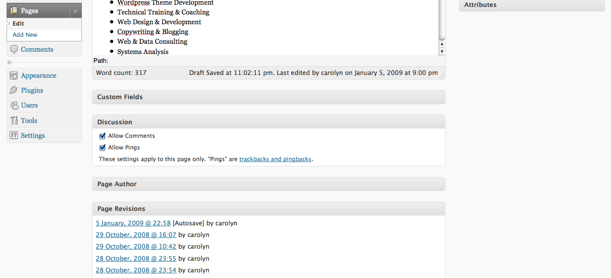
A
Fig. 41
Adding & Editing Pages
Scroll down until you see the Discussion box.
If the Discussion box is not open, click on the arrow in the right-hand corner (A).
Again, you can decide if you want to allow comments on the page or not.
Now scroll back up to the top of the page.

Slide 78
A
B
Fig. 42
Adding & Editing Pages
To save your page changes, click on the Update Page button (A).
To add a new page, click Add New in the Pages navigation box in the left-hand column (B).
Now you know how to add and edit pages. Let’s look at one more thing — Links.

Slide 79
Edit | Quick Edit | Delete
A
B
Fig. 43
Adding & Editing Links
Links are sometimes called a “blogroll.” Like posts, they are organized by categories. The blogroll/links are a widget that usually appears in the site’s sidebar navigation.
Click on Links button in the navigation box in the left-hand column (A).
Once again you see a list. In this case, a list of your current links. And editing or deleting a Link Name is just like editing/deleting posts or pages. So let’s just jump ahead adding a new link.
Click on Add New link in the Links navigation box (B).

Slide 80
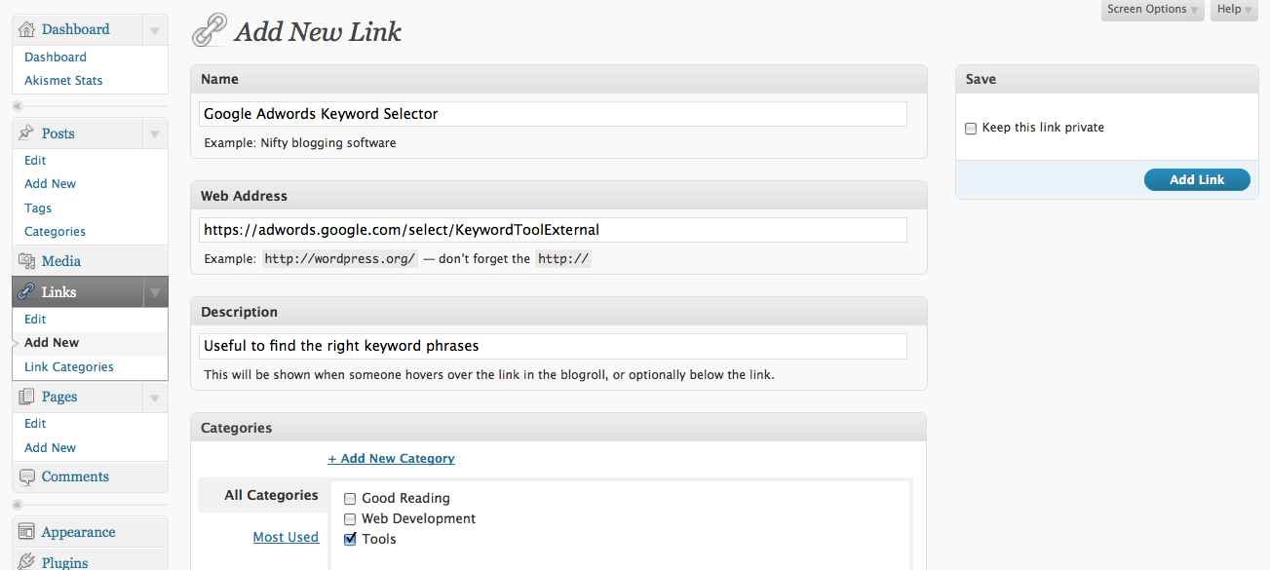
A
B
E
C
D
Fig. 44
Adding & Editing Links
To Add a New Link:
Type in the Name of the link as it will appear in the blogroll/link list (A).
Type or Copy-and-Paste the URL (hyperlink) in the Web Address (B).
If you want, you can add a description of the link (C).
Select a category (otherwise the default category will be assigned) (D).
Click the Add Link button (E).

Slide 81
A
Fig. 45
Adding & Editing Links
You should see a yellow band across the top, below the Add New Link heading, that says Link added (A).

Slide 82
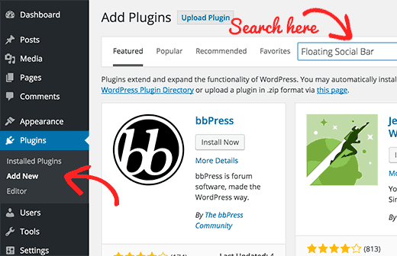
WordPress Plugins
Install a Plugin using WordPress Plugin Search
The easiest way of installing a WordPress plugin is to use the plugin search. The only downside of this option is that a plugin must be in the WordPress plugin directory which is limited to only free plugins.
First thing you need to do is go to your WordPress admin area and click on Plugins » Add New.

Slide 83
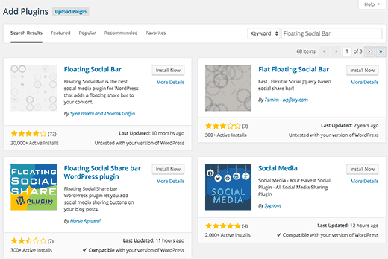
You will see a screen like the one in the screenshot above. Find the plugin by typing the plugin name or the functionality you are looking for, like we did. After that, you will see a bunch of listings like the example below:
You can pick the plugin that is best for you. Since in our search, we were looking for Floating Social Bar which happens to be the first plugin, we will click the ‘Install Now’ button.
WordPress will now download and install the plugin for you. After this, you will see the success message with a link to activate the plugin or return to plugin installer.

Slide 84
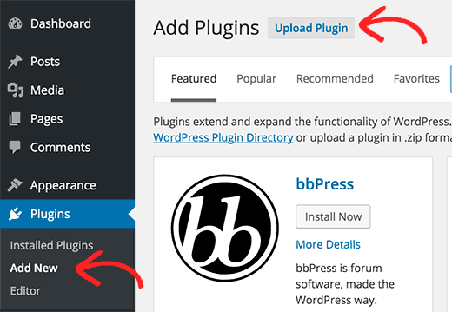
Install a Plugin using the WordPress Admin Plugin Upload
Paid WordPress plugins are not listed in the WordPress plugin directory. These plugins cannot be installed using the first method.
That’s why WordPress has the Upload method to install such plugins. We will show you how to install WordPress plugins using the upload option in the admin area.
First, you need to download the plugin from the source (which will be a zip file). Next, you need to go to WordPress admin area and visit Plugins » Add New page.
After that, click on the Upload Plugin button on top of the page.

Slide 85
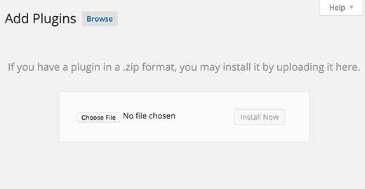
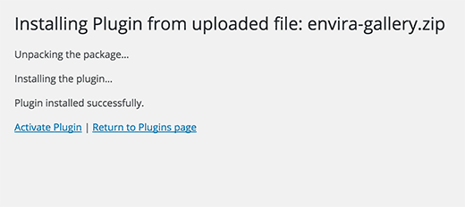
This will bring you to the plugin upload page. Here you need to click on the choose file button and select the plugin file you downloaded earlier to your computer.
After you have selected the file, you need to click on the install now button.
WordPress will now upload the plugin file from your computer and install it for you. You will see a success message like this after the installation is finished.
Once installed, you need to click on the Activate Plugin link to start using the plugin.
You would have to configure the settings to fit your needs. These settings will vary for each plugin therefore we will not be covering that in this post.

Slide 86
Thank You
Sisoft Technologies Pvt Ltd
SRC E7, Shipra Riviera Bazar, Gyan Khand-3, Indirapuram, Ghaziabad
Website: www.sisoft.in Email:info@sisoft.in
Phone: +91-9999-283-283

