Slide 1
Restricting Access
User authentication, passwords

Slide 2
User Authentication
Nowadays most internet applications are available only for registered (paying) users
How do we restrict access to our website only to privileged users?
Use login forms for user authentication

Slide 3
A simple login script
<html>
<head><title>User Authentication</title></head>
<body>
<?php
$user = strtolower($_POST["user"]);
$pass = strtolower($_POST["pass"]);
if (isset($user) && isset($pass) && $user=="php5" && $pass=="iscool") {
?>
<h1>Welcome! Here is the truth about aliens visiting Earth ...</h1>
<?php
} else {
?>
<h3>Please login</h3>
<form method=post>
User name: <input type=text name=user /><br/>
Password: <input type=password name=pass /><br />
<input type=submit name=submit value=Login />
</form>
<?php
}
?>
</body>
</html>
What are the limitations of this?

Slide 4
Limitations of simple login script
It only protects the page on which it is included.
We could include it on all pages we wish to protect using something like:
include “login.php”
Clearly not a good solution!

Slide 5
include
vars.php
<?php
$color = 'green';
$fruit = 'apple';
?>
test.php
<?php
echo "A $color $fruit"; // A
include 'vars.php';
echo "A $color $fruit"; // A green apple
?>
When a file is included, the code it contains inherits the variable scope of the line on which the include occurs.

Slide 6
PHP Sessions
Create a true login “session”
Use session variables to tag a “logged in” status

Slide 7
Login script using sessions
<?php
session_start();
if (isset( $_POST["submit"] ) )// Have the credentials been submitted?
{
$user = strtolower($_POST["user"]);
$pass = strtolower($_POST["pass"]);
if ($user=="dug" && $pass=="paradise") {
$_SESSION["username"] = $user;
}
else {
echo "<p>Login incorrect!";
}
} ?>
<html><head><title>Authentication</title></head><body>
<?php
if (isset( $_SESSION["username"] ) ) {
echo "<p>You are logged in";
} else {
?>
<h3>Please login</h3>
<form method=post>
User name: <input type=text name=user /><br/>
Password: <input type=password name=pass /><br />
<input type=submit name=submit value=Login />
</form>
<?php } ?>

Slide 8
More Advanced logins
Redirect after logging in
Store login information for registered users
  Take login information from a file storing usernames and passwords of registered users
  Store this information in a database (see later)
  Raises issues of data security.

Slide 9
Authentication using Apache
Part 1: Server Configuration: httpd.conf

Slide 10
Apache
Authentication:
  Verify if the user/passwd correct
Authorization:
  Once authenticated, does user have permission?
Access control
  Grant or deny access based on some criteria
  e.g., IP address, group name, domain ...

Slide 11
File-based authentication
Apache has a module that provides authentication
  mod_auth_basic
  Similar to /etc/passwd in Unix
  Entries look like admin:kajsJjkh97U (encrypted)
To add a user (Linux and Windows)
  htpasswd -c <file> <userid>
    This creates a new file with encrypted passwords
  htpasswd <file> <userid2>
    Appends other users

Slide 12

Creating a user password file
  SYNTAX: htpasswd -c <file> <userid>
C:\Program Files (x86)\EasyPHP-5.3.3\apache\bin>htpasswd -c password napoleon
Automatically using MD5 format.
New password: ********
Re-type new password: ********
Adding password for user napoleon
Create a new file (will delete if it exists already)
To create the file, use the htpasswd utility that came with Apache. This is located in the bin directory of wherever you installed Apache.
Filename: password
napoleon:$apr1$B5gzgGKw$AWVqtO2Romn5B4Zkc1bPk0
Encrypted password = hash key or message digest
- One way

Slide 13
Settings for this Example
Note: The password file was moved to another directory.
Password File:
C:\Program Files (x86)\EasyPHP-5.3.3\apache\users\password
Restricted Directory:
C:\Program Files (x86)\EasyPHP-5.3.3\www\protected

Slide 14
Configuring Apache: httpd.conf
Directory you want to restrict access to
Filename: httpd.conf
<Directory "${path}/www/protected">
  AuthUserFile "${path}/apache/users/password"
  AuthName "This is a protected area"
  AuthGroupFile /dev/null
  AuthType Basic
  Require valid-user
</Directory>
File containing user passwords
Putting authentication directives in a <Directory> section, in your main server configuration file, is the preferred way
${path} = directory of easyPHP

Slide 15
Configuration Parameters
AuthUserFile | The location of the password file.
AuthName | The authentication realm or name. This is the message that the user will see in the username/password pop-up.
AuthGroupFile | The location of the group file, if any.
AuthType | The type of authentication being used.
Require | What conditions need to be satisfied in order to allow the user through. It could be more than one condition.

Slide 16
Summary of Steps
Create a password file.
Move the password file into a separate folder.
Create a directory to be restricted access to.
Modify Apache’s httpd.conf.
Restart Apache webserver after making the modifications.

Slide 17
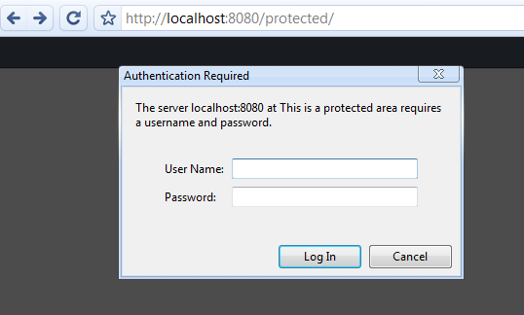
Sample Run: Accessing a “protected” section of your site
a dialog box automatically pops-up for user authentication

Slide 18
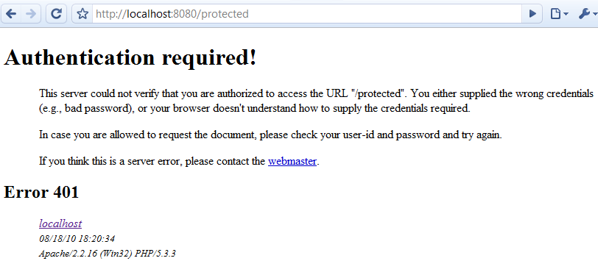
Sample Run: Invalid user name, password!

Slide 19
Demo
See Apache configuration, using EasyPHP.
Find mod_auth_basic

Slide 20
Authentication using Apache
Part 2: .htaccess files
The .htaccess file is used to override default server settings in particular folders (directories).
.htaccess files should be used only if you don't have access to the main server configuration file

Slide 21
File-based authentication
By default overriding is not set on
httpd.conf (Linux: in /etc/httpd/conf/)
...
<Directory />
Options FollowSymLinks
AllowOverride None
</Directory>
...
Follow Symbolic Links
If FollowSymlinks is NOT set at all, Apache has to issue some extra system calls when looking for a file.
For example, if you browse to the /index.html document, Apache would look for that file in your /www, /www/htdocs, and /www/htdocs/index.html.
These additional system calls will add to the latency. The system call results are not cached, so they will occur on every request.
Specifies which directives declared in the .htaccess file can override earlier configuration directives.
http://www.maxi-pedia.com/FollowSymLinks

Slide 22
Example: File-based authentication
Filename: httpd.conf
AccessFileName .htaccess
<Directory />
Options FollowSymLinks
AllowOverride None
Order Deny, Allow
Deny from All
</Directory>
<Directory "${path}/www/protected2">
AllowOverride All
Order allow,deny
Allow from all
</Directory>
Note that the default Apache access for <Directory /> is Allow from All. This means that Apache will serve any file mapped from an URL.
This is the recommended initial setting!
We can then override this for directories we want accessible.
http://httpd.apache.org/docs/2.2/mod/core.html#directory
Specifies which directives declared in the .htaccess file can override earlier configuration directives.

Slide 23
Settings for this Example
Note: The password file was moved to another directory.
Password File:
C:\Program Files (x86)\EasyPHP-5.3.3\apache\users\password
Restricted Directory:
C:\Program Files (x86)\EasyPHP-5.3.3\www\protected2
Away from the folder open to the public (not in the document root)

Slide 24
Example: .htaccess
Filename: .htaccess
AuthUserFile "C:/Program Files/EasyPHP-5.3.2i/apache/users/password"
AuthName "Protected Area 2"
AuthGroupFile /dev/null
AuthType Basic
Require valid-user
Create the file using a temporary name first, then rename it afterwards
implemented by mod_auth_basic.
(Alternatively, mod_auth_digest for Digest), better but non-standard yet.
To implement authentication, you must also use the AuthName and Require directives. In addition, the server must have an authentication-provider module such as mod_authn_file and an authorization module such as mod_authz_user.
Directory: C:\Program Files\EasyPHP-5.3.2i\www\protected2
Your .htaccess file should reside in this directory

Slide 25
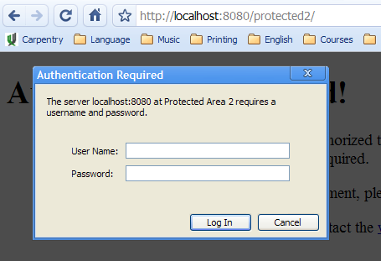
Sample Run
Filename: .htaccess
AuthUserFile "C:/Program Files/EasyPHP-5.3.2i/apache/users/password"
AuthName "Protected Area 2"
AuthGroupFile /dev/null
AuthType Basic
Require valid-user

Slide 26
.htaccess files
Pros
  Easy way to allow authentication
  Control is given to users (developers)
  No admin
Cons
  Performance: Apache reads and looks for .htaccess files for every GET
  Wrong permissions (given by directory owners) can lead to security problems

Slide 27
Another .htaccess Example (Linux)
If allowed, the following .htaccess file overrides authorisation:
<Directory /www/mysite/example>
  IndexIgnore * ##does not allow dir lists
  AuthType Basic
  AuthName "Private Area" ##popup
  AuthUserFile /usr/local/apache/passfile
  AuthAuthoritative on
  Require valid-user
</Directory>

Slide 28
Options FollowSymLinks
More on
Apache Webserver’s Configuration
Order Allow, Deny

Slide 29
Options FollowSymLinks
Follow Symbolic Links
Websites are often set up in a way that they show pictures and other content as being physically located at some other location than they really are.
If a visitor requests /system/files/images/image.png
then show him /pictures/image.png.“
You might see something like
IMG SRC="/system/files/images/image.png" for the location of some picture. This would be viewable by a browser, but not downloadable as it resides in another physical directory.
Enable FollowSymLinks by default
Notes:
Symbolic links are available in NTFS starting with Windows Vista.
http://msdn.microsoft.com/en-us/library/aa365680(v=VS.85).aspx

Slide 30
Order Allow, Deny
Restricting access
Order allow, deny is a setting in your Apache web server configuration that is used to restrict access to certain directories (folders) or even globally.
Configuring who can access your directories is very important for your web site security.
Order allow,deny is one way to restrict who can see what.

Slide 31
Order Allow, Deny
Restricting access
The Allow directive affects which hosts "can access" an area of the server. Access is usually controlled by hostname, IP address, or IP address range.
The Deny directive "restricts access" to the server. Restrictions can be based again on hostname, IP address, or environment variables.
We can set the Order directive in two ways:
  Order allow, deny
  Order deny, allow

Slide 32
Order Allow, Deny
Restricting access
Order allow, deny tells your web server that the Allow rules are processed before the Deny rules.
If the client does not match the Allow rule or it does match the Deny rule, then the client will be denied access.
Order deny, allow means that the deny rules are processed before the allow rules.
If the client does not match the deny rule or it does match the allow rule, then it will be granted access.

Slide 33
Order Allow, Deny
Example of Allow
Allow from example.com
All hosts from this domain will be allowed.
Allowed: abc.example.com
www.example.com.
Not Allowed: www.abcexample.com
✓
✓
✗
Only complete components are matched

Slide 34
Order Allow, Deny
Example of Allow
Allow from example.com
This configuration will cause the server to perform a double reverse DNS lookup on the client IP address, regardless of the setting of the HostnameLookups directive.
It will do a reverse DNS lookup on the IP address to find the associated hostname, and then do a forward lookup on the hostname to assure that it matches the original IP address.
Only if the forward and reverse DNS are consistent and the hostname matches will access be allowed.
http://httpd.apache.org/docs/2.0/mod/core.html#hostnamelookups
Notes:
Computer networks use the Domain Name System to determine the IP address associated with a domain name. This process is also known as forward DNS resolution. Reverse DNS lookup is the inverse process of this, the resolution of an IP address to its designated domain name.

Slide 35
Order Allow, Deny
Example of Allow
Allow from 10.1.2.3
You can define the access level also by providing the IP address. In this example, just the host with just that IP address would be allowed access.
Allow from 10.1
All hosts from all subnets within 10.1.x.x would be allowed access.

Slide 36
Order Allow, Deny
Example
<Directory "/www">
  Order Allow, Deny
  Deny from all
  Allow from all
</Directory>
In this case, your client would be denied access. Why?
Apache first evaluates the Allow directive rules and then the Deny directive rules.
Allow from all would be executed first and then the Deny from all would take place.

Slide 37
Order Deny, Allow
Example: order has been swapped
<Directory "/www">
  Order Deny, Allow
  Deny from all
  Allow from all
</Directory>
The configuration above would result in your client being allowed access because the Deny from all rule would be processed first and the Allow from all rule would be processed second.

Slide 38
Order Deny, Allow
Example: restricted server, intranet site
<Directory "/www">
  Order Deny, Allow
  Deny from all
  Allow from example.com
</Directory>
This configuration would restrict everyone from accessing the /www directory except hosts in the example.com domain.
Abc.example.com would be allowed access
www.myexample.com would be restricted.
✓
✗
Only complete components are matched

Slide 39
Order Allow, Deny
Example: blocking someone from some specific domain
<Directory "/www">
  Order Allow, Deny
  Allow from all
  Deny from www.myattacker.com phishers.example.com
</Directory>
The configuration provided above would give access to everyone and restrict all hosts from the www.myattacker.com and phishers.example.com domains.

Slide 40
Order Allow, Deny
What happens if you forget to provide specific rules and use just the Order allow,deny directive alone?
<Directory "/www">
  Order Allow, Deny
</Directory>
when you specify the Order allow,deny you also control the default access state.
The example above will Deny all access to the /www directory because the default access state is set to Deny.

Slide 41
IndexIgnore
IndexIgnore relates to the default directory listing mechanism that returns a directory listing for directories which do not contain an index.html or other "index" file. If that file is present, then IndexIgnore does not do anything.
IndexIgnore file [file] ...
You can find the IndexIgnore directive in two places.
  httpd.conf Apache server configuration file
  .htaccess file
    If you edit IndexIgnore in your root .htaccess file, it will affect all subdirectories as well. If you want to apply your setting to a subdirectory only, then you have to add a .htaccess file to that subdirectory and edit that.
IndexIgnore relies on the mod_autoindex module. Without this module enabled, no directory listings take place.

Slide 42
IndexIgnore
Examples
IndexIgnore readme.txt .htaccess
Disable the readme.txt and .htaccess files from showing in your directory listing.
IndexIgnore *
Block the directory listing completely

Slide 43
Summary
Methods for user authentication
  Simple login scripts
  HTTP authentication
  Authentication using sessions
Enable FollowSymLinks by default

Slide 44
Summary
The Allow and Deny directives are used to specify which clients are or are not allowed access to the server.
The Order directive sets the default access state, and configures how the Allow and Deny directives interact with each other.

