Slide 1
JQUERY - AJAX
Sisoft Technologies Pvt Ltd
SRC E7, Shipra Riviera Bazar, Gyan Khand-3, Indirapuram, Ghaziabad
Website: www.sisoft.in Email:info@sisoft.in
Phone: +91-9999-283-283

Slide 2
LEARNING TOPICS
Introduction to JQuery
The DOM (Document Object Modal)
JQuery Functions
JQuery Ajax Methods

Slide 3
Introduction to jQuery
Developed by John Resig at Rochester Institute of Technology
“jQuery is a lightweight JavaScript library that emphasizes interaction between JavaScript and HTML. It was released in January 2006 at BarCamp NYC by John Resig.”
“jQuery is free, open source software Dual-licensed under the MIT License and the GNU General Public License.”
“It’s all about simplicity. Why should web developers be forced to write long, complex, book-length pieces of code when they want to create simple pieces of interaction?”
Current version is 1.3.2.
Version 1.4 due out soon.

Slide 4
Introduction to jQuery
Installation – You just download the jquery-1.3.2.js file and put it in your website folder
Can access via URL
What jQuery Does
“Unobtrusive” JavaScript – separation of behavior from structure
CSS – separation of style from structure
Allows adding JavaScript to your web pages
Advantages over just JavaScript
Much easier to use
Eliminates cross-browser problems
HTML to CSS to DHTML

Slide 5
5 Things jQuery Provides
Select DOM (Document Object Model) elements on a page – one element or a group of them
Set properties of DOM elements, in groups (“Find something, do something with it”)
Creates, deletes, shows, hides DOM elements
Defines event behavior on a page (click, mouse movement, dynamic styles, animations, dynamic content)
AJAX calls
The DOM
Document Object Model
jQuery is “DOM scripting”
Heirarchal structure of a web page
You can add and subtract DOM elements on the fly
You can change the properties and contents of DOM elements on the fly

Slide 6
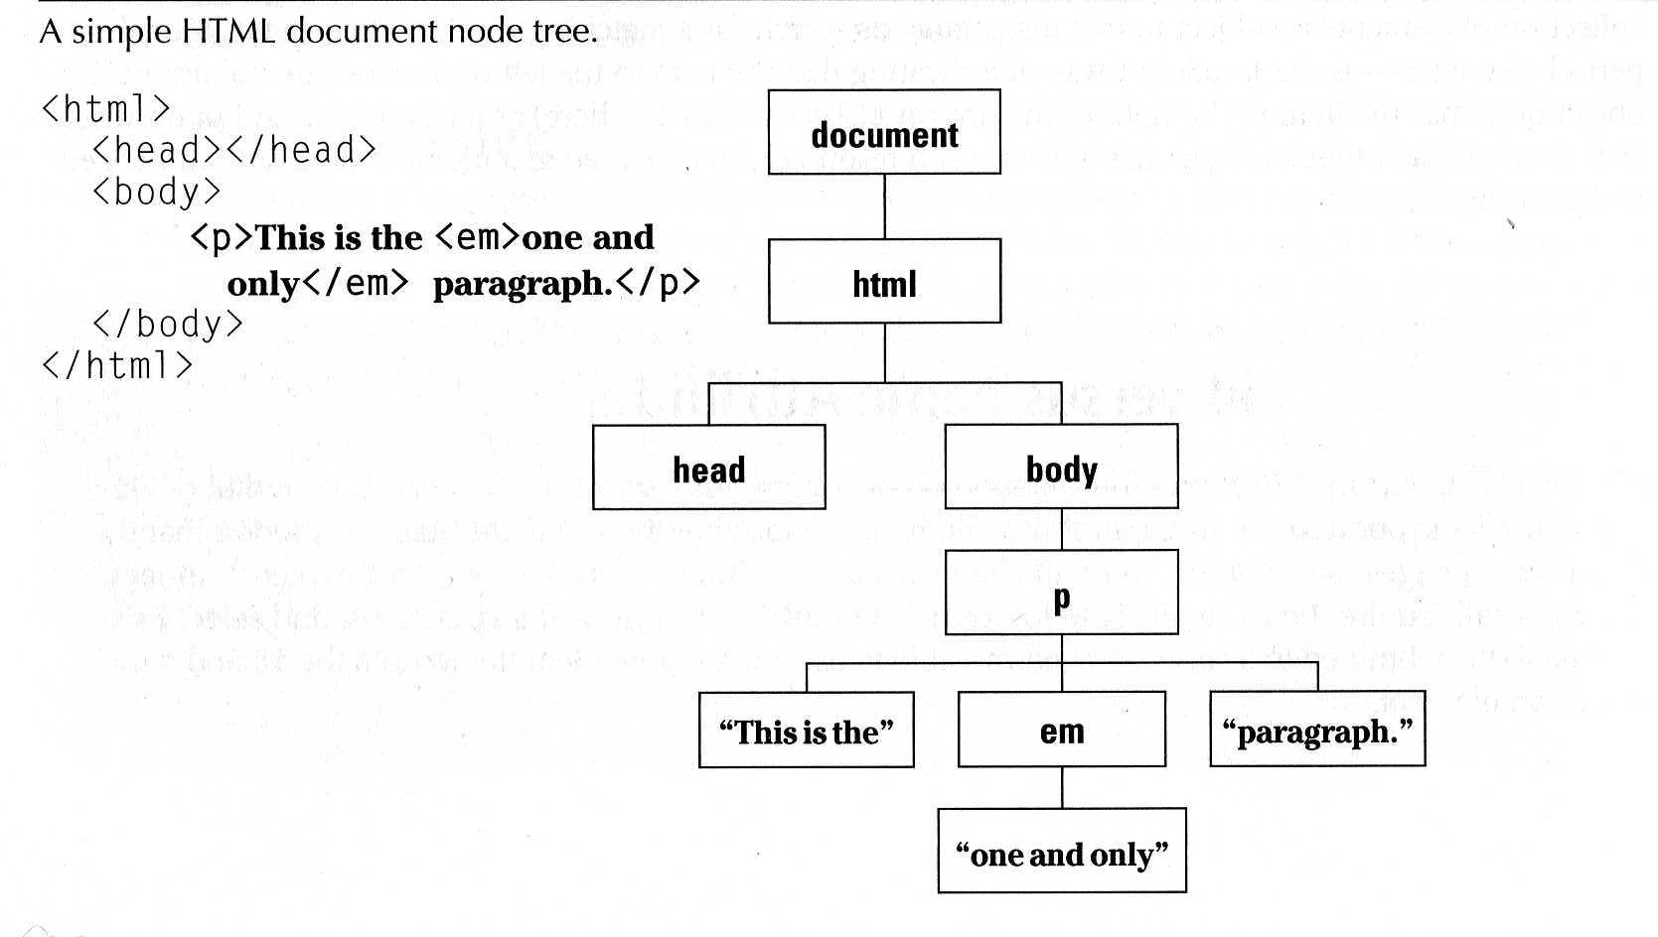
The DOM
“The Document Object Model (DOM) is a cross-platform and language-independent convention for representing and interacting with objects in HTML, XHTML and XML documents. Aspects of the DOM (such as its "Elements") may be addressed and manipulated within the syntax of the programming language in use.”

Slide 7
The jQuery Function
jQuery() = $()
$(function) The “Ready” handler
$(‘selector’) Element selector expression
$(element) Specify element(s) directly
$(‘HTML’) HTML creation
$.function() Execute a jQuery function
$.fn.myfunc(){} Create jQuery function
The Ready Function
Set up a basic HTML page and add jQuery
Create a “ready” function
Call a function
5 ways to specify the ready function
jquery(document).ready(function(){…};);
jquery().ready(function(){…};)
jquery(function(){…};)
jquery(dofunc);
$(dofunc);

Slide 8
Selecting Elements Creating a “wrapped set”
$(selector)
selector:
$(‘#id’) id of element
$(‘p’) tag name
$(‘.class’) CSS class
$(‘p.class’) <p> elements having the CSS class
$(‘p:first’) $(‘p:last’) $(‘p:odd’) $(‘p:even’)
$(‘p:eq(2)’) gets the 2nd <p> element (1 based)
$(‘p’)[1] gets the 2nd <p> element (0 based)
$(‘p:nth-child(3)) gets the 3rd <p> element of the parent. n=even, odd too.
$(‘p:nth-child(5n+1)’) gets the 1st element after every 5th one
$(‘p a’) <a> elements, descended from a <p>
$(‘p>a’) <a> elements, direct child of a <p>
$(‘p+a’) <a> elements, directly following a <p>
$(‘p, a’) <p> and <a> elements
$(‘li:has(ul)’) <li> elements that have at least one <ul> descendent
$(‘:not(p)’) all elements but <p> elements
$(‘p:hidden’) only <p> elements that are hidden
$(‘p:empty’) <p> elements that have no child elements

Slide 9
Selecting Elements, cont.
$(‘img’[alt]) <img> elements having an alt attribute
$(‘a’[href^=http://]) <a> elements with an href attribute starting with ‘http://’
$(‘a’[href$=.pdf]) <a> elements with an href attribute ending with ‘.pdf’
$(‘a’[href*=ntpcug]) <a> elements with an href attriute containing ‘ntpcug’
Useful jQuery Functions
.each() iterate over the set
.size() number of elements in set
.end() reverts to the previous set
.get(n) get just the nth element (0 based)
.eq(n) get just the nth element (0 based) also .lt(n) & .gt(n)
.slice(n,m) gets only nth to (m-1)th elements
.not(‘p’) don’t include ‘p’ elements in set
.add(‘p’) add <p> elements to set
.remove() removes all the elements from the page DOM
.empty() removes the contents of all the elements
.filter(fn/sel) selects elements where the func returns true or sel
.find(selector) selects elements meeting the selector criteria
.parent() returns the parent of each element in set
.children() returns all the children of each element in set
.next() gets next element of each element in set
.prev() gets previous element of each element in set
.siblings() gets all the siblings of the current element

Slide 10
Formatting Elements
.css(property, value)
.html()
.val() (form elements)
.text()
.addClass(‘class’)
.removeClass(‘class’)
Add Page Elements
$(‘#target’).before(‘<p>Inserted before #target</p>’);
$(‘#target’).after(‘<p>This is added after #target</p>’);
$(‘#target’).append(‘<p>Goes inside #target, at end</p>’);
$(‘#target’).wrap(‘<div></div>’);

Slide 11
Adding Events
Mouseover events – bind, hover, toggle
Button click events
Keystrokes
Event Background
DOM Level 2 Event Model
Multiple event handlers, or listeners, can be established on an element
These handlers cannot be relied upon to run an any particular order
When triggered, the event propagates from the top down (capture phase) or bottom up (bubble phase)
IE doesn’t support the “capture phase”

Slide 12
Basic Syntax of Event Binding
$(‘img’).bind(‘click’,function(event){alert(‘Howdy’;});
$(‘img’).bind(‘click’,imgclick(event));
Allows unbinding the function
$(‘img’).unbind(‘click’,imgclick());
$(‘img’).unbind(‘click’);
$(‘img’).one(‘click’,imgclick(event));
Only works once
$(‘img’).click(imgclick);
$(‘img’).toggle(click1, click2);
$(‘img’).hover(mouseover, mouseout);
Element Properties – “this”
this
this.id
this.tagName
this.attr
this.src
this.classname
this.title
this.alt
this.value (for form elements)

Slide 13
‘Event’ properties
event.target ref to element triggering event
Event.target.id id of element triggering event
event.currentTarget
event.type type of event triggered
event.data second parm in the bind() func
Various mouse coordinate properties
Various keystroke related properties
Event Methods
stopPropagation() no bubbling
.preventDefault() no <a> link, no <form> submit
.trigger(eventType) does not actually trigger the event, but calls the appropriate function specified as the one tied to the eventType
.click(), blur(), focus(), select(), submit()
With no parameter, invokes the event handlers, like trigger does, for all the elements in the wrapped set.

Slide 14
Shortcut Event Binding
.click(func)
.submit(func)
.dblclick(func)
.mouseover(func)
.mouseout(func)
.select(func)
Useful Event Functions
.hide() display:true
.show() display:none
.toggle(func1, func2) first click calls func1, next click executes func2
.hover(over, out) mouseover, mouseout

Slide 15
jQuery AJAX Methods
AJAX is the art of exchanging data with a server, and update parts of a web page - without reloading the whole page.
The following table lists all the jQuery AJAX methods:
$.ajax():-
Performs an async AJAX request
$("button").click(function(){ $.ajax({url: "demo_test.txt", success: function(result){ $("#div1").html(result); }}); });
Syntax
$.ajax({name:value, name:value, ... })
The parameters specifies one or more name/value pairs for the AJAX request.
You can refer the website https://www.w3schools.com/jquery/ajax_ajax.asp for possible names/values given in the table.

Slide 16
$.ajaxPrefilter() | Handle custom Ajax options or modify existing options before each request is sent and before they are processed by $.ajax()
jQuery ajaxSetup() Method:-
Sets the default values for future AJAX requests
$("button").click(function(){ $.ajaxSetup({url: "demo_ajax_load.txt", success: function(result){ $("div").html(result);}}); $.ajax(); });
$.ajaxTransport() | Creates an object that handles the actual transmission of Ajax data

Slide 17
jQuery get() Method:-
The $.get() method loads data from the server using a HTTP GET request.
Syntax:-
$.get(URL,data,function(data,status,xhr),dataType)
$("button").click(function(){ $.get("demo_test.asp", function(data, status){ alert("Data: " + data + "\nStatus: " + status); }); });
jQuery getJSON() Method :-
The getJSON() method is used to get JSON data using an AJAX HTTP GET request.
Syntax:-
$(selector).getJSON(url,data,success(data,status,xhr))
$("button").click(function(){ $.getJSON("demo_ajax_json.js", function(result){ $.each(result, function(i, field){ $("div").append(field + " "); }); }); });

Slide 18
jQuery getScript() Method:-
The getScript() method is used to get and execute a JavaScript using an AJAX HTTP GET request.
Syntax:-
$(selector).getScript(url,success(response,status))
$("button").click(function(){ $.getScript("demo_ajax_script.js"); });
jQuery param() Method:-
The param() method creates a serialized representation of an array or an object.
The serialized values can be used in the URL query string when making an AJAX request.
Syntax:-
$.param(object,trad)
$("button").click(function(){ $("div").text($.param(personObj)); });

Slide 19
jQuery param() Method:-
The param() method creates a serialized representation of an array or an object.
The serialized values can be used in the URL query string when making an AJAX request.
Syntax:-
$.param(object,trad)
$("button").click(function(){ $("div").text($.param(personObj)); });
jQuery post() Method:-
The $.post() method loads data from the server using a HTTP POST request.
Syntax:-
$(selector).post(URL,data,function(data,status,xhr),dataType)
Load data from the server using a HTTP POST request:
$("button").click(function(){ $.post("demo_test.asp", function(data, status){ alert("Data: " + data + "\nStatus: " + status); }); });

Slide 20
Change the text of a <div> element using an AJAX POST request:
$("input").keyup(function(){ var txt = $("input").val(); $.post("demo_ajax_gethint.asp", {suggest: txt}, function(result){ $("span").html(result); }); });
jQuery ajaxComplete() Method:-
The ajaxComplete() method specifies a function to be run when an AJAX request completes.
Note: As of jQuery version 1.8, this method should only be attached to document.
Unlike ajaxSuccess(), functions specified with the ajaxComplete() method will run when the request is completed, even it is not successful.
Syntax:-
$(document).ajaxComplete(function(event,xhr,options))

Slide 21
Example
Show a "loading" indicator image while an AJAX request is going on:
$(document).ajaxStart(function(){ $("#wait").css("display", "block"); }); $(document).ajaxComplete(function(){ $("#wait").css("display", "none"); });
jQuery ajaxError() Method:-
The ajaxError() method specifies a function to be run when an AJAX request fails.
Syntax:-
$(document).ajaxError(function(event,xhr,options,exc))
$(document).ajaxError(function(){ alert("An error occurred!"); });

Slide 22
jQuery ajaxSend() Method:-
The ajaxSend() method specifies a function to run when an AJAX requests is about to be sent.
Syntax:-
$(document).ajaxSend(function(event,xhr,options))
$(document).ajaxSend(function(e, xhr, opt){ $("div").append("<p>Requesting: " + opt.url + "</p>"); });
jQuery ajaxStart() Method:-
The ajaxStart() method specifies a function to be run when an AJAX request starts.
Syntax:-
$(document).ajaxStart(function())
$(document).ajaxStart(function(){ $(this).html("<img src='demo_wait.gif'>"); });

Slide 23
jQuery ajaxStop() Method:-
The ajaxStop() method specifies a function to run when ALL AJAX requests have completed.
When an AJAX request completes, jQuery checks if there are any more AJAX requests. The function specified with the ajaxStop() method will run if no other requests are pending.
Syntax:-
$(document).ajaxStop(function())
$(document).ajaxStop(function(){ alert("All AJAX requests completed"); });
jQuery ajaxSuccess() Method:-
The ajaxSuccess() method specifies a function to be run when an AJAX request is successfully completed.
Syntax:-
$(document).ajaxSuccess(function(event,xhr,options))
$(document).ajaxSuccess(function(){ alert("AJAX request successfully completed"); });

Slide 24
jQuery load() Method:-
The load() method loads data from a server and puts the returned data into the selected element.
Syntax:
$(selector).load(url,data,function(response,status,xhr))
$("button").click(function(){ $("#div1").load("demo_test.txt"); });
jQuery serialize() Method:-
The serialize() method creates a URL encoded text string by serializing form values.
You can select one or more form elements (like input and/or text area), or the form element itself.
The serialized values can be used in the URL query string when making an AJAX request.
Syntax:-
$(selector).serialize()
$("button").click(function(){ $("div").text($("form").serialize()); });

Slide 25
jQuery serializeArray() Method:-
The serializeArray() method creates an array of objects (name and value) by serializing form values.
You can select one or more form elements (like input and/or text area), or the form element itself.
Syntax:-
$(selector).serializeArray()
$("button").click(function(){ var x = $("form").serializeArray(); $.each(x, function(i, field){ $("#results").append(field.name + ":" + field.value + " "); }); });

Slide 26
Thank You
Sisoft Technologies Pvt Ltd
SRC E7, Shipra Riviera Bazar, Gyan Khand-3, Indirapuram, Ghaziabad
Website: www.sisoft.in Email:info@sisoft.in
Phone: +91-9999-283-283

