Slide 1
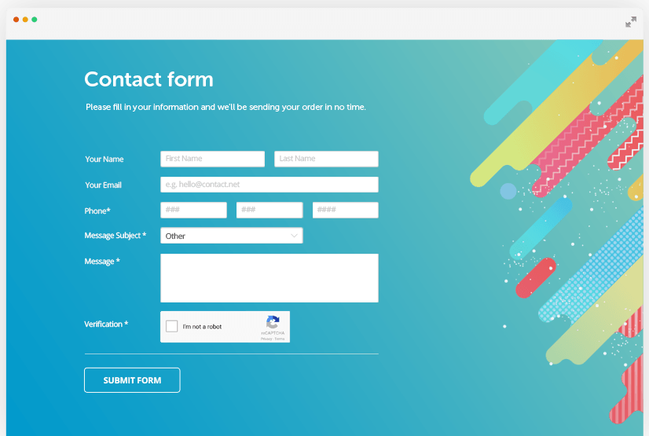
PHP FORMS
Sisoft Technologies Pvt Ltd
SRC E7, Shipra Riviera Bazar, Gyan Khand-3, Indirapuram, Ghaziabad
Website: www.sisoft.in Email:info@sisoft.in
Phone: +91-9999-283-283

Slide 2
Learning Topics -Working with Forms
Creating a form
Accessing the submitted data
Common operations on forms

Slide 3
1 - Creating a form

Slide 4
Form - <form>
<form action = ".."
method = "...">
...
</form>
action = URL
method = get | post
http://www.w3schools.com/tags/tag_form.asp

Slide 5
Text field - <input>
For single line text input:
<input type = "text"
name = "mytextfield"
value = "initial value"
size = "50"
maxlength = "50"/>
http://www.w3schools.com/tags/tag_input.asp

Slide 6
Password - <input>
For single line masked text input
<input type = "password"
name = "pwd"/>

Slide 7
Radio button - <input>
Single choice
Male: <input type = "radio" name = "gender" value="Male"/>
Female: <input type = "radio" name = "gender" value="Female"/>

Slide 8
Checkbox - <input>
Multiple choice
<input type = "checkbox"
name = "sailing"/>

Slide 9
Labelling
Old School (Strict DTD only):
<input type="checkbox" name="choice1"> Choice 1
</input>
Strict DTD compliant:
Choice 1: <input type="checkbox" name="choice1/>
Elegant:
<label for="choice1ID">Choice 1</label>
<input type="checkbox" name="choice1 id="choice1ID"/>

Slide 10
Drop-down list <select><option>
Single choice
<select name="country" size="1">
<option value="UK">United Kingdom</option>
<option value="USA">United States of America</option>
<option value="NK">North Korea</option>
<option value="BE">Belgium</option>
</select>

Slide 11
(multiple) selection list <select><option>
Multiple choice
<select name="country[]" size="3" multiple="multiple">
<option value="UK">United Kingdom</option>
<option value="USA">United States of America</option>
<option value="NK">North Korea</option>
<option value="BE">Belgium</option>
</select>

Slide 12
Text area - <textarea>
For multiple line text input
<textarea name="myTextArea"
cols="30"
rows="5">
</textarea>
http://www.w3schools.com/tags/tag_textarea.asp

Slide 13
Hidden fields - <input>
To send information with the form
<input type="hidden"
name="hidden1"
value="Form example for demo"/>

Slide 14
Button - <input> or <button>
<input type="submit"
name="submitButton"
value="Submit Form"/>
<button type="submit"
name="submitButton">
SubmitForm
</button>

Slide 15
2 - How does one access the submitted data?

Slide 16
Using PHP
Data stored in a variable
Depends on submission method:
GET
POST
If POST, either:
$varName (requires special configuration)
$_POST['varName'] (recommended)
$HTTP_POST_VARS['varName']
If GET, use:
$_GET['varName']

Slide 17
Two basic approaches
Approach 1 (today)
HTML form
PHP script to process it
Approach 2 (in the tutorial)
PHP script containing the form and the processing script:
<form action =
"<?php echo $_SERVER['PHP_SELF']; ?>"
method="post">

Slide 18
Examples
Display content of $_POST
Display value of text input field
Display value of the hidden field
Display content of the text area
Display value(s) of (multiple) selection list
Notes:
Ask students to write the code for 2, 3 and 4

Slide 19
3 - Common operations

Slide 20
1. Check existence
Has a variable been set?
if (isset($_POST['myCheckbox2']))
echo "Option 2 was selected";
else
echo "Option 2 wasn't selected.";

Slide 21
2. Check which button was pressed
Same as above
if (isset($_POST['button1']))
echo "Button 1 was pressed";
elseif (isset($_POST['button2']))
echo "Button 2 was pressed";
else
echo "no button pressed";

Slide 22
3. Email data
$to = "m.rutter@napier.ac.uk";
$subject = "form data";
$body = "Country chosen by the user: $_POST['country1'] ";
mail($to,$subject,$body);
Requires appropriate server configuration (this is not permitted on the school’s server).

Slide 23
Example 1: mandatory text field
Check that the value of the text field contains characters and redirect the user accordingly
Two cases:
Separate form and processing script
Processing is done in the form

Slide 24
Example 1 Case 1
In processing script:
<?php
if ($_POST['myTextField'] == ''){
header("location: form.html");
}?>
Problem:
No information regarding the error is passed back to the form
Solution:
Make the form a PHP script
Send back some information about the error
Will be done in the tutorial

Slide 25
Example 2: directed study validate phone number
Requirement: ensure that phone number has the following format: +44dddddddddd, where d is a digit.
Hint:
Check that the string has 13 characters
Check that the first three characters (substring) is equal to ‘+44’.

Slide 26
4. Error checking
Ensure entered data is valid
Examples
Mandatory fields
Postcode format
Phone number format
Date format
etc

Slide 27
Variable scope

Slide 28
Six scope rules – directed study
Built-in superglobal
Constants
Global (2 flavours)
Static
Local (by default)
Read:
http://uk2.php.net/variables.scope

Slide 29
Superglobals
$GLOBALS
$_SERVER
$_GET
$_POST
$_COOKIE
$_FILES
$_ENV
$_REQUEST
$_SESSION

Slide 30
Summary
Form creation
Form processing
Some common operations
To be completed during the tutorial
Thank You
Sisoft Technologies Pvt Ltd
SRC E7, Shipra Riviera Bazar, Gyan Khand-3, Indirapuram, Ghaziabad
Website: www.sisoft.in Email:info@sisoft.in
Phone: +91-9999-283-283

