Slide 1

View-Controller Family
Sisoft Technologies Pvt Ltd
SRC E7, Shipra Riviera Bazar, Gyan Khand-3, Indirapuram, Ghaziabad
Website: www.sisoft.in Email:info@sisoft.in
Phone: +91-9999-283-283

Slide 2
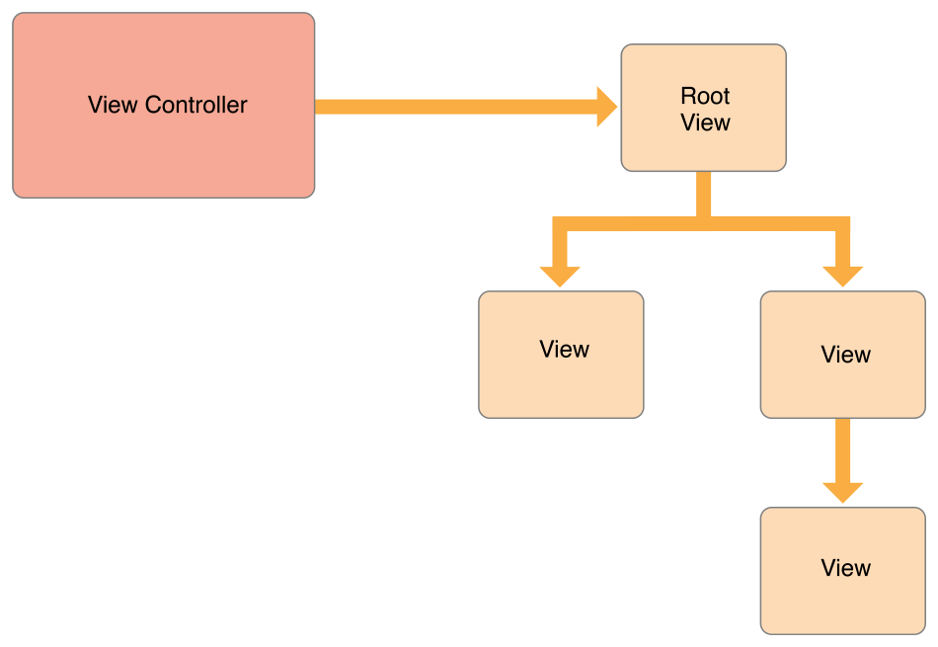
View Controller and its Views

Slide 3
The View Controller family
Content View Controllers
UIViewController
UITableViewController
Container View Controller
UINavigationController
UITabBarController
UIPageViewController
UISplitViewController
UIPopOverController

Slide 4
Content vs Container
A content view controller manages all of its views by itself.
A container view controller manages its own views plus the root views from one or more of its child view controllers.
The container does not manage the content of its children.
It manages only the root view, sizing and placing it according to the container’s design.

Slide 5
Navigation One View to Another
presentViewController offers a mechanism to display a so-called modal view controller; i.e., a view controller that will take full control of your UI by being superimposed on top of a presenting controller.
presentViewController is an instance method of UIViewController
Use [self presentViewController:vc2 animated:YES completion:NULL];
Use triggered Segue
To finish the current View
dismissViewControllerAnimated:YES completion:nil

Slide 6
UIViewController - Navigation
//This will identify the Storyboard in use UIStoryboard
*storyboard = [UIStoryboard storyboardWithName:@"MainStoryboard" bundle:nil];
//This will identify the View Controller to switch to
SecondViewController *vc2 = [storyboard instantiateViewControllerWithIdentifier:@"SecondViewContr ollerID" ];
[self presentViewController:vc2 animated:YES completion:NULL];

Slide 7
Triggered Segue
Segue represents a transition from one screen to another.
Segues are triggered by taps on buttons, table view cells, gestures, and so on
Passing Value Using Segue
- (void) prepareForSegue:(UIStoryboardSegue *)segue sender:(id)sender
Get reference to destination View controller using method [segue destinationViewController]
Then desired property of the destination view controller may be set.

Slide 8
Passing Data Back to Parent Class
Get reference to the parent class
[self presentingViewController]
Set the desired data in parent view controller

Slide 9
Navigation Controller
A navigation controller manages a stack of view controllers to provide a drill-down interface for hierarchical content.
The view hierarchy of a navigation controller is self contained. It is composed of views that the navigation controller manages directly and views that are managed by content view controllers you provide.
Each content view controller manages a distinct view hierarchy, and the navigation controller coordinates the navigation between these view hierarchies.
In addition to telling the navigation controller when to display a new view, you are responsible for configuring the navigation bar—the view at the top of the screen that provides context about the user’s place in the navigation hierarchy.
You can also provide items for a toolbar that is managed by the navigation controller.

Slide 10
Navigation Controller
A navigation controller is a container view controller—that is, it embeds the content of other view controllers inside of itself. You access a navigation controller’s view from its view property. This view incorporates the navigation bar, an optional toolbar, and the content view corresponding to the topmost view controller
The navigation controller manages the creation, configuration, and display of the navigation bar and optional navigation toolbar.
A navigation controller builds the contents of the navigation bar dynamically using the navigation item objects (instances of the UINavigationItem class) associated with the view controllers on the navigation stack

Slide 11
Navigation Controller
A navigation controller object manages the currently displayed screens using the navigation stack, which is represented by an array of view controllers. The first view controller in the array corresponds to the root view controller. The last view controller in the array represents the view controller currently being displayed
To add a view controller to the top of the stack using the pushViewController:animated: method
To remove a view controller from the stack programmatically, you call the popViewControllerAnimated: method

Slide 12
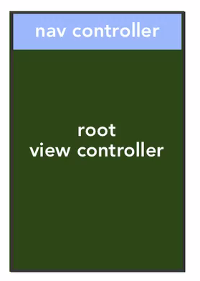
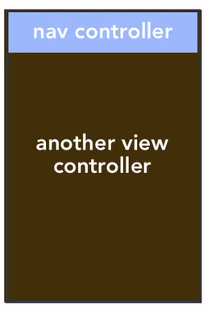
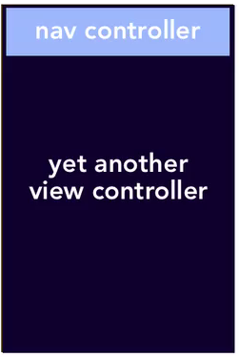
Navigation Controller
push
push
pop
pop

Slide 13
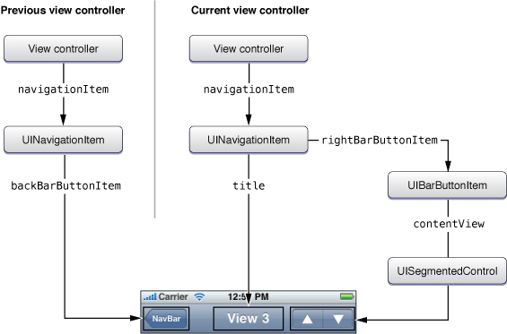

Slide 14
Tab Bar Controller
NSObject->UIResponder->UIViewController->UITabBar Controller
Tab bar controller is used to organize your app into one or more distinct modes of operation.
The key component of a tab bar interface is the presence of a tab bar view along the bottom of the screen. This view is used to initiate the navigation between your app’s different modes and can also convey information about the state of each mode
The tab bar controller creates and manages the tab bar view and also manages the view controllers that provide the content view for each mode. Each content view controller is designated as the view controller for one of the tabs in the tab bar view. When a tab is tapped by the user, the tab bar controller object selects the tab and displays the view associated with the corresponding content view controller.

Slide 15
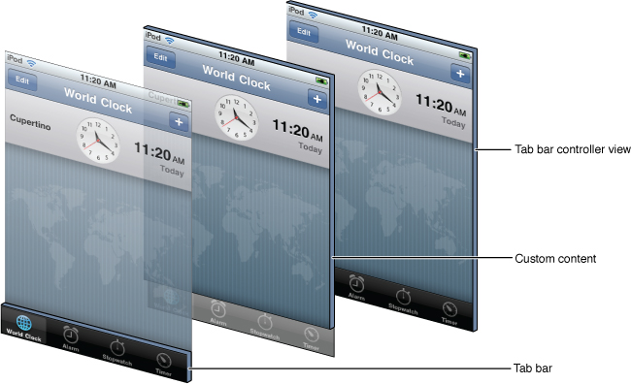

Slide 16
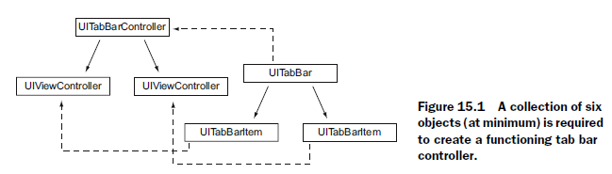

Slide 17
Tab Bar Controller
Adding new Tab
Drag ViewController from Object Library
Control Drag from Tab Bar VC to New VC
New Segue relationship pops up
Select last Relationship Segue -> View Controllers

Slide 19
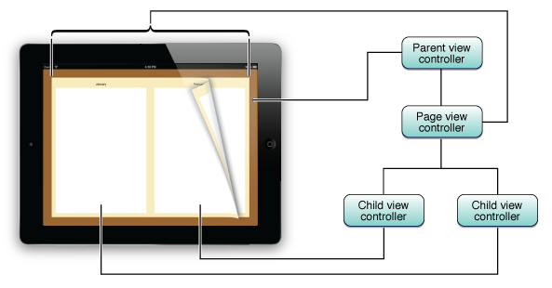
Page View Controllers
You use a page view controller to present content in a page-by-page manner. A page view controller manages a self-contained view hierarchy. The parent view of this hierarchy is managed by the page view controller, and the child views are managed by the content view controllers that you provide.

Slide 20
A page view interface consists of the following objects:
An optional delegate
An optional data source
An array of the current view controllers
An array of gesture recognizers
The data source provides view controllers on demand.
The delegate provides methods that are called in response to gesture-based navigation and orientation changes.
The array of view controllers contains the content view controllers that are currently being displayed. The number of items in this array varies depending on the options passed to the page view controller.
The array of gesture recognizers is populated only if a data source is set. These gesture recognizers let the user turn pages by tapping, flicking, or dragging.

Slide 21
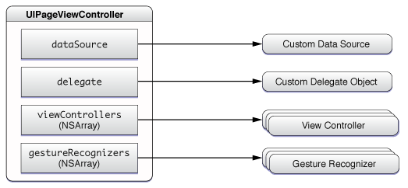

Slide 22
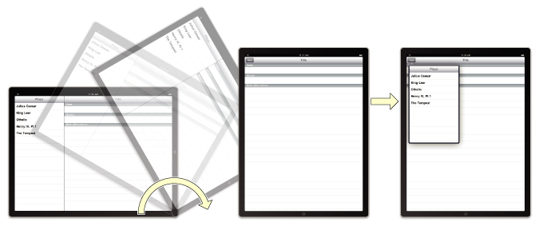
Split View Controllers
The UISplitViewController class is a container view controller that manages two panes of information. The first pane has a fixed width of 320 points and a height that matches the visible window height. The second pane fills the remaining space.

Slide 23
Popovers
Although not a view controller itself, the UIPopoverController class manages the presentation of view controllers. You use a popover controller object to present content using a popover, which is a visual layer that floats above your app’s window.
Popovers provide a lightweight way to present or gather information from the user and are commonly used in the following situations:
To display information about an object on the screen
To manage frequently accessed tools or configuration options
To present a list of actions to perform on objects inside one of your views
To present one pane from a split view controller when the device is in a portrait orientation

Slide 24
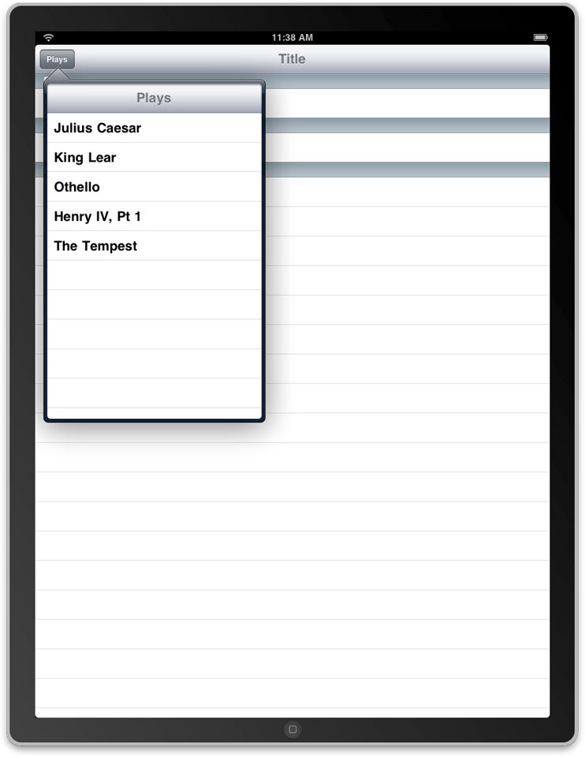

Slide 25
Important links
For view controller visit link:
https://developer.apple.com/library/ios/featuredarticles/ViewControllerPGforiPhoneOS/AboutViewControllers/AboutViewControllers.html
For table view visit link
https://developer.apple.com/library/ios/documentation/userexperience/conceptual/TableView_iPhone/AboutTableViewsiPhone/AboutTableViewsiPhone.html
For Tab Bar controllers visit link:
https://developer.apple.com/library/ios/documentation/WindowsViews/Conceptual/ViewControllerCatalog/Chapters/TabBarControllers.html

Slide 26
JUNKIES
JUNKIES

Slide 27
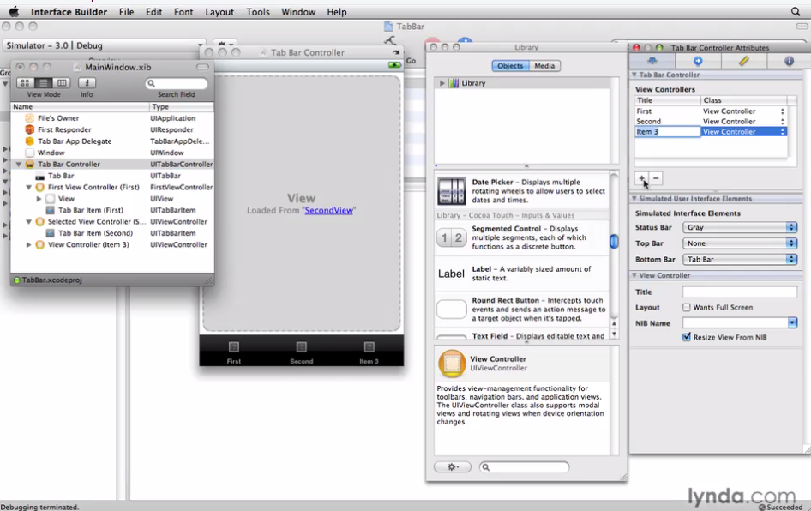
Adding item to Tab bar App

Slide 28
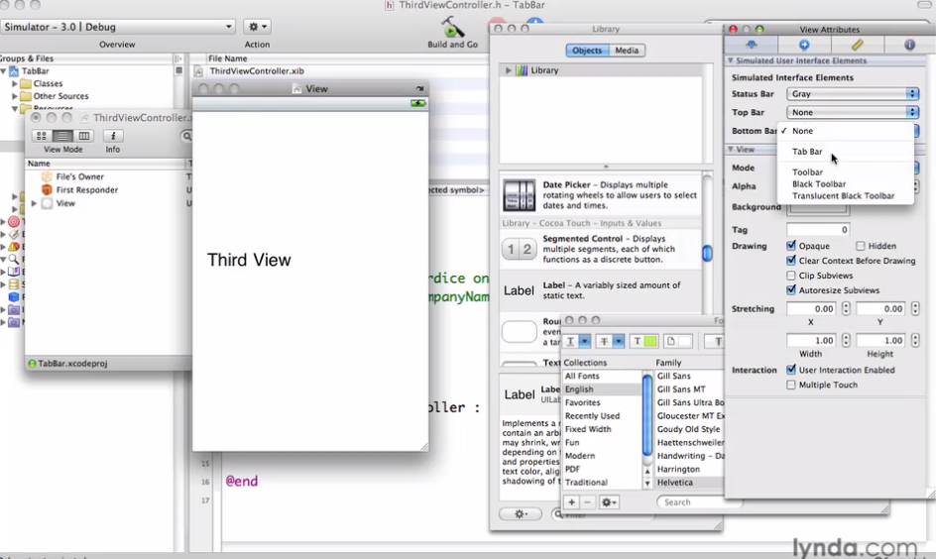

Slide 29
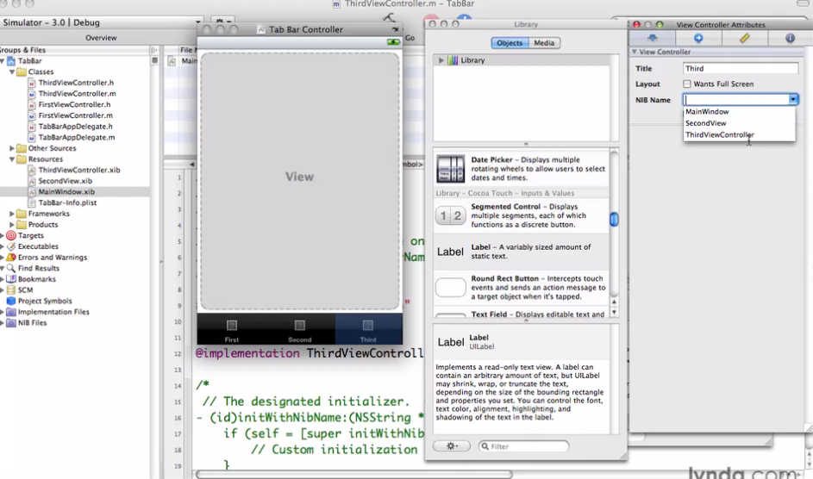

Slide 30
able 1-2 Item positions on a navigation bar
Position | Property | Description
Left | backBarButtonItem leftBarButtonItem | In a navigation interface, the navigation controller assigns a Back button to the left position by default. To get the default Back button provided by the navigation controller, get the value of the backBarButtonItem property. To assign a custom button or view to the left position, and thereby replace the default Back button, assign a UIBarButtonItem object to the leftBarButtonItem property.
Center | titleView | In a navigation interface, the navigation controller displays a custom view with the title of your content view controller by default. You can replace this view as desired with your own custom view. If you do not provide a custom title view, the navigation bar displays a custom view with the navigation item’s title string. Or, if the navigation item doesn’t provide a title, the navigation bar uses the view controller’s title.
Right | rightBarButtonItem | This position is empty by default. It is typically used to place buttons for editing or modifying the current screen. You can also place custom views here by wrapping the view in a UIBarButtonItem object.

Slide 31
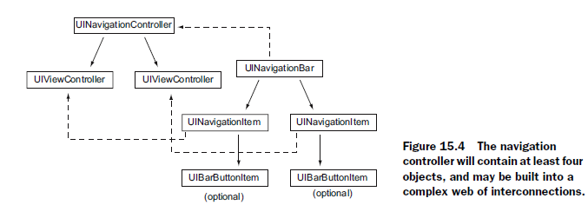

Slide 32
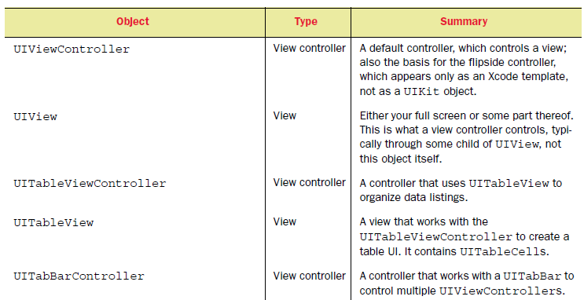
The view controller family

Slide 33
The view controller family

Slide 34
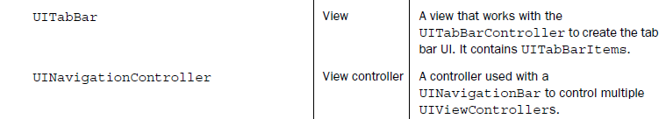
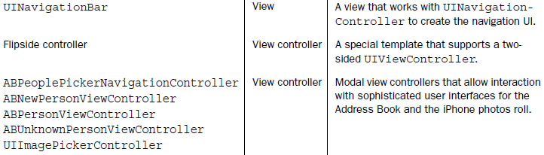

Slide 35
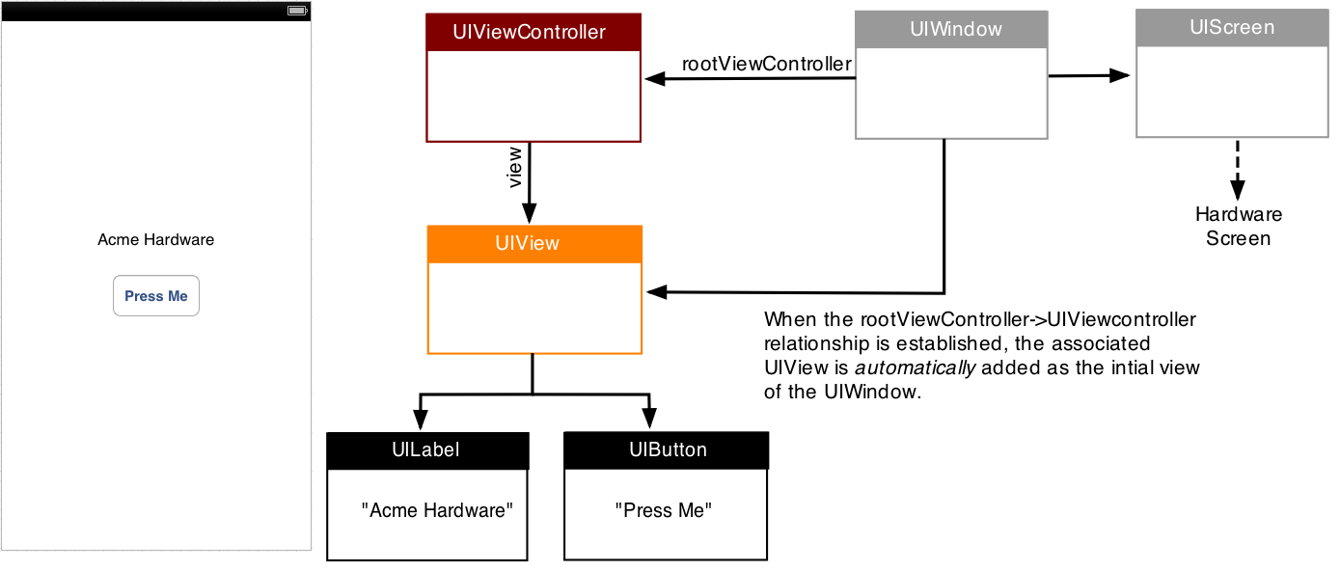
Views and view controllers are the fundamental

Slide 36
UIScreen
The UIScreen object represents the physical iPhone or iPad screen. Other than to perhaps query the size (the so-called bounds) of the screen, you will typically not interact much with the UIScreen object.
UIWindow
The UIWindow object provides drawing support for the screen, and your app will usually have just one. Other than setting the UIWindow object's initial root view controller (discussed below), you won't interact with the UIWindow object very much either.
UIViews
UIView objects are where the real magic begins to happen. They are attached to the UIWindow object and draw their contents when directed to do so by the window. The visual interface of your app is essentially a set of UIView objects, which are themselves managed by UIViewController objects.

Slide 37
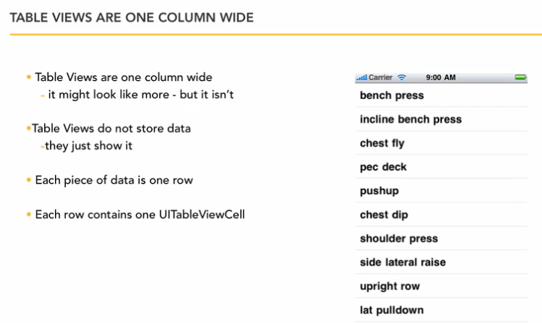
Table View

Slide 38
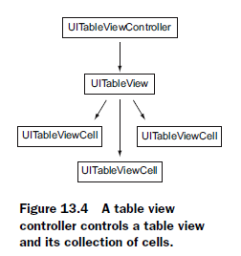

Slide 39
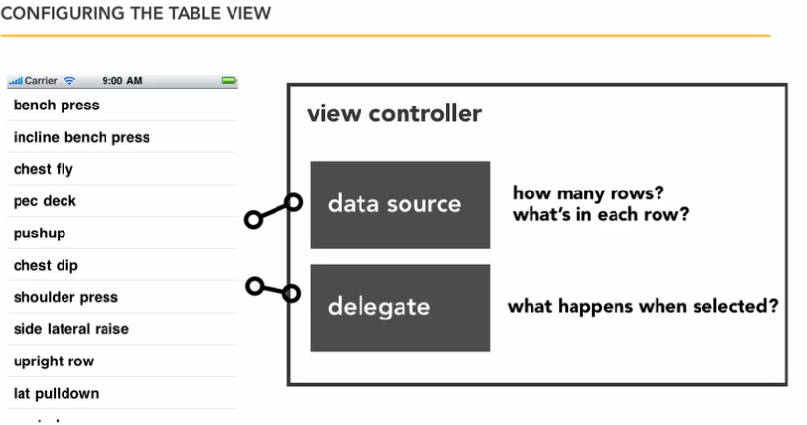

Slide 40
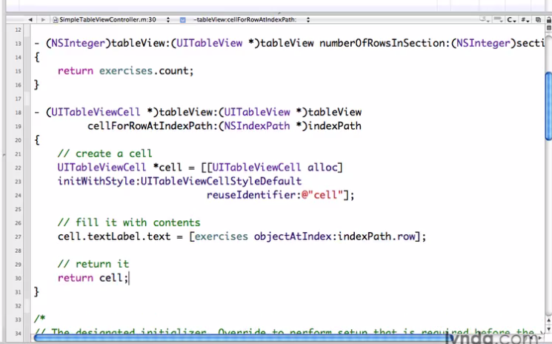
Implementing Protocol

Slide 41
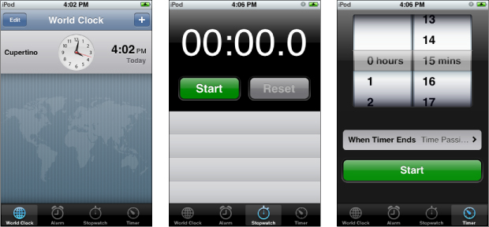
Tab Bar view controller

