Slide 1

IOS Design Patterns
MVC, Singleton, Delegation, Target-action, Facade
Sisoft Technologies Pvt Ltd
SRC E7, Shipra Riviera Bazar, Gyan Khand-3, Indirapuram, Ghaziabad
Website: www.sisoft.in Email:info@sisoft.in
Phone: +91-9999-283-283

Slide 2
What Is a Design Pattern?
A design pattern is a template for a design that solves a general, recurring problem in a particular context
It is a tool of abstraction that is useful in fields like architecture and engineering as well as software development

Slide 3
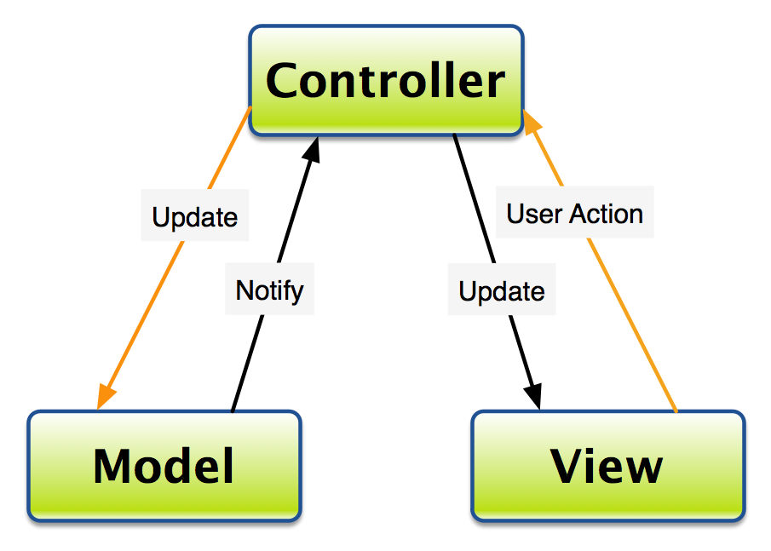
MVC Communication pattern

Slide 4
View objects
are visible to the user
the buttons, labels, and the view they are placed on top of are all view objects
Views are usually standard UIView subclasses (UIButton, UISlider), but you will sometimes write custom view classes

Slide 5
Model objects
Hold data and know nothing about the user interface
Model objects typically use standard collection classes (NSArray, NSDictionary, NSSet) and standard value types (NSString, NSDate, NSNumber)
But there can be custom classes, which typically have names that sound like data-bearing objects

Slide 6
Controller objects
View and model objects are the factory workers of an application – they focus tightly on specific tasks.
For example, an instance of UILabel (a view object) knows how to display text in a given font within a given rectangle.
An NSString instance (a model object) knows how to store a characterstring.
But the label doesn’t know what text it should display, and the string doesn’t know what characters it should store.

Slide 7
Controller objects Cont….
This is where controller objects come in
Controllers are the managers in an application
They keep the view and model objects in sync, control the “flow” of the application
and save the model objects out to the filesystem

Slide 8
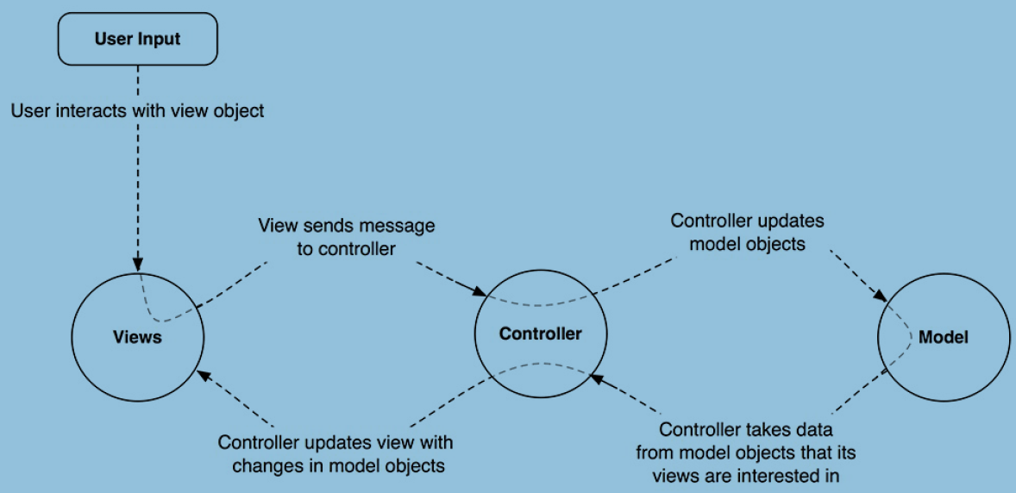

Slide 9
The Singleton Pattern
The Singleton design pattern ensures that only one instance exists for a given class and that there’s a global access point to that instance
It usually uses lazy loading to create the single instance when it’s needed the first time
Apple uses this approach a lot. For example: [NSUserDefaults standardUserDefaults], [UIApplication sharedApplication], [UIScreen mainScreen], [NSFileManager defaultManager] all return a Singleton object

Slide 10
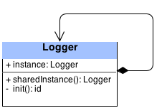
How to Use the Singleton Pattern

Slide 11
How to Use the Singleton Pattern…
The above image shows a Logger class with a single property (which is the single instance), and two methods: sharedInstance and init
The first time a client sends the sharedInstance message, the property instance isn’t yet initialized, so you create a new instance of the class and return a reference to it
The next time you call sharedInstance, instance is immediately returned without any initialization. This logic promises that only one instance exists at all times

Slide 12
Delegation
Delegation, is a mechanism in which one object acts on behalf of, or in coordination with, another object
For example, when you use a UITableView, one of the methods you must implement is tableView:numberOfRowsInSection
You can’t expect the UITableView to know how many rows you want to have in each section, as this is application-specific

Slide 13
Delegation…
Therefore, the task of calculating the amount of rows in each section is passed on to the UITableView delegate
This allows the UITableView class to be independent of the data it displays

Slide 14
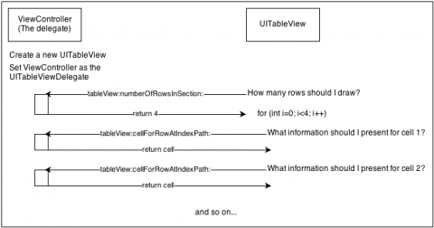
Delegation….

Slide 15
The Target-Action Mechanism
The target-action mechanism enables a control object—that is, an object such as a button, slider, or text field—to send a message to another object that can interpret the message and handle it as an application-specific instruction
The receiving object, or the target, is usually a custom controller object
The message—named an action message—is determined by a selector, a unique runtime identifier of a method

Slide 16
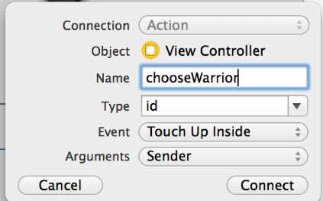
Action on a Button

Slide 17
The Facade Design Pattern
The Facade design pattern provides a single interface to a complex subsystem
Instead of exposing the user to a set of classes and their APIs, you only expose one simple unified API
The user of the API is completely unaware of the complexity that lies beneath
This pattern is ideal when working with a large number of classes, particularly when they are complicated to use or difficult to understand

Slide 18
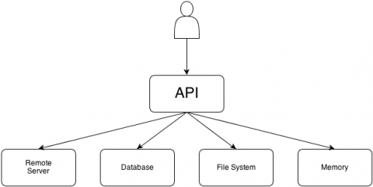
The Facade Design Pattern…

Slide 19
Quick Links
For more on design pattern visit links
Link 1 https://developer.apple.com/legacy/library/documentation/Cocoa/Conceptual/CocoaFundamentals/CocoaDesignPatterns/CocoaDesignPatterns.html
Link 2 http://www.raywenderlich.com/46988/ios-design-patterns

