Slide 1

Submitting Your App
Sisoft Technologies Pvt Ltd
SRC E7, Shipra Riviera Bazar, Gyan Khand-3, Indirapuram, Ghaziabad
Website: www.sisoft.in Email:info@sisoft.in
Phone: +91-9999-283-283

Slide 2
before you even get started
Your app’s name
Your app’s description
Your app’s icon sized 512px by 512px
At least one app screenshot. These should be sized 320×460 (no status bar); 320×480; 640×920 (retina, no status); 640×960 (retina); or, for landscape, 480×300 (no status bar); 480×320; 960×600 (retina, no status bar); or 960×640 (retina)

Slide 3
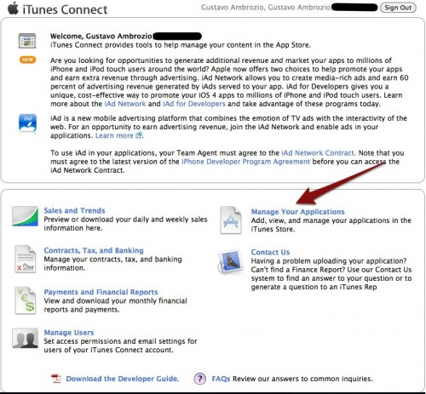
Manage Your Applications” in iTunes Connect

Slide 4
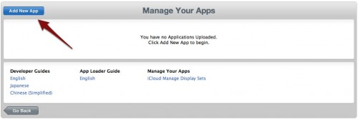
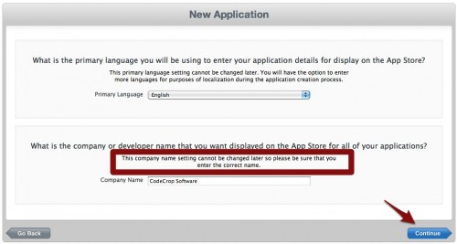
Add New App

Slide 5
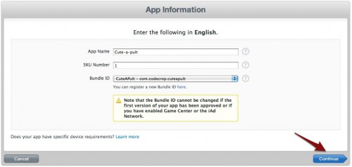
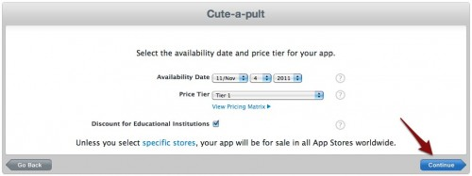
App Information

Slide 6
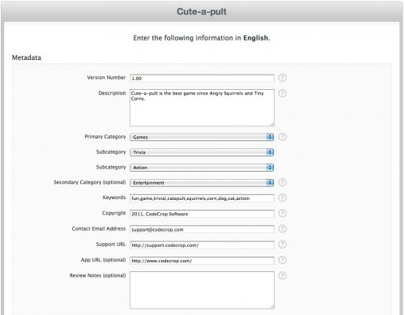
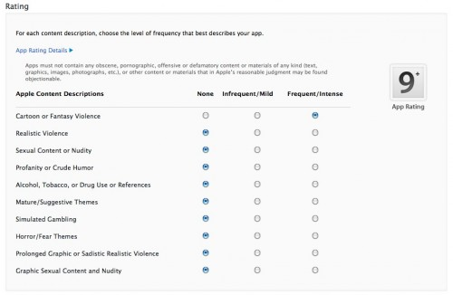

Slide 7
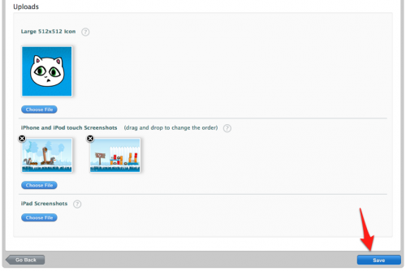
After uploading, check order of the screenshots and click “Save”

Slide 8
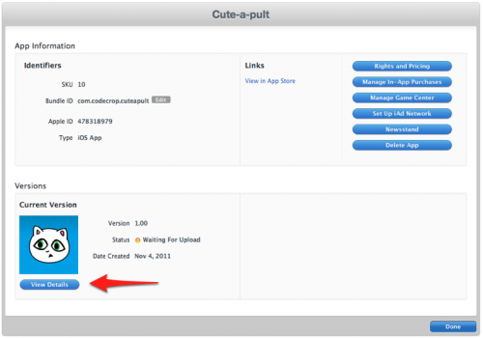
Ready to Upload Binary

Slide 9
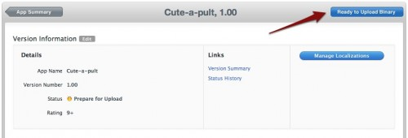
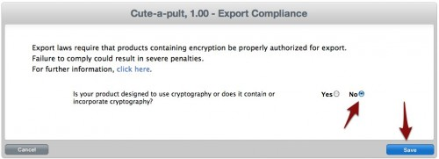
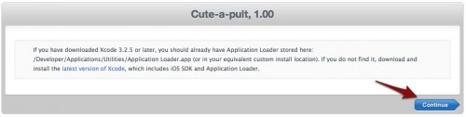

Slide 10
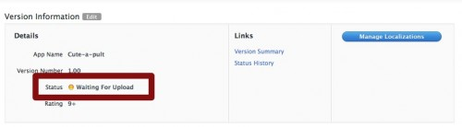
ready for upload

Slide 11
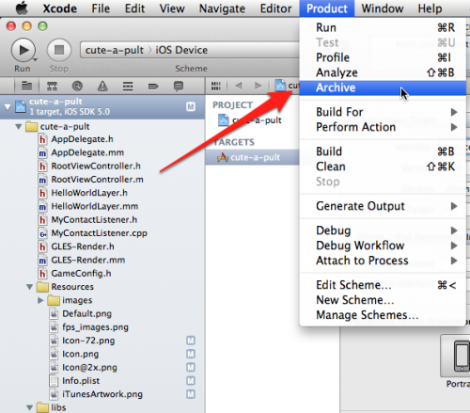
Submitting with Xcode

Slide 12
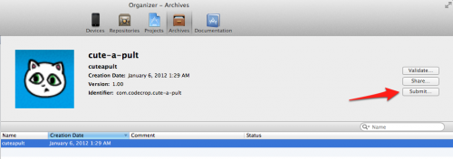
open the Organizer--->Archives tab

Slide 13
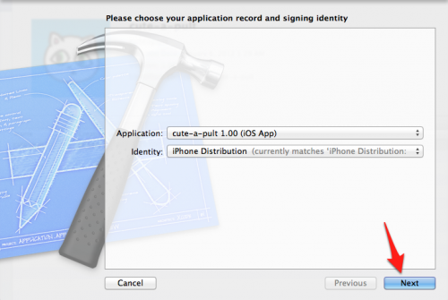
Choose the app

Slide 14
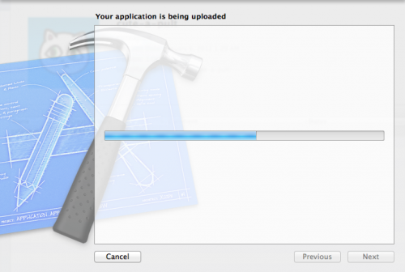
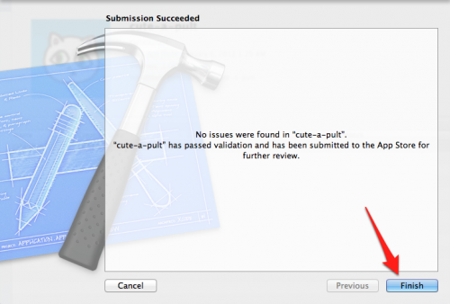
Your app will start uploading to iTunes Connect

Slide 15
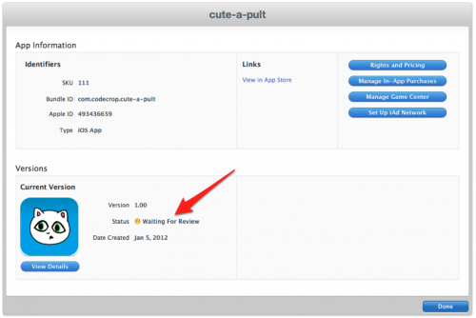
Waiting For Review

