Slide 1

Location And Maps
Sisoft Technologies Pvt Ltd
SRC E7, Shipra Riviera Bazar, Gyan Khand-3, Indirapuram, Ghaziabad
Website: www.sisoft.in Email:info@sisoft.in
Phone: +91-9999-283-283

Slide 2
Core Location
Core Location framework is used to determine the current latitude and longitude of a device
To use the features of the Core Location framework, you must link your app to CoreLocation.framework in your Xcode project
To access the classes and headers of the framework, include an #import <CoreLocation/CoreLocation.h> statement at the top of any relevant source files.

Slide 3
Core Location
There are three technologies that core location uses :
  GPS
  Reads microwave signals from multiple satellites to determine the current location
  Cell Tower Triangulation
  Determine the current location by calculation based on location of cell towers in iPhone’s range.
  Wi-Fi positioning Service (WPS)
  Uses IP address from iPhone’s Wi-Fi connection by referencing database of service providers and areas they service

Slide 4
CLLocationManager
This class defines the interface for configuring the delivery of location-related events to your application
To interact with core location we need to create an instance of Location Manager
  CLLocationManager *locationManager =[[CLLocationManager alloc]init];
When you are ready to start polling for location, you tell the location manager to start
  [locationManager startUpdatingLocation];

Slide 5
Setting Desired Accuracy
The accuracy is set using CLLocationAccuracy
Value, a type that’s defined as double
  kCLLocationAccuracyBest
  kCLLocationAccuracyNearestTenMeters
  kCLLocationAccuracyHundredMetres
  kCLLocationAccuracyKilometers
  kCLLocationAccuracyThreeKilometers
Setting Delegate and Accuracy:
locationManager.delegate=self;
locationManager.desiredAccuracy= kCLLocationAccuracyBest

Slide 6
Setting Distance Filter
By specifying distance filter you can tell Location manager not to notify for every change in location but to only notify you when location changes by certain amount
Specifying a distance filter of 1000 tells location manager not to notify the delegate until the iPhone has moved at least 1000 meters from previously reported position
For example:
locationManager.distanceFilter=1000.0f;

Slide 7
Location Object
(CLLocation)
Represents the location data generated by a CLLocationManager object
The latitude and longitude are stored in property called coordinate
  CLLocationDegress latitude=theLocation.coordinate.latitude
  CLLocationDegress latitude=theLocation.coordinate.latitude
The CLLocation object also has a property called altitude that tell you how many metres above the sea level you are:
- CLLocationDistance altiude=theLocation.altitude

Slide 8
CLLocationManagerDelegate protocol
The location manager must confirms to CLLocationManagerDelegate protocol, which defines two methods, both are optional
One method is called by location manager when it has determined current location or detects any change in location:
locationManager:didUpdateToLocation:fromLocation
Other method is called when location manager encounters an error:
locationManager:didFailWithError

Slide 9
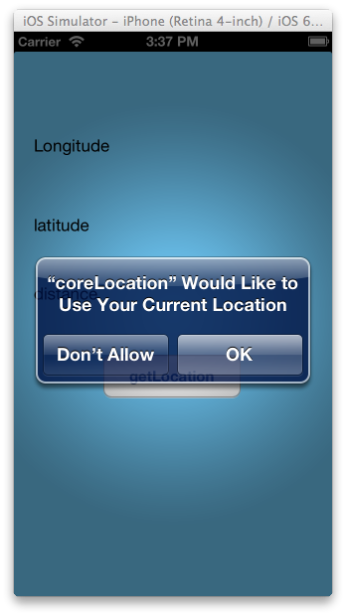
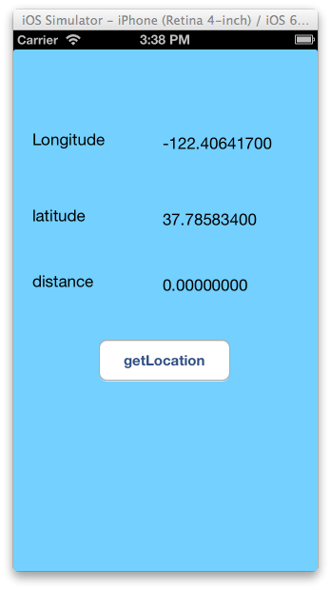

Slide 10
MapKit
Maps are provided by the Map Kit framework, which supports both the display and annotation of maps
Plan
  Adding MapKit to your iPhone Application
  Setting and zooming the Position
  Annotations
  Geocoding

Slide 11
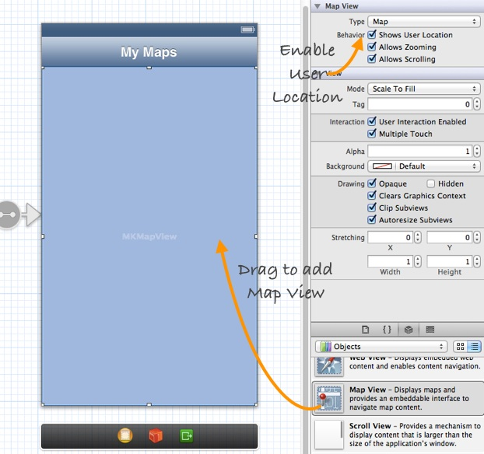
Adding Mapkit

Slide 12
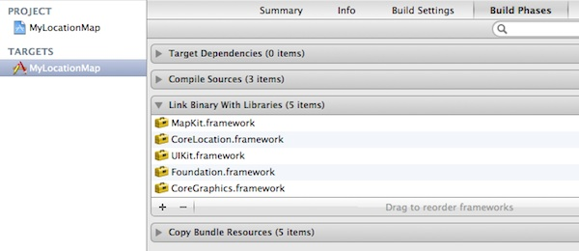
Adding Framework

Slide 13
MKMapViewDelegate protocol
The MKMapViewDelegate protocol defines a set of optional methods that you can use to receive map-related update messages
The MKMapViewDelegate protocol have methods for:
  Responding to Map Position Changes
  Loading the Map Data
  Tracking the User Location
  Managing Annotation Views
  Managing the Display of Overlays

Slide 14
Map Region to Display
A structure that defines which portion of the map to display.
Set the region property (MKCoordinateRegion)
Define the center point and a span
Span defines the vertical & horizontal distance to display (zoom)
{ MKCoordinateRegion region; region.center.latitude = [eventVenue.latitude doubleValue]; region.center.longitude = [eventVenue.longitude doubleValue]; region.span.latitudeDelta = 0.0039; region.span.longitudeDelta = 0.0034; //zoom ~.3 miles mapView.region = region;
}

Slide 15
Annotations
Annotations offer a way to highlight specific coordinates on the map and provide additional information about them
In order to display an annotation on a map, your app must provide two distinct objects:
  An object that conforms to the MKAnnotation protocol and manages the data for the annotation(annotation object)
  A view used to draw the visual representation of the annotation(annotation view)

Slide 16
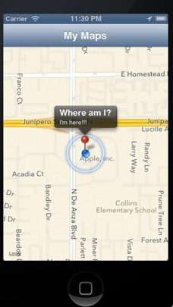
MKPointAnnotation
// Add an annotation
  MKPointAnnotation *point =[[MKPointAnnotation alloc] init];
  point.coordinate = userLocation.coordinate; point.title = @"Where am I?";
  point.subtitle = @"I'm here!!!"; [self.mapView addAnnotation:point];

Slide 17
CLGeocoder
The CLGeocoder class provides services for converting between a GPS coordinate and the user-readable address of that coordinate
By specify the latitude and longitude of a given location, you can use CLGeocoder to find a user-readable address
The result (i.e. the address) returned by CLGeocoder is saved in a CLPlacemark object

