Slide 1

Notification
Sisoft Technologies Pvt Ltd
SRC E7, Shipra Riviera Bazar, Gyan Khand-3, Indirapuram, Ghaziabad
Website: www.sisoft.in Email:info@sisoft.in
Phone: +91-9999-283-283

Slide 2
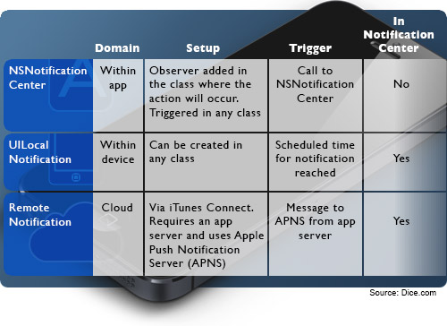
Notification Types

Slide 3
NSNotificationcenter
NSNotificationcenter is one way you can communicate with other object in a project
An NSNotificationCenter object (or simply, notification center) provides a mechanism for broadcasting information within a program
Communication of objects can be done by delegate
Object may register as observers with notification center and while other can post the notification

Slide 4
NotificationCenter-Register as Observer
Use addObserver to register.
NSNotificationCenter *ncenter =[[NSNotificationCenter defaultNotification]
[ncenter addObserver:self selector:@selector(receivednotification:) name:@”notification id” object:nil];
The method specified by notificationSelector must have one and only one argument (an instance of NSNotification).
-(void)receivednotification:(NSNotification *)notification
{
// write code here ;
}

Slide 5
NotificationCenter – Post Message
Notification name should be matched in class where notification is posted and in observer class.
[nCenter postNotificationName:@”MyNotification” object:myarray ];
Sample Example:
http://code.tutsplus.com/tutorials/ios-sdk-nsnotification--mobile-10619

Slide 6
Notifications: Local & Push
Local notifications and push notifications are ways for an application that isn’t running in the foreground to let its users know it has information for them
The information could be a message, an impending calendar event, or new data on local or on remote server
When presented by the operating system, local and push notifications look and sound the same

Slide 7
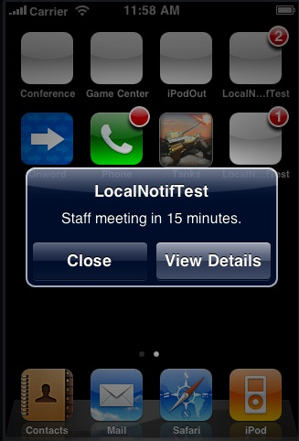
Notification View

Slide 8
Scheduling Local Notifications
Creating and scheduling local notifications in iOS requires that you perform a few simple steps:
Allocate and initialize a UILocalNotification object
Set the date and time that the operating system should deliver the notification(fireDate)
Configure the substance of the notification: alert, icon badge number, and sound
Schedule the local notification for delivery

Slide 9
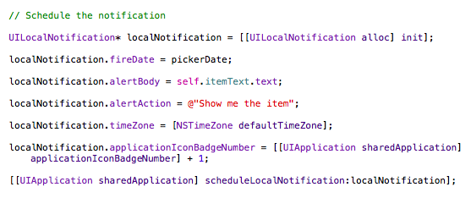
Scheduling Local Notifications…

Slide 10
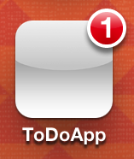
Handling Local Notifications
Application is NOT Running
When the app is not running, users see notifications in the following ways, depending on the notification settings
Displaying an alert or banner
Badging the app icon
Playing a sound

Slide 11
Application not running…
By tapping on action button of the notification, users will launch the app
In this case, the application:didFinishLaunchingWithOptions: method of the application delegate is called
Change the method to Set icon badge number to zero and Handle launching from a notification

Slide 12
Applicaton is Running in Foreground
If the app is running while the notification is delivered, there is no alert displayed on screen
The application automatically calls its delegate’s application:didReceiveLocalNotification: method
Add this method in app delegate .m file and handell the notification
For example on locale notification visit:
http://www.appcoda.com/ios-programming-local-notification-tutorial/

Slide 13
Push Notifications
Push notifications—also known as remote notifications—arrive from outside a device
They originate on a remote server—the application’s provider
And are pushed to applications on devices (via the Apple Push Notification service) when there are messages to see or data to download

Slide 14
Using Push Notifications
When to use them
Social networking
Current events
Games
When not to use them
Delivering critical application information
Push may not be available
Instead, pull data from server

Slide 15
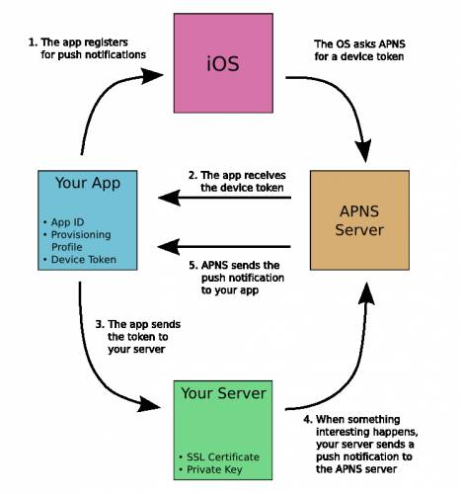
Push Notification Lifecycle

Slide 16
Registering for Notifications
Application launch
{
UIRemoteNotificationType myTypes = UIRemoteNotificationTypeSound |
UIRemoteNotificationTypeBadge;
[application registerForRemoteNotificationTypes:myTypes];}

Slide 17
Registering for Notifications…
Delegate methods for
Successful registration
- (void)application:(UIApplication *)applicationdidRegisterForRemoteNotificationsWithDeviceToken:(NSData *)token
Failure to register
- (void)application:(UIApplication *)applicationdidFailToRegisterForRemoteNotificationsWithError:(NSError *)error

Slide 18
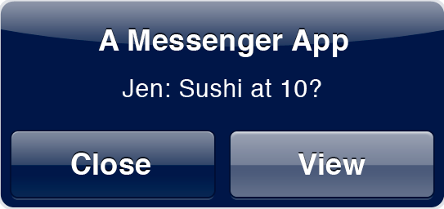
Creating Push Notifications
Message payload
aps dictionary reserved for the sound, badge, or alert keys
All keys optional
{
"aps" : { "alert" : "Jen: Sushi at 10?”,"badge" : 1,"sound" : "Jingle.aiff”},"acme1" : "conversation9964”}

Slide 19
Handling Push Notifications
If your app is running, you’ll only get
- (void)application:(UIApplication *)applicationdidReceiveRemoteNotification
(NSDictionary *)userInfo
If not, tapping View will launch your app with:
In application:didFinishLaunchingWithOptions: method
{ NSDictionary *userInfo = [launchOptions objectForKey:UIApplicationLaunchOptionsRemoteNotificationKey];
}

