Slide 1

Web Services
Sisoft Technologies Pvt Ltd
SRC E7, Shipra Riviera Bazar, Gyan Khand-3, Indirapuram, Ghaziabad
Website: www.sisoft.in Email:info@sisoft.in
Phone: +91-9999-283-283

Slide 2
About Web Services
Fetch content via HTTP
Parse the content
Content is usually
  XML
  JSON
Example: weather data,bus traffic information Twitter…

Slide 3
Fetching content over HTTP
In iOS it’s easy to fetch content over HTTP
Classes needed
  NSURL
  NSURLRequest
  NSURLConnection
  NSURLSession

Slide 4
NSURL
NSURL object represents a URL that contains the location of resource(file)
  NSURL *baseURL = [NSURL URLWithString:@“http://www.sisoft.in"];
  NSURL *url = [NSURL URLWithString:@"folder/file.html" relativeToURL:baseURL];

Slide 5
NSURLRequest
Represents a URL Load request
HTTPMethod may be set. The default HTTP method is “GET”
The default cache policy is NSURLRequestUseProtocolCachePolicy
The default timeout interval is 60 seconds
Simply append your key/value pair to the post string

Slide 6
NSURLRequest
Represents a URL Load request
HTTPMethod may be set. The default HTTP method is “GET”.
The default cache policy is NSURLRequestUseProtocolCachePolicy and the default timeout interval is 60 seconds
Simply append your key/value pair to the post string

Slide 7
NSURLRequest
NSURL *aUrl = [NSURL URLWithString:@"http://www.apple.com/"];
NSMutableURLRequest *request = [NSMutableURLRequest requestWithURL:aUrl cachePolicy:NSURLRequestUseProtocolCachePolicy timeoutInterval:60.0];
[request setHTTPMethod:@"POST"];
NSString *postString = @"company=Locassa&quality=AWESOME!";
[request setHTTPBody:[postString dataUsingEncoding:NSUTF8StringEncoding]];
NSURLConnection *connection= [[NSURLConnection alloc] initWithRequest:request delegate:self];

Slide 8
NSURLConnection
Loads the contents of a URL by providing a URL request object
Provides convenience class methods to load URL requests both asynchronously using a callback block and synchronously
NSURLConnection Protocols:
  NSURLConnectionDelegate: credential handling
  NSURLConnectionDataDelegate: progress information
  NSURLConnectionDownloadDelegate: Only for downloads
Notes:
http://codewithchris.com/tutorial-how-to-use-ios-nsurlconnection-by-example/

Slide 9
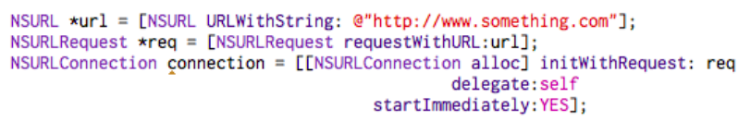
NSURLConnection Example
*connection

Slide 10
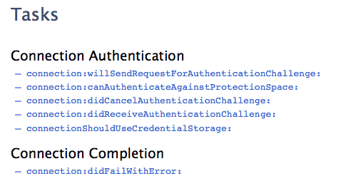
NSURLConnectionDelegate

Slide 11
PARSING XML Options
SAX
  Event driven
  Does not consume lot of memory
  iOS:NSXMLParser
DOM
  Reads entire document to memory
  You can move in the object tree
  Libxml2–C based API for SAX and DOM

Slide 12
Parsing XML Data using NSXMLParser
iOS has NSXMLParser for parsing data
The NSXMLParser opens xml data and calls methods like
  didStartElement
  foundCharacters
  didEndElement

Slide 13

Parsing XML Data using NSXMLParser….
The NSXMLParserDelegate provides you methods
For handelling parsing

Slide 14
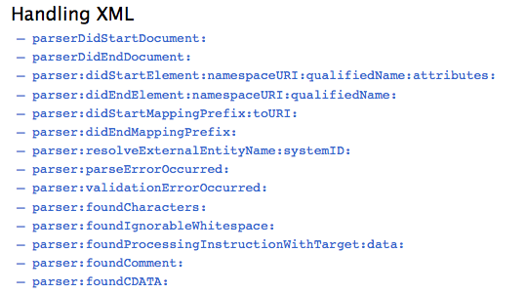

Slide 15
JSON(JavaScript Object Notation)
JSON is a lightweight data-interchange format
It is easy for humans to read and write
It is easy for machines to parse and generat
JSON is a text format that is completely language independent but uses conventions that are familiar to programmersof the C-family of languages, including C, C++, C#, Java, JavaScript, Perl, Python, and many others
JSON is built on two structures:
  A collection of name/value pairs(mostly used)
  An ordered list of values

Slide 16
NSJSONSerialization
You use the NSJSONSerialization class to convert JSON to Foundation objects and convert Foundation objects to JSON
An object that may be converted to JSON must have the following properties
  The top level object is an NSArray or NSDictionary
  All objects are instances of NSString, NSNumber, NSArray, NSDictionary, or NSNull
  All dictionary keys are instances of NSString
  Numbers are not NaN or infinity

Slide 17
Parsing JSON from the data
We can use the method dataWithJSONObject:options:error:
to parse a jason object to data
Ex- NSDictionary* Data = [NSJSONSerialization JSONObjectWithData:responseData options:kNilOptions error:&error];
  where response data is jason data
  Option is parsing option
  error for error message

Slide 18
NSJSONReadingOptions
kNilOptions:
  kNilOptions is just a constant for 0 which means no parsing option is choosen
NSJSONReadingMutableContainers:
  The arrays and dictionaries created will be mutable. Good if you want to add things to the containers after parsing it.
NSJSONReadingAllowFragments:
  Parses out the top-level objects that are not arrays or dictionaries.

Slide 19
Generating JSON Data
Now lets do opposite ,from NSDictionary lets build some JSON data
Ex-
NSData* jsonData = [NSJSONSerialization dataWithJSONObject:info options:NSJSONWritingPrettyPrinted error:&error];
-Where info is NSDictionary with information
-Option for crating jason type
  -error for error message

Slide 20
NSJSONWritingOptions
For the options parameter there’s only one possible value – NSJSONWritingPrettyPrinted
if you want to see the JSON use NSJSONWritingPrettyPrinted as this will format it nicely
If you want to send the JSON over the Internet to a server use kNilOptions as this will generate compact JSON code
For example on working with json visit link:
http://www.raywenderlich.com/5492/

