Slide 1

Drawing And Animations
Terms: CALayer, NSBezierPath,
Sisoft Technologies Pvt Ltd
SRC E7, Shipra Riviera Bazar, Gyan Khand-3, Indirapuram, Ghaziabad
Website: www.sisoft.in Email:info@sisoft.in
Phone: +91-9999-283-283

Slide 2
About Animation
Animations provide fluid visual transitions between different states of your user interface
In iOS, animations are used extensively to reposition views, change their size, remove them from view hierarchies, and hide them
You might use animations to convey feedback to the user or to implement interesting visual effects

Slide 3
About Animation
In iOS, creating sophisticated animations does not require you to write any drawing code
All of the animation techniques described in this chapter use the built-in support provided by Core Animation
All you have to do is trigger the animation and let Core Animation handle the rendering of individual frames
In iPhone there are various type of animation and their delegate method.

Slide 4
What Can Be Animated?
Both UIKit and Core Animation provide support for animations, but the level of support provided by each technology varies
In UIKit, animations are performed using UIView objects
Views support a basic set of animations that cover many common tasks

Slide 5
UIKit:UIView Animation
There are two different ways to initiate animations:
In iOS 4 and later, use the block-based animation methods. (Recommended)
Use the begin/commit animation methods
The following properties of the UIView class are animatable:
frame : The frame rectangle describes the view’s location and size in its superview’s coordinate system
bounds: The bounds rectangle describes the view’s location and size in its own coordinate system
center: The center of the frame.
transform: Specifies the transform applied to the receiver, relative to the center of its bounds.
alpha: floating-point number in the range 0.0 to 1.0, where 0.0 represents totally transparent and 1.0 represents totally opaque.
backgroundColor:

Slide 6
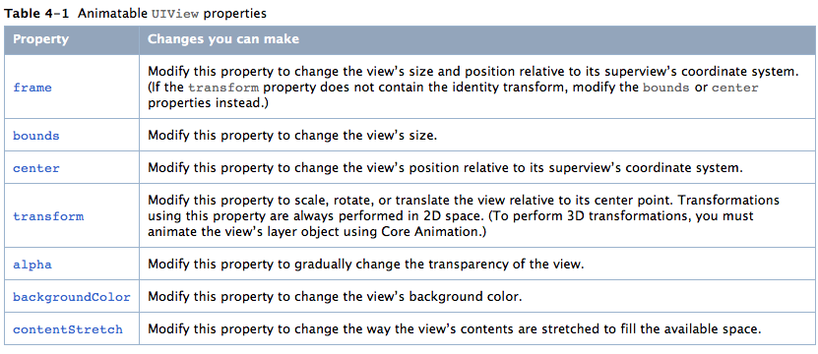
Animatable UIView Properties

Slide 7
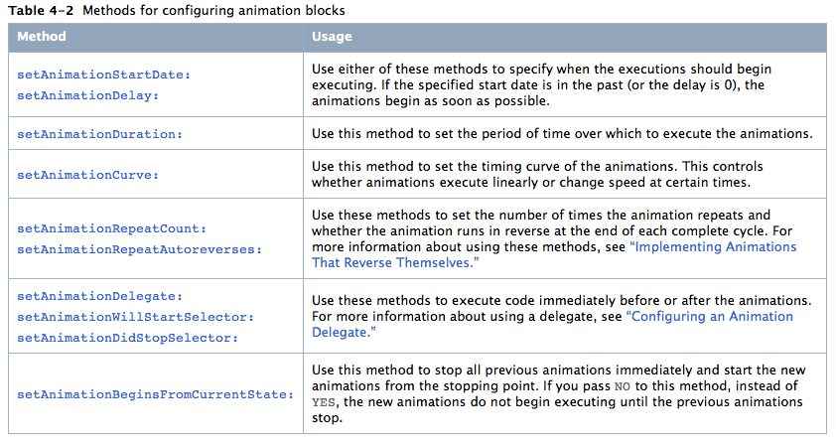
Methods For Animation

Slide 8
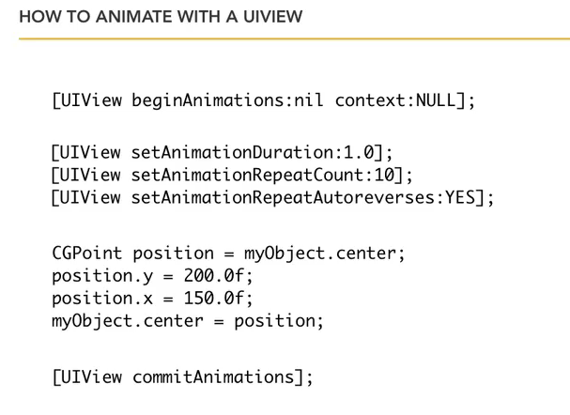
Animaton Block

Slide 9
UIView Animation: Block Based Methods
Block-based methods are class method and offer different levels of configuration for the animation block. These methods are:
animateWithDuration:animations:
animateWithDuration:animations:completion:
animateWithDuration:delay:options:animations:completion:
[UIView animateWithDuration:1.0
delay: 0.0
options: UIViewAnimationOptionCurveEaseIn
animations:^{
firstView.alpha = 0.0;
secondView.alpha = 1.0;}];

Slide 10
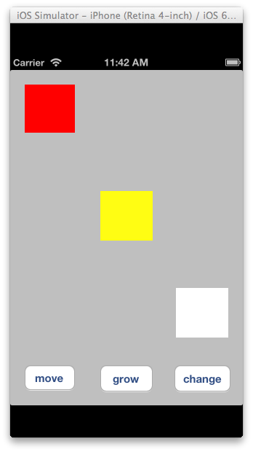
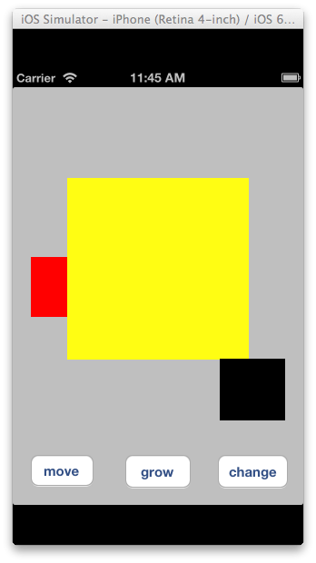
View Based Animation

Slide 11
Frame By Frame Animation
Frame by frame animation is UIImage View
based animation
One UIImage View will contain array of images
Images in UIImage View will be added by add
animationimages property
Frame by Frame animation can be startd by sending message(startAnimating) to UIImage View

Slide 12
Frame By Frame Animation
// Load images
NSArray *imageNames = @[@"win_1.png", @"win_2.png", @"win_3.png", @"win_4.png”, @"win_5.png", @"win_6.png", @"win_7.png", @"win_8.png”,];
NSMutableArray *images = [[NSMutableArray alloc] init];
for (int i = 0; i < imageNames.count; i++) {
[images addObject:[UIImage imageNamed:[imageNames objectAtIndex:i]]]; }
// Normal Animation
UIImageView *animationImageView = [[UIImageView alloc] initWithFrame:CGRectMake(60, 95, 86, 193)];
animationImageView.animationImages = images;
animationImageView.animationDuration = 0.5;
[self.view addSubview:animationImageView];
[animationImageView startAnimating];

Slide 13
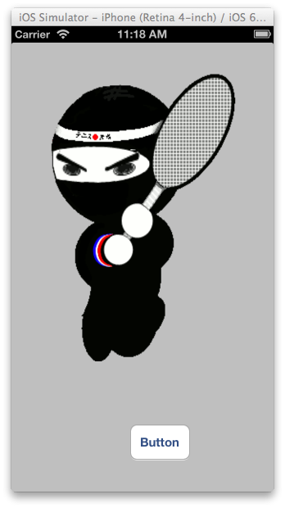
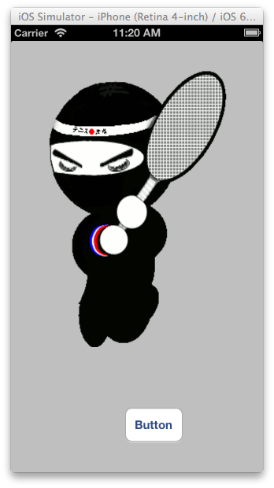
Frame By Frame Animation

Slide 14
Core Animation
Core Animation provides a general purpose system for animating views and other visual elements of your app
Core Animation is not a replacement for your app’s views
Instead, it is a technology that integrates with views to provide better performance and support for animating their content
It achieves this behavior by caching the contents of views into bitmaps that can be manipulated directly by the graphics hardware

Slide 15
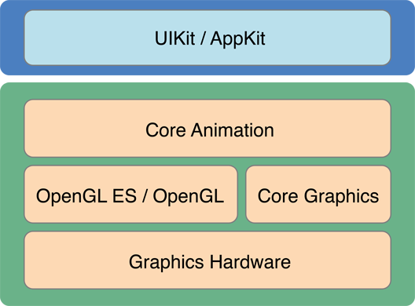
Core Animation…
There are two classes that make Core Animation work: CALayer and CAAnimation
To use any part of Core Animation, you need to add the QuartzCore framework to your project

Slide 16
CALayer
The CALayer class manages image-based content and allows you to perform animations on that content
Layers are often used to provide the backing store for views but can also be used without a view to display content
A layer’s main job is to manage the visual content that you provide but the layer itself has visual attributes that can be set, such as a background color, border, and shadow

Slide 17
CALayer…
The neat thing about the CALayer class is that it contains a lot of properties that you can set on it to affect the visual appearance, such as:
The size and position of the layer
The layer’s background color
The contents of the layer (an image, or something drawn with core graphics
For more on CALayer visit:
http://www.raywenderlich.com/2502/calayers-tutorial-for-ios-introduction-to-calayers-tutorial

Slide 18
CALayer Animatable Properties
Opacity
Position
Transform
Backgroundcolor
Bounds
Frame
For more visit link:
https://developer.apple.com/library/ios/documentation/Cocoa/Conceptual/CoreAnimation_guide/AnimatableProperties/AnimatableProperties.html

Slide 19
CABasicAnimation
It has two properties: fromValue and toValue, and it inherits CAAnimation’s duration property
When a basic animation is added to a layer, the property to be animated is set to the value in fromValue
Over the time specified by duration, the value of the property is interpolated linearly from fromValue to toValue

Slide 20
CABasicAnimation
CABasicAnimation* fadeAnim = [CABasicAnimation animationWithKeyPath:@"opacity »] ;
fadeAnim.fromValue = [NSNumber numberWithFloat:1.0];
fadeAnim.toValue = [NSNumber numberWithFloat:0.0];
fadeAnim.duration = 1.0;
fadeAnim.repeatCount=20 ;
// CALayer *theLayer=self.button10.layer ;
CALayer *theLayer=self.view.layer ;
[theLayer addAnimation:fadeAnim forKey:@"opacity"];
// Change the actual data value in the layer to the final value.
theLayer.opacity = 1.0;

Slide 21
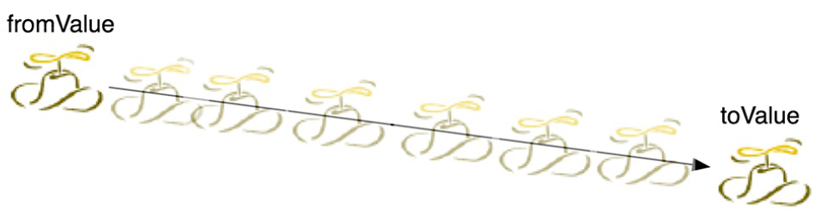
CABasicAnimation

Slide 22
CAKeyframeAnimation
The difference between CABasicAnimation and CAKeyframeAnimation is that a basic animation only interpolates two values while a keyframe animation can interpolate as many values as you give it
These values are put into an NSArray in the order in which they are to occur
This array is then set as the values property of a CAKeyframeAnimation instance

Slide 23
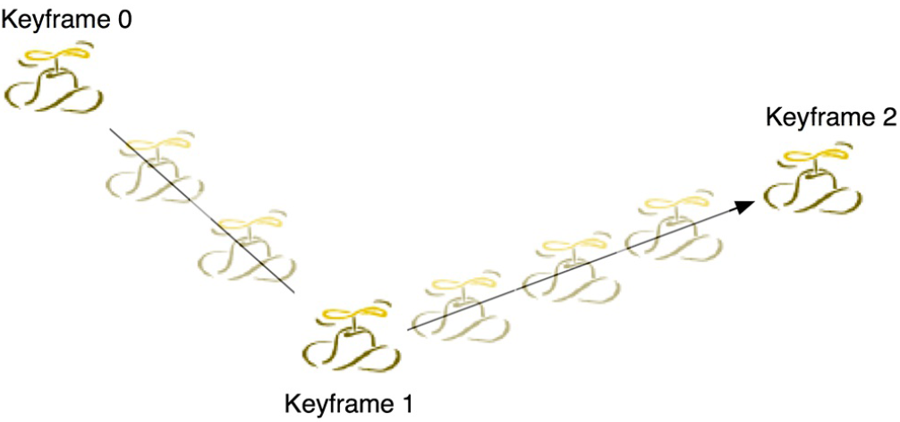
CAKeyframeAnimation

Slide 24
Other Animations
Group Animation
Various animation can be grouped together
Transform Animation
Can be added to basic as well to keyframe animation
For Key Path Support for Structures visit link:
https://developer.apple.com/library/ios/documentation/Cocoa/Conceptual/CoreAnimation_guide/Key-ValueCodingExtensions/Key-ValueCodingExtensions.html

Slide 25
Drawing
Sisoft Technologies Pvt Ltd
SRC E7, Shipra Riviera Bazar, Gyan Khand-3, Indirapuram, Ghaziabad
Website: www.sisoft.in Email:info@sisoft.in
Phone: +91-9999-283-283

Slide 26
Custom Drawing
High-quality graphics are an important part of a well-designed application.
High-quality graphics is one of the things that sets Mac OS X apart from many other operating systems.
Mac OS X uses color, transparency, and its advanced compositing system to give programs a more fluid and inviting appearance.

Slide 27
Custom Drawing….
Drawing is only one step in the process of creating a fully functional Cocoa view.
Drawing is a fundamental part of most Cocoa applications.
Cocoa does maximum parts of the drawing for you.

Slide 28
Cocoa Drawing Support
The Cocoa drawing environment is available to all applications.
There are numerous classes and functions for drawing everything from primitive shapes to complex images and text.
The Cocoa drawing environment is compatible with all of the other drawing technologies in Mac OS X

Slide 29
The Painter’s Model
Cocoa drawing uses the painter’s model for imaging.
In the painter’s model successive drawing operation applies a layer of “paint” to an output “canvas.
This model allows you to construct extremely sophisticated images from a small number of powerful primitives.

Slide 30
The Graphics Context
A graphics context encapsulates all of the information needed to draw to an underlying canvas.
graphics contexts are represented by the NSGraphicsContext class.
The most common drawing destination is your application's windows.
Most drawing occurs on your application's main thread.

Slide 31
The Graphics Context…..
Graphics context objects make it possible to draw from secondary threads as well.
You can also create graphics contexts explicitly.
There also some are other ways to create graphics context objects explicitly.

Slide 32
Color and Color Spaces
Color is an important part of drawing.
Before drawing any element, you must choose the colors.
Cocoa provides complete support for specifying color information.
There are several different color spaces.

Slide 33
Basic Drawing Elements
The creation of complex graphics often has a simple beginning.
In Cocoa, everything you draw is derived from a set of basic elements.
These elements are fundamental to all drawing operations and are described in the following sections.

Slide 34
Shape Primitives
Cocoa provides support for drawing shape primitives with the NSBezierPath class.
You can use this class to create several shapes.
Lines
Rectangles
Ovals and circles
Arcs
Bezier cubic curves
For more on NSBezierPath Class Reference Visit link:
https://developer.apple.com/library/mac/documentation/Cocoa/Reference/ApplicationKit/Classes/NSBezierPath_Class/Reference/Reference.html

