Slide 1

Data Persistence
Sisoft Technologies Pvt Ltd
SRC E7, Shipra Riviera Bazar, Gyan Khand-3, Indirapuram, Ghaziabad
Website: www.sisoft.in Email:info@sisoft.in
Phone: +91-9999-283-283

Slide 2
App SandBox Directory
The operating system installs each iOS application in a sandbox directory, which contains the application bundle directory and three additional directories, Documents, Library, and tmp
The Documents directory is meant for user data
The Library directory is used for application data that isn't strictly tied to the user
The tmp directory should only be used for temporarily storing files and this is not included in backups
The application's sandbox directory, often referred to as its home directory, can be accessed by calling a simple Foundation function, NSHomeDirectory()
NSLog(@"HOME > %@", NSHomeDirectory());

Slide 3
Data Persistence Options
User defaults
Property lists
SQLite
Core Data

Slide 4
NSUserDefaults
The NSUserDefaults class provides a programmatic interface for interacting with the defaults system
The defaults system allows an application to customize its behaviour to match a user’s preferences
NSUserDefault *nud=[NSUserDefaults standardUserDefaults]
[nud setObject:@”xxxx” forKey:@”YYYY”]
NSString *user=[nud objectForKey:@”YYYY] ;

Slide 5
USING plist
A property list is a representation of a hierarchy of objects that can be stored in the file system and reconstituted later
Property lists give applications a lightweight and portable way to store small amounts of data
Property lists are easy to create programmatically and are even easier to serialize into a representation that is persistent

Slide 6
Property List Types and Objects
Property lists consist only of certain types of data: dictionaries, arrays, strings, numbers (integer and float), dates, binary data, and Boolean values

Slide 7
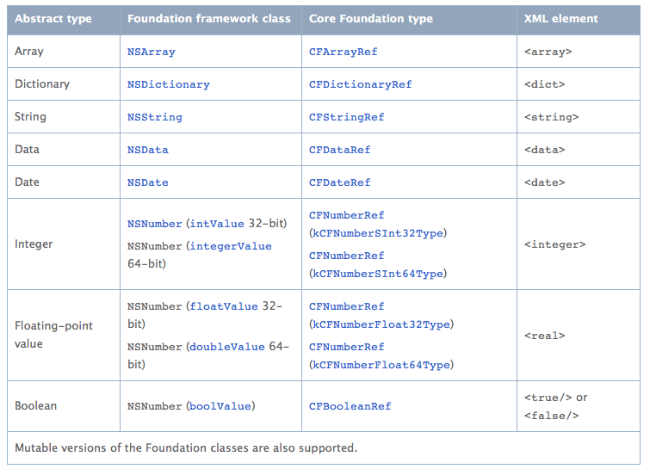

Slide 8
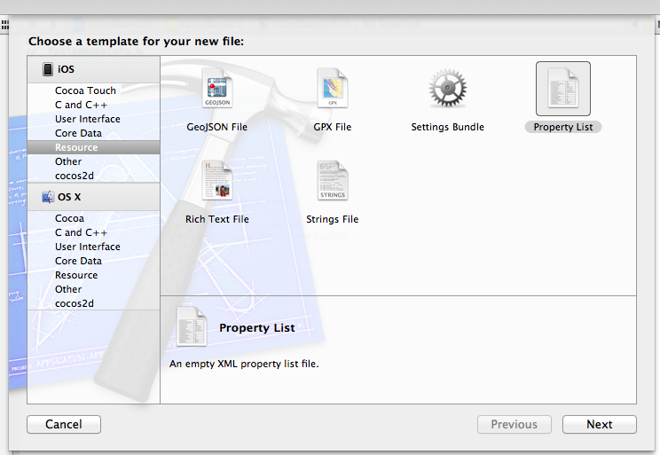
Adding plist

Slide 9
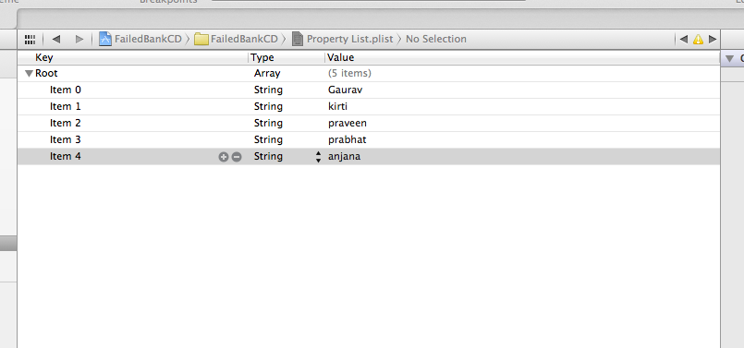
Plist view

Slide 10
Reading pList
Find out the path of plist file
  NSString *path = [[NSBundle mainBundle] pathForResource:@"recipes" ofType:@"plist"];
  Property List may be an Dictionary or an Array. Load the file content and read the data into arrays
Array
  NSMutableArray *data=[[NSMutableArray alloc] initWithContentsOfFile:path] ;
Dictionary
  NSDictionary *dict = [[NSDictionary alloc] initWithContentsOfFile:path];
  NSArray *tableData = [dict allValues];

Slide 11
Writing pList
NSString* plistPath = nil;
NSFileManager* manager = [NSFileManager defaultManager];
if (plistPath = [[[NSBundle mainBundle] bundlePath] stringByAppendingPathComponent:@"Contents/Info.plist"]) {
if ([manager isWritableFileAtPath:plistPath]) {
NSMutableDictionary* infoDict = [NSMutableDictionary dictionaryWithContentsOfFile:plistPath];
[infoDict setObject:[NSNumber numberWithBool:hidden] forKey:@"LSUIElement"];
[infoDict writeToFile:plistPath atomically:NO];
[manager changeFileAttributes:[NSDictionary dictionaryWithObject:[NSDate date] forKey:NSFileModificationDate] atPath: [[NSBundle mainBundle] bundlePath]]; } }

Slide 12
SQLite

Slide 13
Sqlite
iOS includes the popular SQLite library, a lightweight yet powerful relational database engine that is easily embedded into an application
Used in countless applications across many platforms, SQLite is considered a de facto industry standard for lightweight embedded SQL database programming
Unlike the object-oriented Core Data framework, SQLite uses a procedural, SQL-focused API to manipulate the data tables directly

Slide 14
SQLite Datatypes
SQLite is weakly typed having following storage types:
NULL: indicates a NULL value
INTEGER: used to store an integer, according to the size can be used to store 1,2,3,4,6,8.
REAL: floating-point
TEXT: In accordance with string to store
BLOB: according to the binary value is stored without any change.

Slide 15
Sqlite API Commands
sqlite3_open() : This routine opens a connection to an SQLite database file and returns a database connection object.
  int sqlite3_open(
  const char *filename, /* Database filename (UTF-8) */ sqlite3 **ppDb /* OUT: SQLite db handle */
  );

Slide 16
Sqlite API Commands
sqlite3_exec() : convenience wrapper around sqlite3_prepare_v2(), sqlite3_step(), and sqlite3_finalize(), that allows an application to run multiple statements of SQL without having to use a lot of C code
  int sqlite3_exec(
  sqlite3*, /* An open database */
  const char *sql, /* SQL to be evaluated */
  int (*callback)(void*,int,char**,char**), /* Callback function */
  void *, /* 1st argument to callback */
  char **errmsg /* Error msg written here */
  );

Slide 17
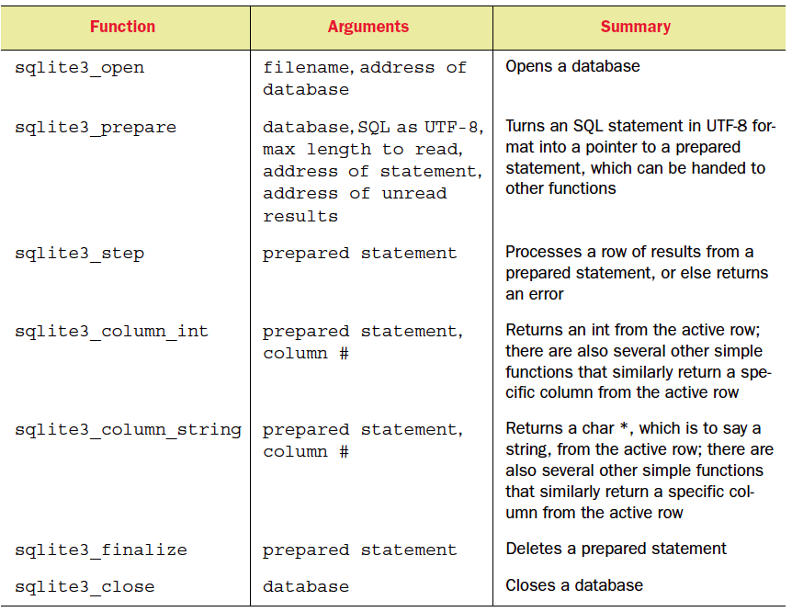
The most important SQLite API commands

Slide 18
Developing Apps using Sqlite
Configure the project to include the SQLite dynamic library (libsqlite3.dylib) in choose frameworks.
Import the sqlite3.h header file into any files where we make use of SQLite
Declare a variable pointer to a structure of type sqlite3 that will act as the reference to our database
  @property (nonatomic) sqlite3 *contactDB;
Declare an NSString property in which to store the path to the database
  @property (strong, nonatomic) NSString *databasePath;

Slide 19
Sqlite: Creating Databases
Database will reside in application sandbox. App sandbox home path can be find by method NSHomeDirectory()
Build the path to the database file
  databasePath = [[NSString alloc] initWithString: [docsDir stringByAppendingPathComponent: @"student.db"]];
When the application is launched it will need to check whether the database file already exists
  NSFileManager *filemgr = [NSFileManager defaultManager];
  if ([filemgr fileExistsAtPath: databasePath ] == NO)
if file does not exist, create both the database file and table(s) within the database
  if (sqlite3_open(dbpath, &database) == SQLITE_OK)

Slide 20
Sqlite Database Drawbacks
One of the most important drawback of sqlite database is that it does not provide database migration
Its is slower than core data
No interface provided ios sdk you can use sqlite toolkit in mozila firefox
For scratch start on sqlite click Here
http://www.tutorialspoint.com/ios/ios_sqlite_database.htm

Slide 21
Core Data
https://www.techotopia.com/index.php/An_iOS_7_Core_Data_Tutorial

Slide 22
Core Data
Core data is another but important way for data persistance
Core Data Features:
Schema migration
Relationship maintenance
Change tracking and undo support
Automatic validation of property values
Grouping, filtering, and organizing data in memory and in the user interface
Automatic support for storing objects in external data repositories
Sophisticated query compilation(NSPredicate)
Full, automatic, support for key-value coding and key-value observing

Slide 23
Why Core Data
Code Reduction: 50% to 70% code is reduced for model class you write with core data
Greater Performance: mature code base whose quality is maintained through unit tests
Tool Integration: In addition to the benefits of the framework itself, Core Data integrates well with the OS X tool chain. The model design tools allow you to create your schema graphically, quickly and easily

Slide 24
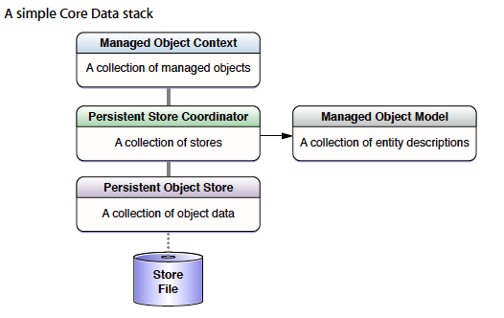
The Core Data Stack

Slide 25
managed object context
The managed object context is an instance of NSManagedObjectContext
A context represents a single object space, or scratch pad, in an application
Its primary responsibility is to manage a collection of managed objects
Data insert,fetch done on context object
The context is a powerful object that your application will be interacting with the most

Slide 26
Managed Objects
A managed object
is an instance of NSManagedObject or of a subclass of NSManagedObject
Conceptually, it’s an object representation of a record in a table in a database, so it’s a model(as in mvc) object that is managed by Core Data
Managed objects represent the data you operate on in your application

Slide 27
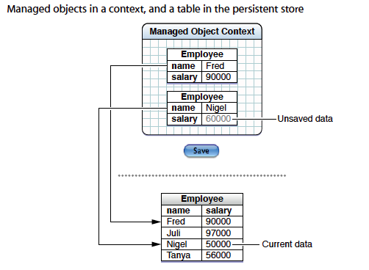

Slide 28
The Managed Object Model
A managed object model is an instance of NSManagedObjectModel
It’s an object representation of a schema that describes your database, and so the managed objects you use in your application
A model is a collection of entity description objects (instances of NSEntityDescription)
An entity description describes an entity (a table in a database) in terms of its name, the name of the class used to represent the entity in your application, and what properties (attributes and relationships) it has

Slide 29
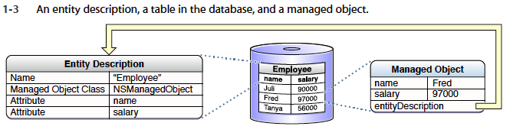

Slide 30
Persistent Store Coordinator
The persistent store coordinator plays a central role in how Core Data manages data
However, you don’t often interact with the coordinator directly when you use the framework
It manages a collection of persistent object stores
A persistent object store represents an external store (file) of persisted data
It’s the object that actually maps between objects in your application and records in the database

Slide 31
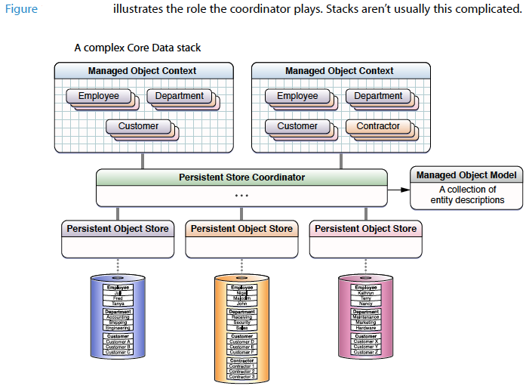

Slide 32
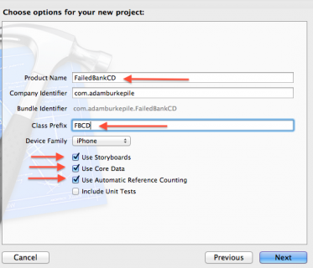
Adding Core Data Project

Slide 33
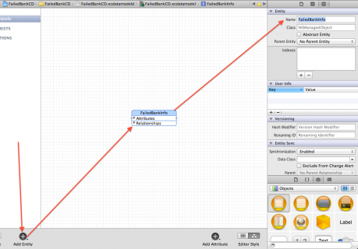
Defining Model: Core Data Model Editor
Select your projectName.xcodedatamodel file and add entity(Table)

Slide 34
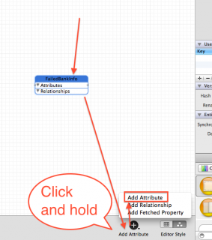
Adding Attributes And Relationships

Slide 35
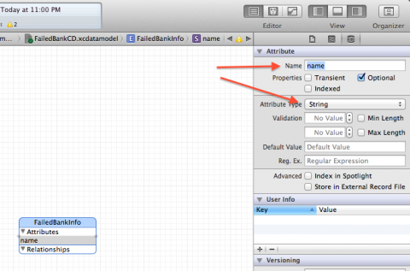
Defining Attribute

Slide 36
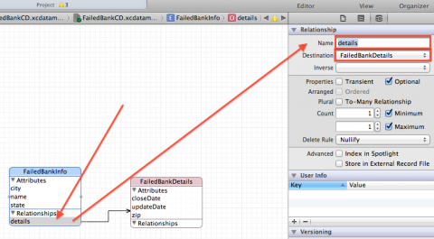
Definning Relationship

Slide 37
Core Data: Classes
NSManagedObjectContext
NSManagedObject
NSEntityDescription
NSFetchRequest
NSPredicate

Slide 38
Get NSManagedObjectContext
- (NSManagedObjectContext *)managedObjectContext {
NSManagedObjectContext *context = nil;
id delegate = [[UIApplication sharedApplication] delegate];
if ([delegate performSelector:@selector(managedObjectContext)]) {
context = [delegate managedObjectContext];
}
return context;
}

Slide 39
Insert and Save
- NSManagedObject *newBooks;
newBooks = [NSEntityDescription insertNewObjectForEntityForName:@"Books” inManagedObjectContext:context];
[newBooks setValue:_book_name.text forKey:@"bookname"];
[newBooks setValue:_author_name.text forKey:@"authorname"] ;
NSError *error;
BOOL ret= [context save:&error] ;
if (ret== NO){
NSLog(@"Error:%@", [error localizedFailureReason]);
}
else
{
NSLog(@"Record Saved\n");
}

Slide 40
Fetch or Query
NSEntityDescription *entityDesc = [NSEntityDescription entityForName:@"Contacts” inManagedObjectContext:context];
NSFetchRequest *request = [[NSFetchRequest alloc] init];
[request setEntity:entityDesc];
NSPredicate *pred =
[NSPredicate predicateWithFormat:@"(bookName = %@)", _book_name.text];
[request setPredicate:pred];
NSManagedObject *matches = nil; NSError *error;
NSArray *objects = [context executeFetchRequest:request error:&error];
if ([objects count] == 0) {
NSLog(@"No Matches") ;} else {
matches = objects[0];
_book_name.text = [matches valueForKey:@"bookName"];
_author_name.text = [matches valueForKey:@"authorName"];
NSLog(@"%lu matches found", (unsigned long)[objects count]);}

Slide 41
What Core Data Is Not
Core Data is not a relational database or a relational database management system (RDBMS)
Core Data does not remove the need to write code
Core Data does not rely on Cocoa bindings, You can readily create a Core Data application without a user interface
For more on Core Data click Here

