Slide 1
iOS - First Application
Anatomy
Sisoft Technologies Pvt Ltd
SRC E7, Shipra Riviera Bazar, Gyan Khand-3, Indirapuram, Ghaziabad
Website: www.sisoft.in Email:info@sisoft.in
Phone: +91-9999-283-283

Slide 2
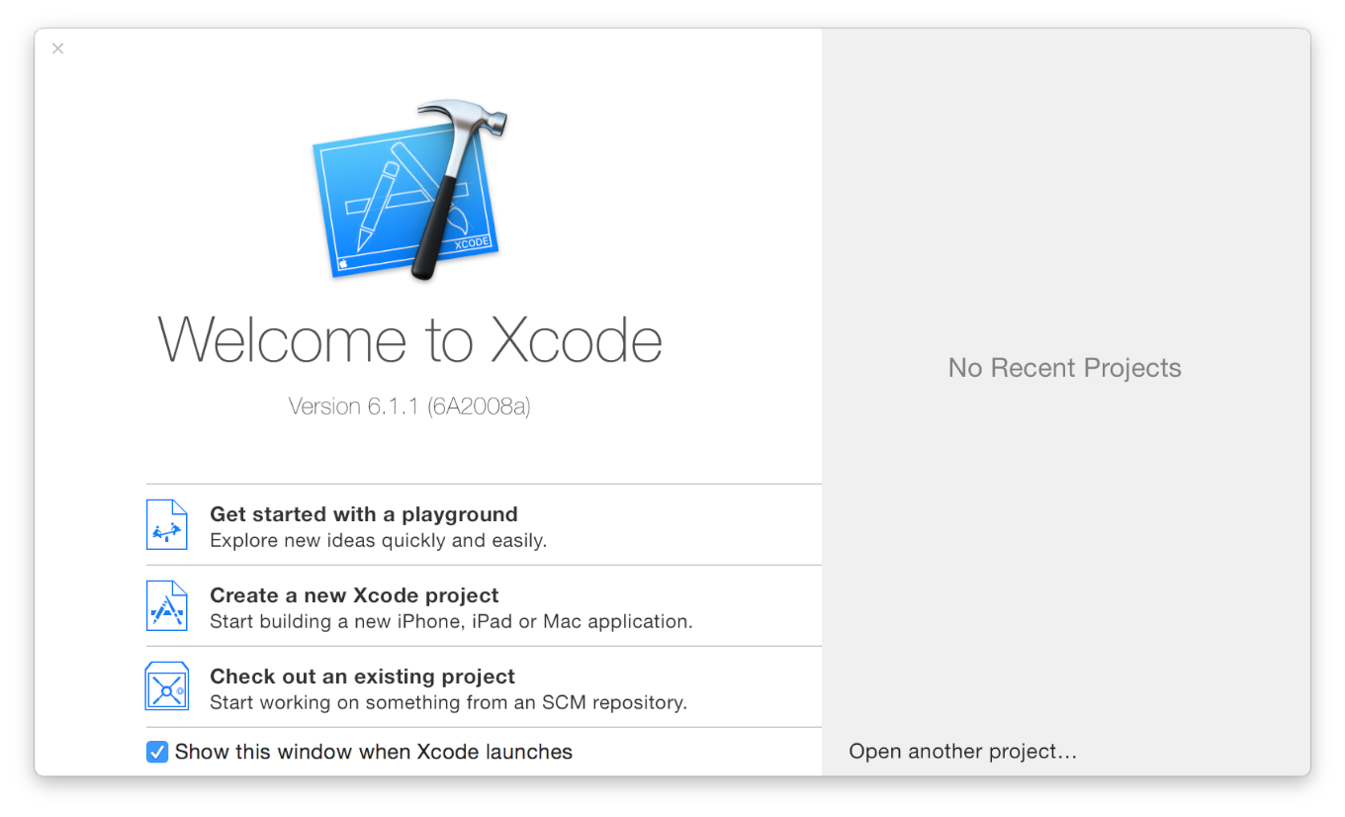
Open Xcode from the /Applications directory
The Xcode welcome window appears.

Slide 3
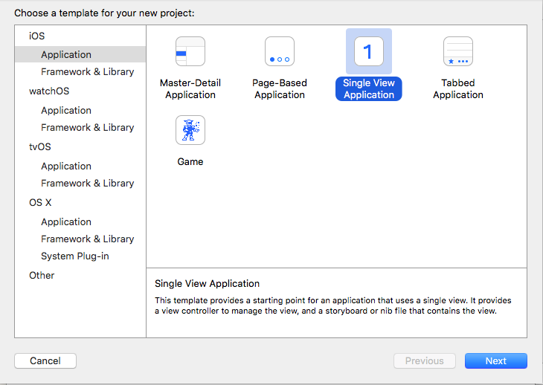
Create a new Xcode Project
Choose a “Single View Application”

Slide 4
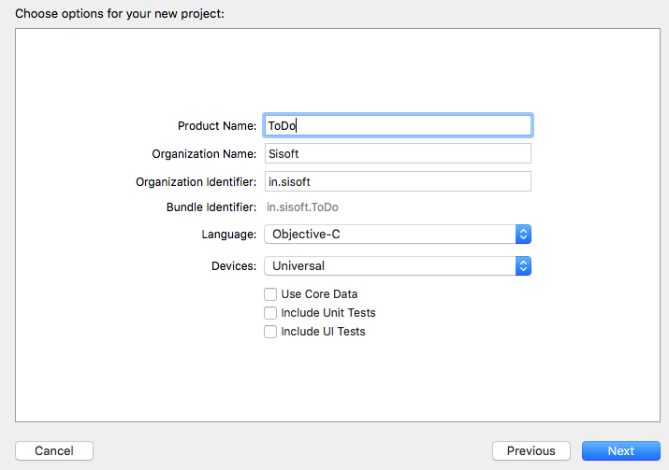
Provide details about your project

Slide 5
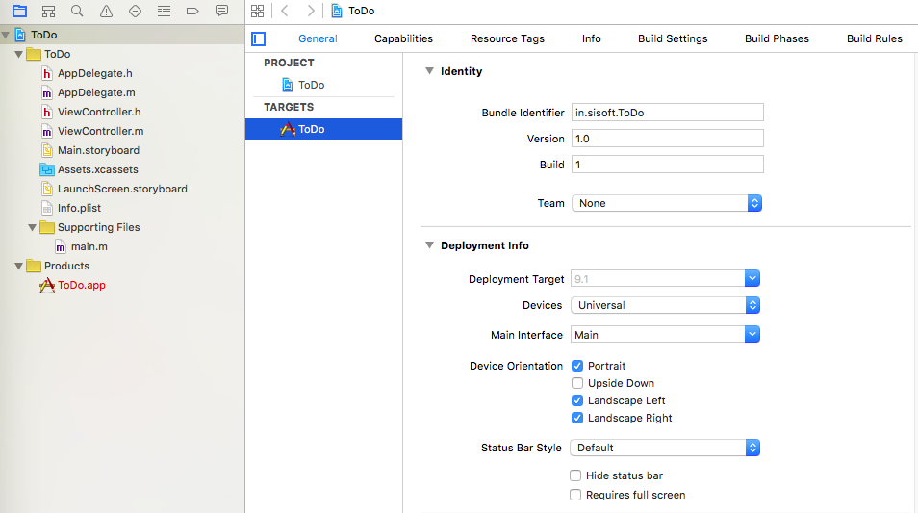
Review the Source Code

Slide 6
Review the Source Code
//
// main.m
// ToDo
#import <UIKit/UIKit.h>
#import "AppDelegate.h"
int main(int argc, char * argv[]) {
@autoreleasepool {
return UIApplicationMain(argc, argv, nil, NSStringFromClass([AppDelegate class]));
}
}

Slide 7
UIApplicationMain
The call to UIApplicationMain creates two important initial components of your app:
An instance of the UIApplication class, called the application object.
The application object manages the app event loop and coordinates other high-level app behaviors. The UIApplication class, defined in the UIKit framework, doesn’t require you to write any additional code to get it to do its job.
An instance of the AppDelegate class, called the app delegate.
The app delegate creates the window where your app’s content is drawn and provides a place to respond to state transitions within the app. The app delegate is where you write your custom app-level code. Like all classes, the AppDelegate class is defined in two source code files in your app: in the interface file, AppDelegate.h, and in the implementation file, AppDelegate.m.

Slide 8
AppDelegate
AppDelegate.h: The app delegate interface contains a single property: window. With this property the app delegate keeps track of the window in which all of your app content is drawn
AppDelegate.m: The app delegate implementation contains “skeletons” of important methods. These predefined methods allow the application object to talk to the app delegate

Slide 9
App States
State | Description
Not running | The app has not been launched or was running but was terminated by the system.
Inactive | The app is running in the foreground but is currently not receiving events. (It may be executing other code though.) An app usually stays in this state only briefly as it transitions to a different state.
Active | The app is running in the foreground and is receiving events. This is the normal mode for foreground apps.
Background | The app is in the background and executing code. Most apps enter this state briefly on their way to being suspended. However, an app that requests extra execution time may remain in this state for a period of time. In addition, an app being launched directly into the background enters this state instead of the inactive state. For information about how to execute code while in the background, see Background Execution.
Suspended | The app is in the background but is not executing code. The system moves apps to this state automatically and does not notify them before doing so. While suspended, an app remains in memory but does not execute any code. When a low-memory condition occurs, the system may purge suspended apps without notice to make more space for the foreground app.

Slide 10
App States
Most state transitions are accompanied by a corresponding call to the methods of your app delegate object.
application:willFinishLaunchingWithOptions:—This method is your app’s first chance to execute code at launch time.
application:didFinishLaunchingWithOptions:—This method allows you to perform any final initialization before your app is displayed to the user.
applicationDidBecomeActive:—Lets your app know that it is about to become the foreground app. Use this method for any last minute preparation.
applicationWillResignActive:—Lets you know that your app is transitioning away from being the foreground app. Use this method to put your app into a quiescent state.
applicationDidEnterBackground:—Lets you know that your app is now running in the background and may be suspended at any time.
applicationWillEnterForeground:—Lets you know that your app is moving out of the background and back into the foreground, but that it is not yet active.
applicationWillTerminate:—Lets you know that your app is being terminated. This method is not called if your app is suspended.

Slide 11
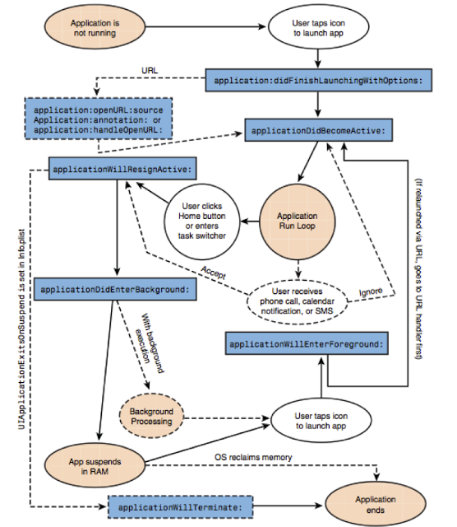

Slide 12
UIViewController
NSObject->UIResponder->UIViewController
The UIViewController class provides the fundamental view-management model for all iOS apps
A view controller manages a set of views that make up a portion of your app’s user interface
A view controller is usually owned by a window or another view controller.
If a view controller is owned by a window object, it acts as the window’s root view controller. The view controller’s root view is added as a subview of the window and resized to fill the window.
If the view controller is owned by another view controller, then the parent view controller determines when and how the child view controller’s contents are displayed.

Slide 13
UIViewController
NSObject->UIResponder->UIViewController
The UIViewController class provides the fundamental view-management model for all iOS apps
A view controller manages a set of views that make up a portion of your app’s user interface
A view controller is usually owned by a window or another view controller.
If a view controller is owned by a window object, it acts as the window’s root view controller. The view controller’s root view is added as a subview of the window and resized to fill the window.
If the view controller is owned by another view controller, then the parent view controller determines when and how the child view controller’s contents are displayed.

Slide 14
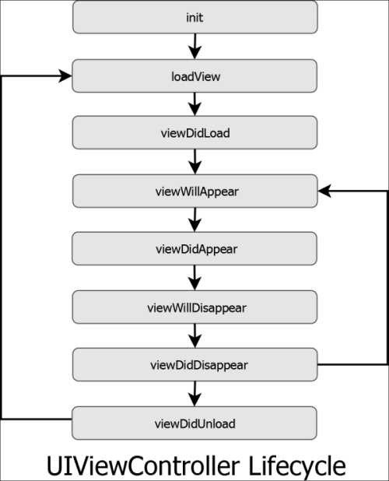
UIViewController

Slide 15
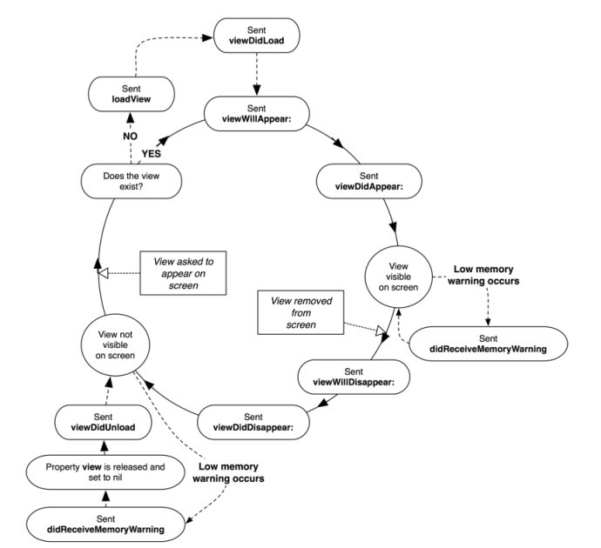
UIViewController

Slide 16
Main.Storyboard
A storyboard is a visual representation of the user interface of an iOS application, showing screens of content and the connections between those screens
A storyboard is composed of a sequence of scenes, each of which represents a view controller and its views
Each scene has at least a View Controller object, a First Responder object and an Exit Item

Slide 17
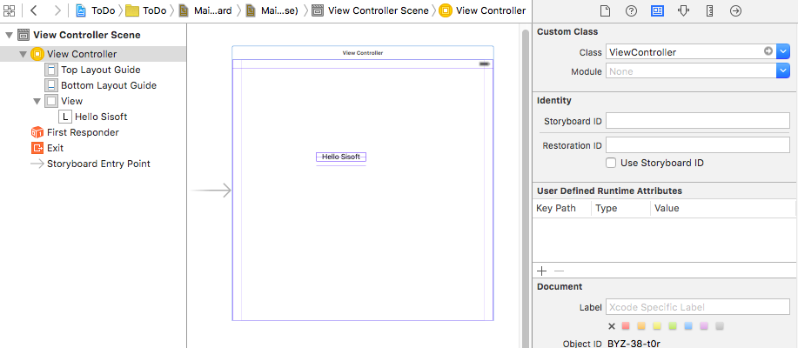
Storyboard
Dock
Canvas
Inspector
File Inspector Help Inspector
Identity Inspector Attribute Inspector
Size Inspector Connection Inspector

Slide 18
Storyboard Scene
View Controller
It consist of the view that contains the screen
The arrow pointing at the view controller from left indicates that it is initial view controller
First Responder
It is first in line for receiving many kinds of app events
It receives key events, motion events, and action messages, among others
Exit
Unwind the scene and return back

Slide 19
Files: Anatomy
Assets.xcassets: The assets catalog contains list of image sets. Each image set contains all version of an image that are necessary to support various devices and scale factors
Info.plist: This file contains the setting for app
Product/.app file: This is executable file for the app

Slide 20
Outlet
An outlet provide a way to reference storyboard objects in view controller source files.
It is a property that is annotated with the symbol IBOutlet
To create an outlet, Control-drag from a particular object to a view controller file

Slide 21
Creating and Connecting an Outlet
Steps
With a storyboard open, choose View > Assistant Editor > Show Assistant Editor
The implementation file(*.h) that corresponds to the storyboard opens in the assistant editor
Control-drag from the object in storyboard to the header file in the assistant editor
Xcode indicates where the new outlet is valid

Slide 22
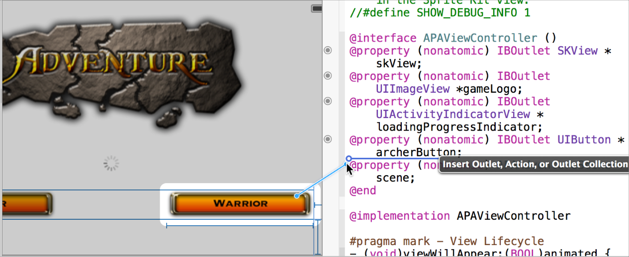
Creating and Connecting an Outlet…

Slide 23
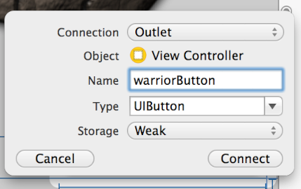
Creating and Connecting an Outlet…
Release the Control-drag
The assistant editor displays a Connection menu
Choose Outlet from the Connection menu
Type the name of the new outlet and click Connect

Slide 24
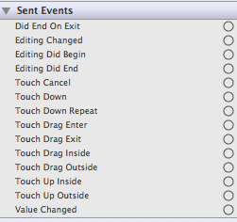
Action
An action is some event that happens

Slide 25
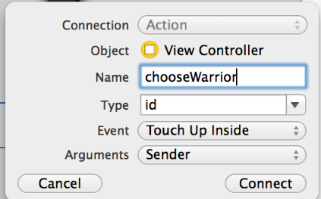
Creating and Connecting an Action
Same above steps change the connection type

Slide 26
UIButton
Implements a button that intercepts touch events and sends an action message to a target object when it's tapped
You can set the title, image, and other appearance properties of a button
In addition, you can specify a different appearance for each button state.

Slide 27
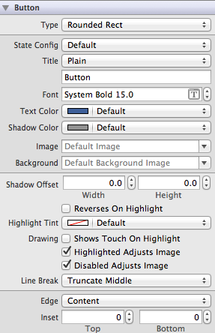
UIButton…
Common action Touch Up Inside
Inspector window showing various properties

Slide 28
UIButton…
A button sends the UIControlEventTouchUpInside event when the user taps it. You can respond to this event by performing some corresponding action in your app, such as saving information. You register the target-action methods for a button as shown below.
_{[self.myButton addTarget:self}
_{action:@selector(myAction:)}
forControlEvents:UIControlEventValueChanged];

Slide 29
Labels
NSObject->UIResponder->UIView->UILabel
The UILabel class implements a read-only text view.
Properties
text
textColor
numberOfLines
Creating Programatically
UILabel *sLabel = [[UILabel alloc] initWithFrame:CGRectMake(20,300,100,60)] ;

Slide 30
Navigation One View to Another
presentViewController offers a mechanism to display a so-called modal view controller; i.e., a view controller that will take full control of your UI by being superimposed on top of a presenting controller.
presentViewController is an instance method of UIViewController
Use [self presentViewController:vc2 animated:YES completion:NULL];
Use triggered Segue
To finish the current View
dismissViewControllerAnimated:YES completion:nil

Slide 31
UIViewController - Navigation
//This will identify the Storyboard in use UIStoryboard
*storyboard = [UIStoryboard storyboardWithName:@"MainStoryboard" bundle:nil];
//This will identify the View Controller to switch to
SecondViewController *vc2 = [storyboard instantiateViewControllerWithIdentifier:@"SecondViewContr ollerID" ];
[self presentViewController:vc2 animated:YES completion:NULL];

Slide 32
Triggered Segue
Segue represents a transition from one screen to another.
Segues are triggered by taps on buttons, table view cells, gestures, and so on
Passing Value Using Segue
- (void) prepareForSegue:(UIStoryboardSegue *)segue sender:(id)sender
Get reference to destination View controller using method [segue destinationViewController]
Then desired property of the destination view controller may be set.

Slide 33
Passing Data Back to Parent Class
Get reference to the parent class
[self presentingViewController]
Set the desired data in parent view controller

